Slide 1
Financial Stability 2017/2
Charts
October 2017

Slide 2
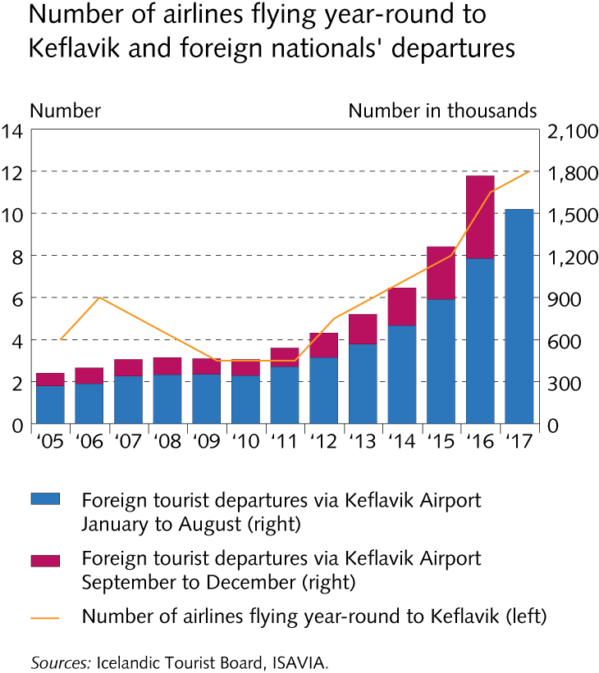
Key risks

Slide 3
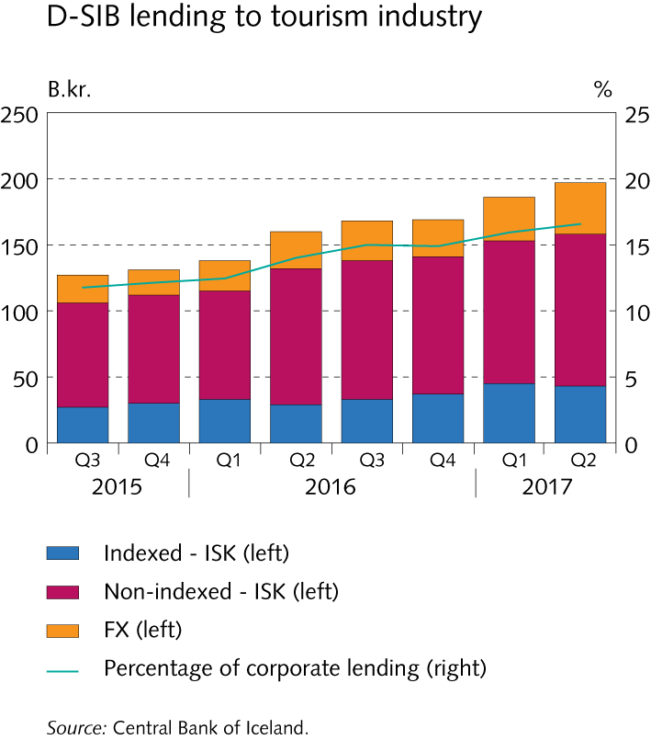
Key risks

Slide 4
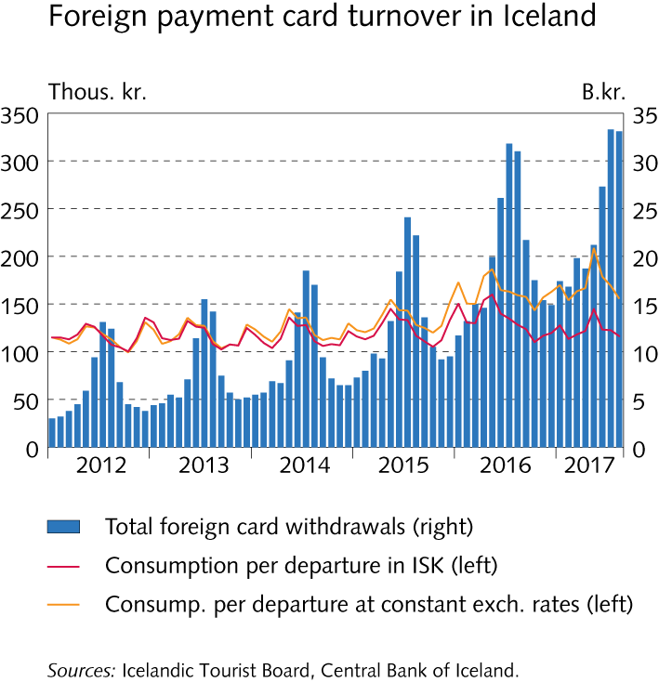
Key risks

Slide 5
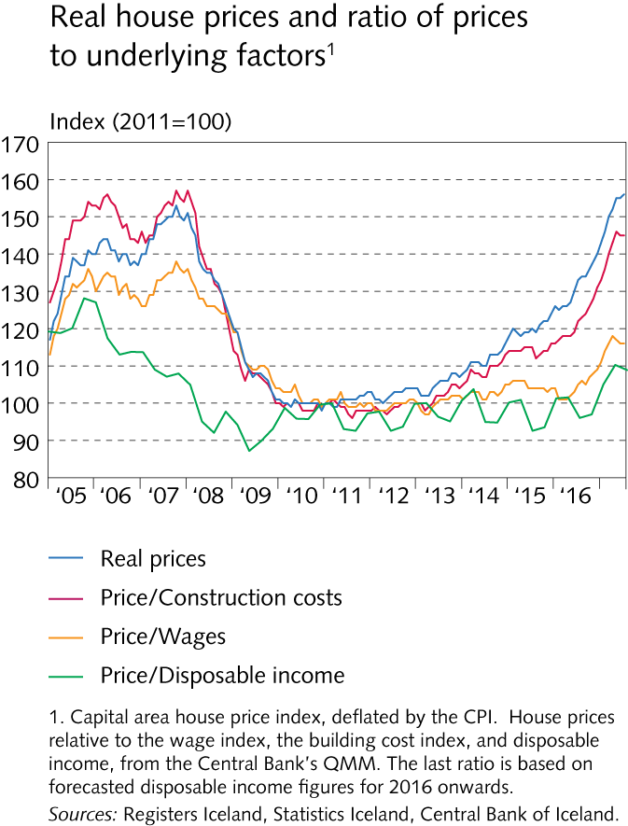
Key risks

Slide 6
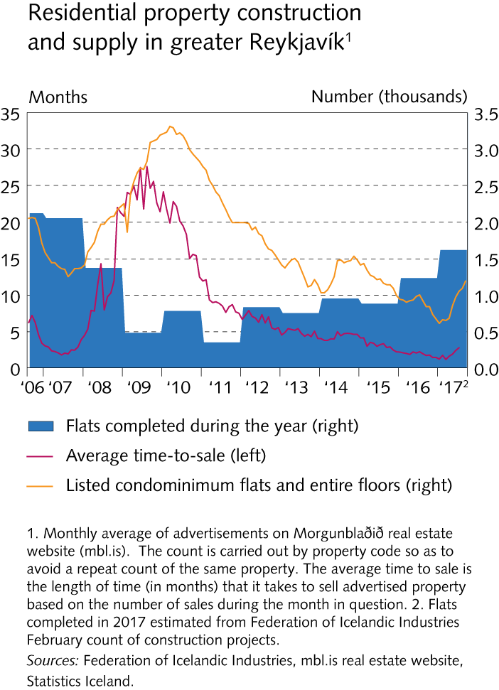
Key risks

Slide 7
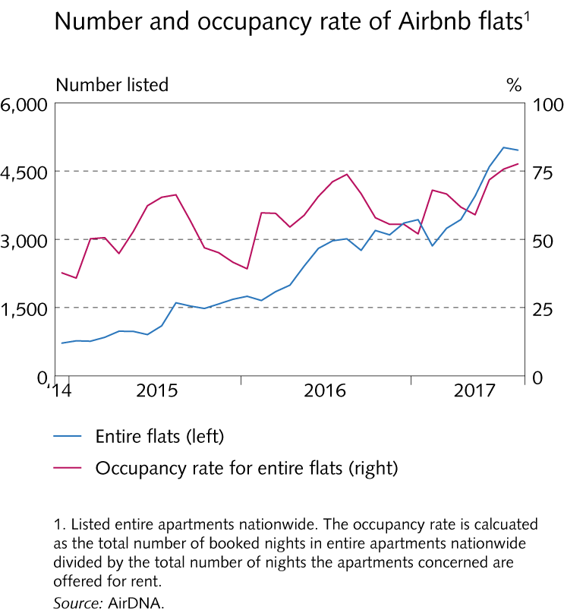
Key risks

Slide 8
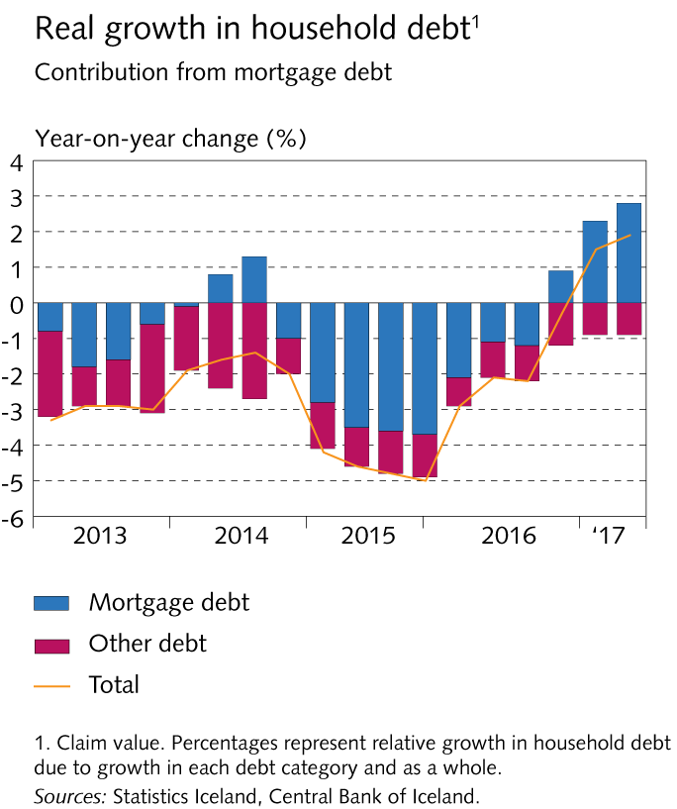
Key risks

Slide 9
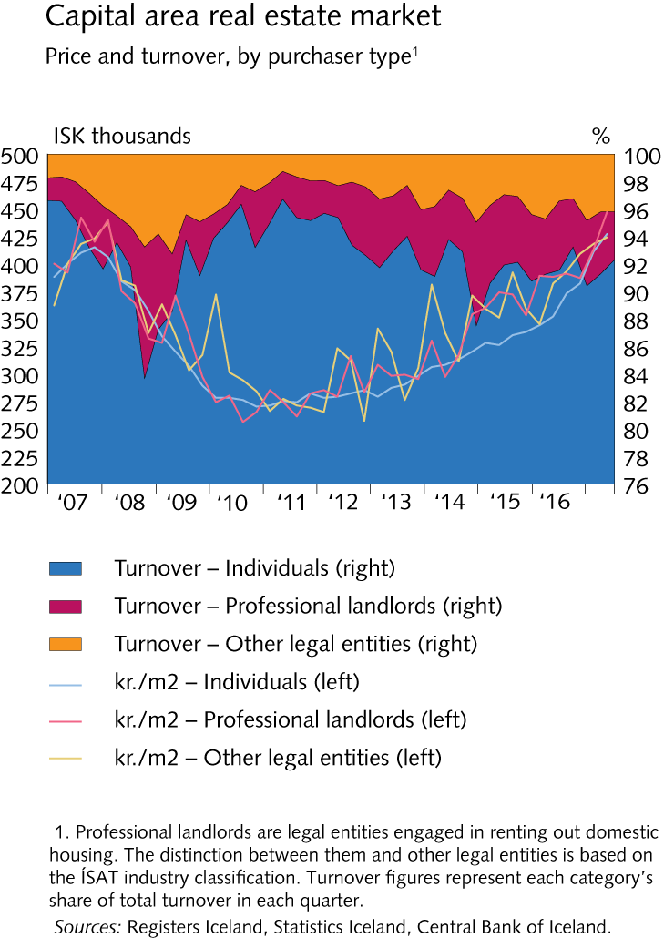
Key risks

Slide 10
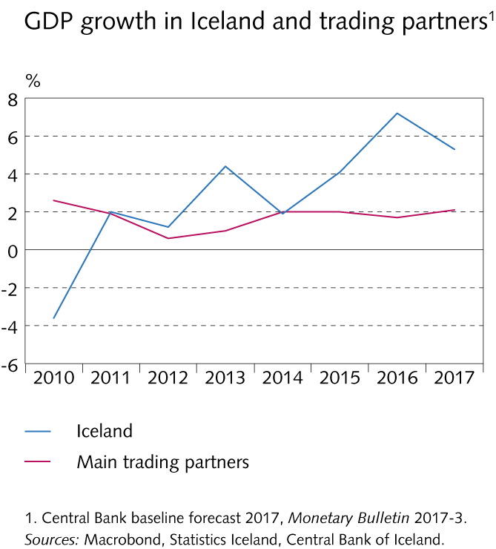
Financial institutions’ operating environment

Slide 11
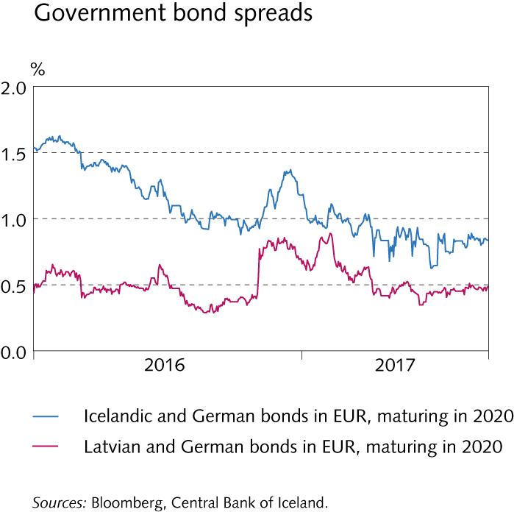
Financial institutions’ operating environment

Slide 12
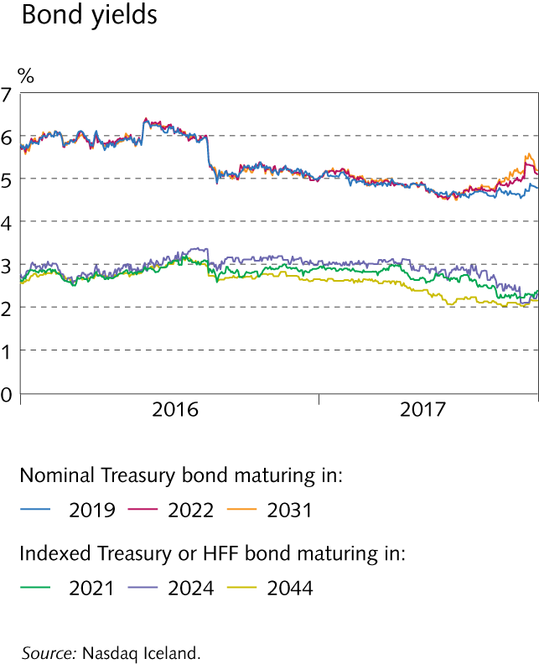
Financial institutions’ operating environment

Slide 13
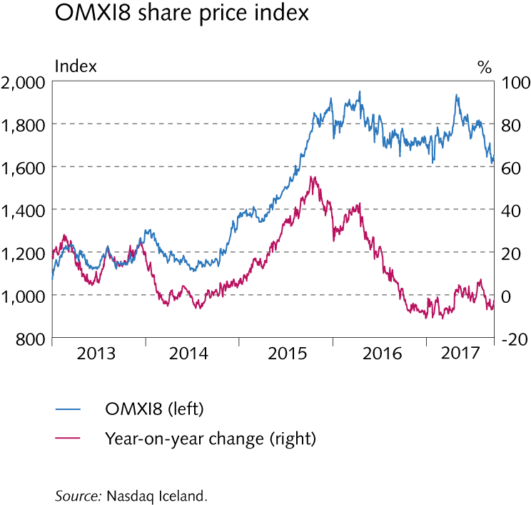
Financial institutions’ operating environment

Slide 14
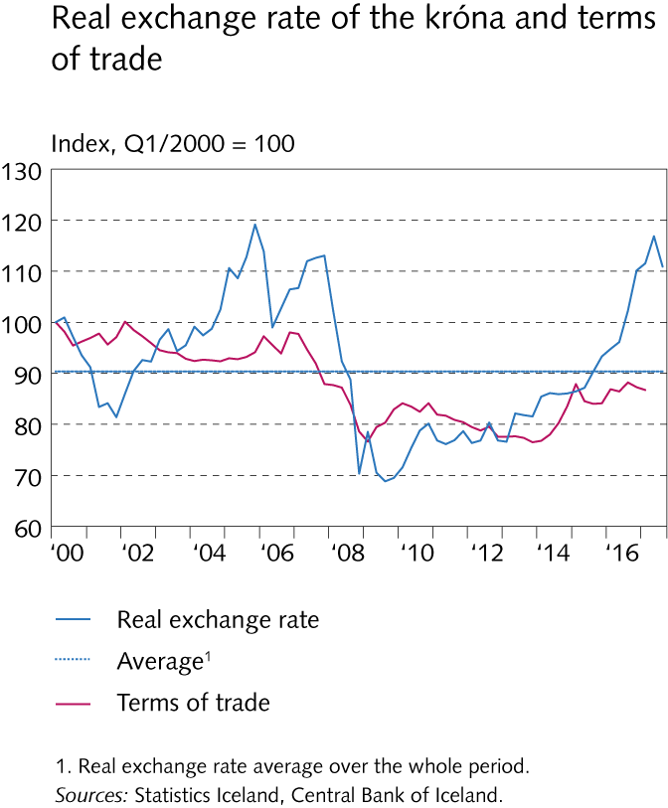
Financial institutions’ operating environment

Slide 15
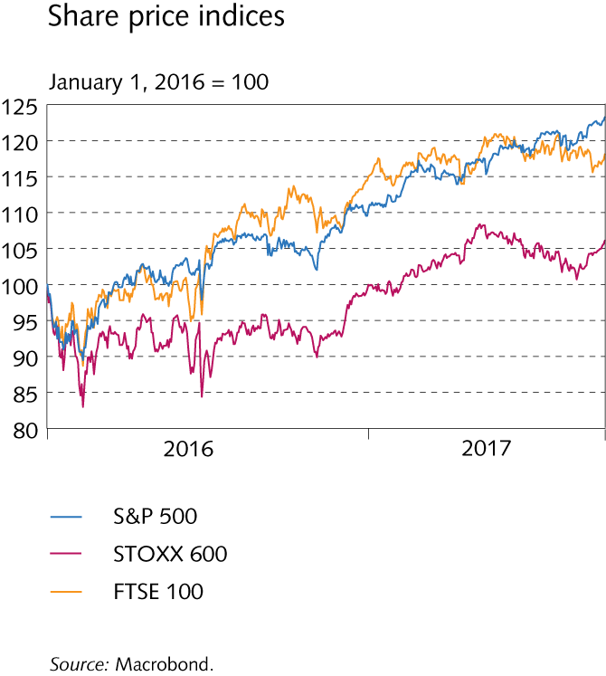
Financial institutions’ operating environment

Slide 16
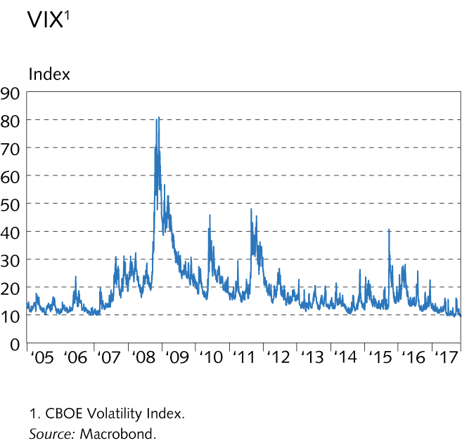
Financial institutions’ operating environment

Slide 17
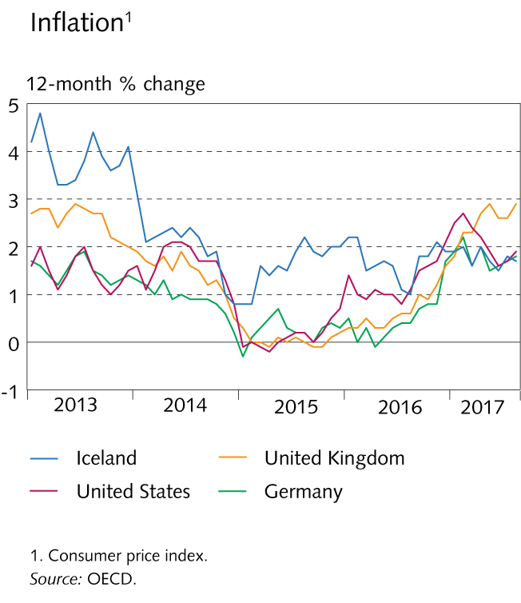
Financial institutions’ operating environment

Slide 18
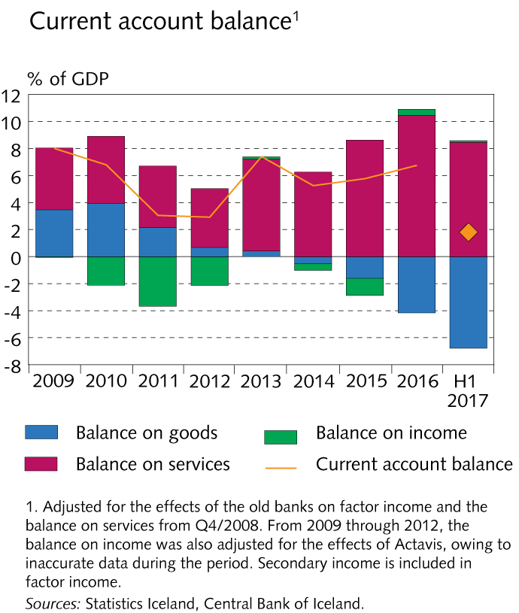
Financial institutions’ operating environment

Slide 19
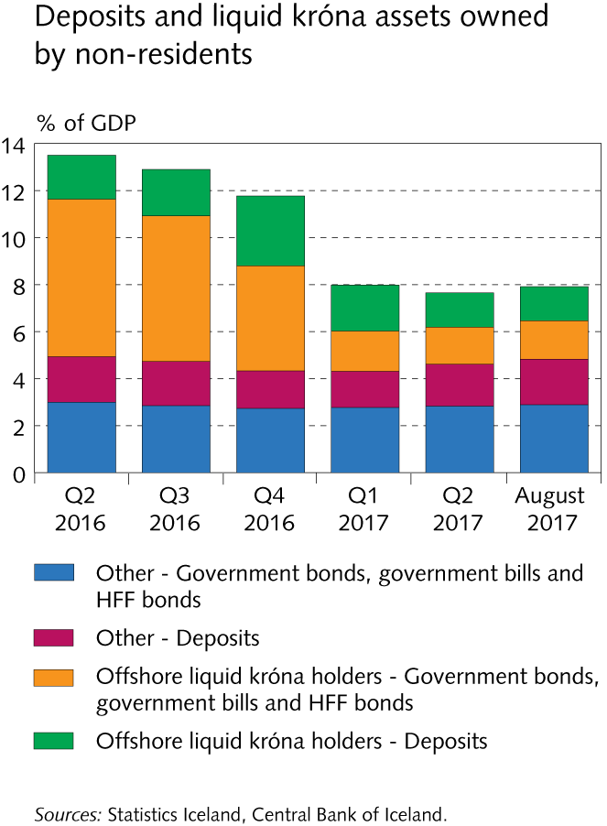
Financial institutions’ operating environment

Slide 20
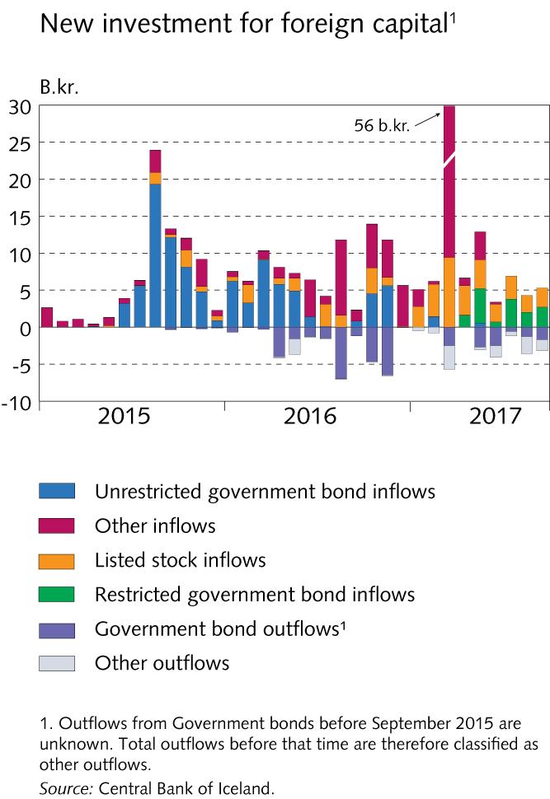
Financial institutions’ operating environment

Slide 21
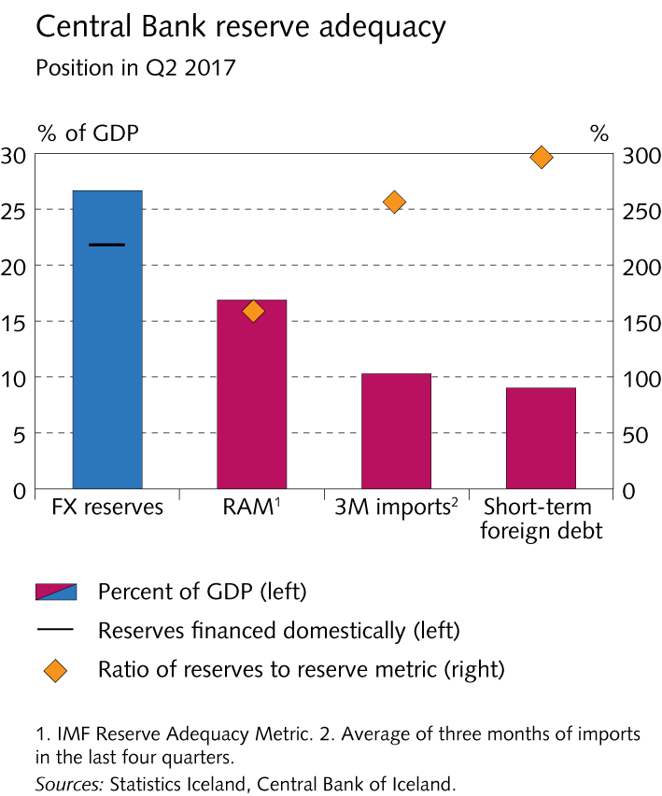
Financial institutions’ operating environment

Slide 22
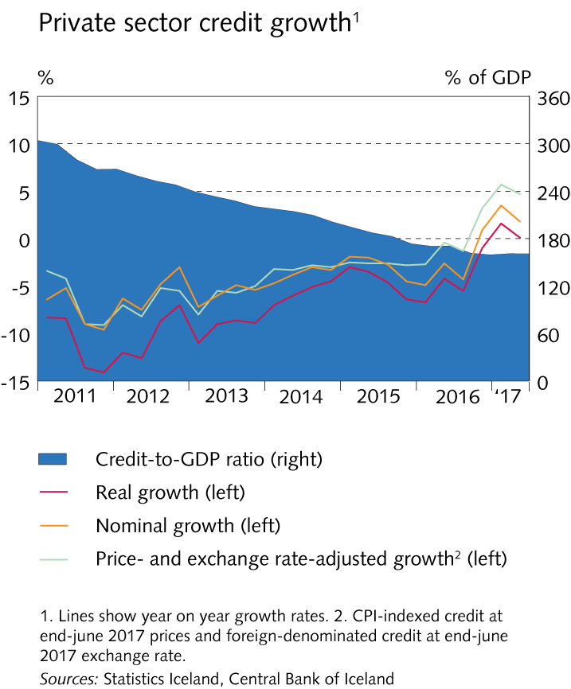
Financial institutions’ operating environment

Slide 23
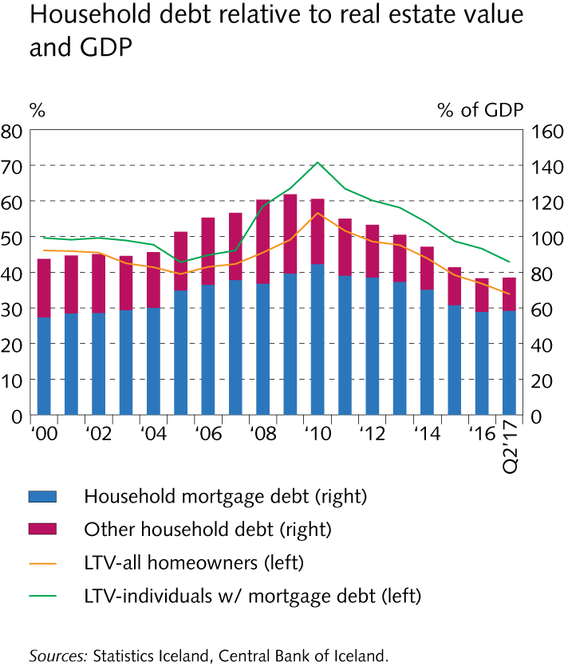
Financial institutions’ operating environment

Slide 24
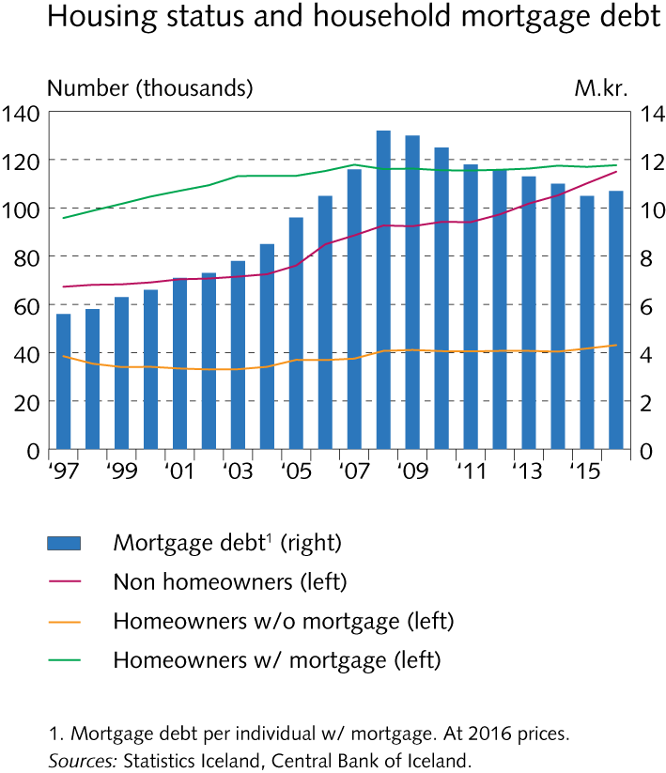
Financial institutions’ operating environment

Slide 25
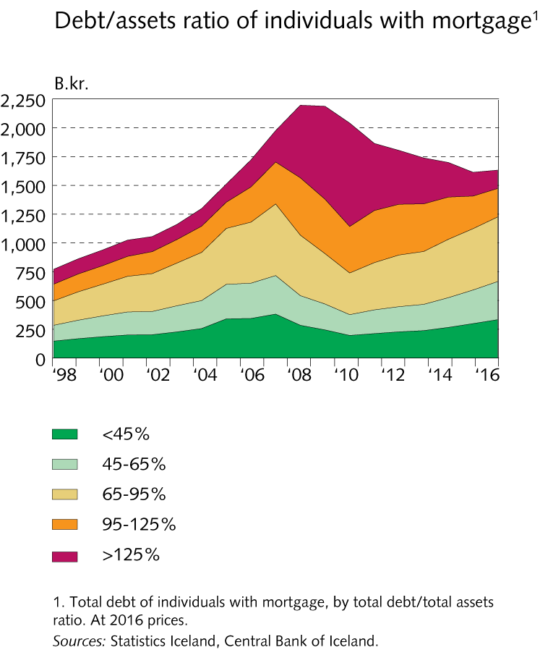
Financial institutions’ operating environment

Slide 26
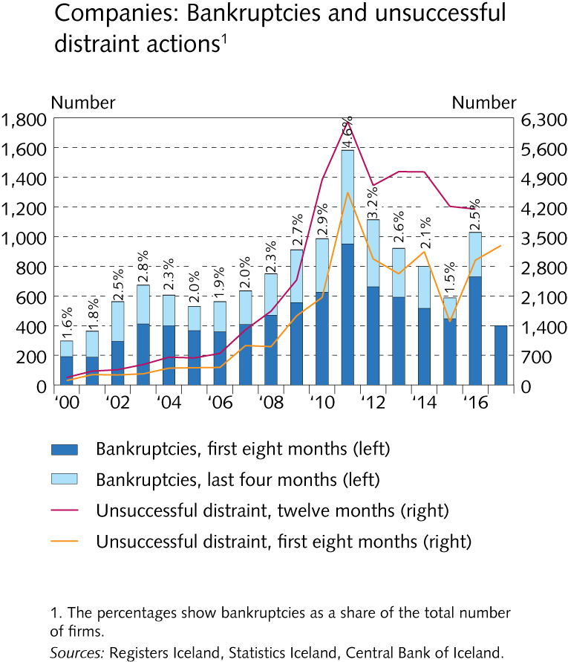
Financial institutions’ operating environment

Slide 27
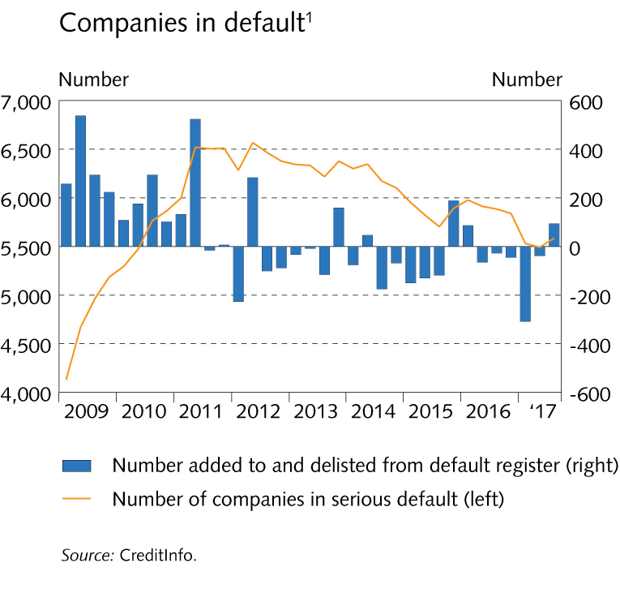
Financial institutions’ operating environment

Slide 28
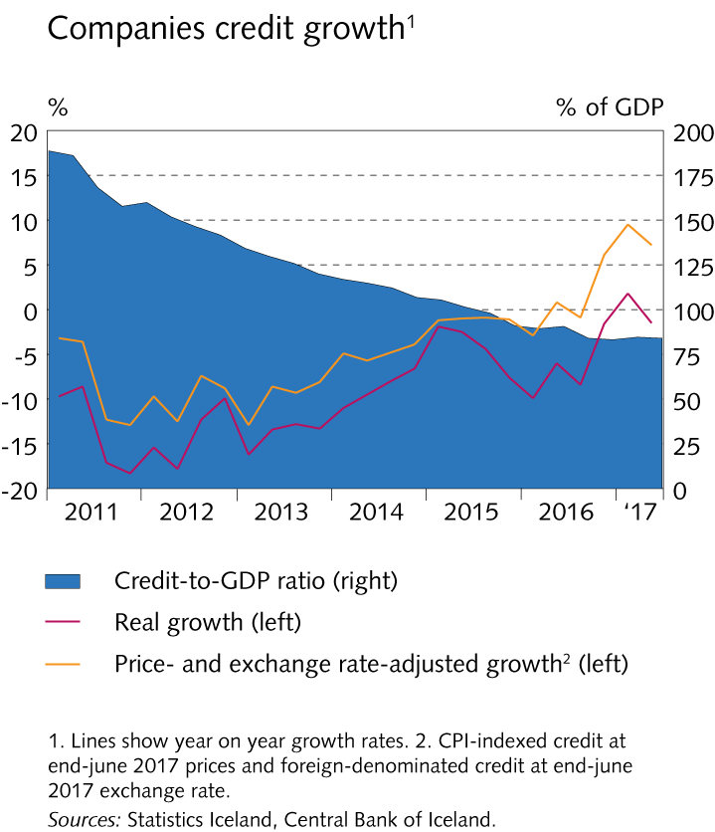
Financial institutions’ operating environment

Slide 29
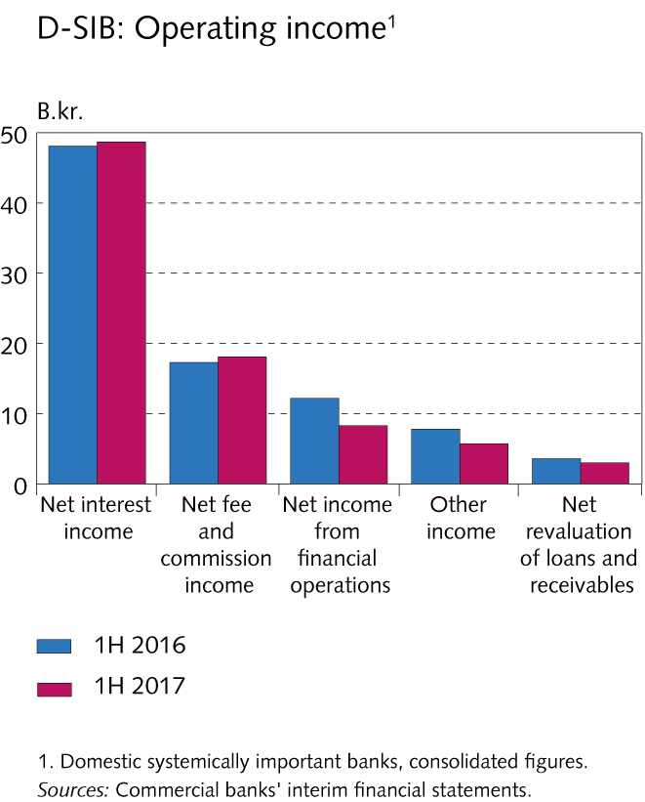
Financial market entities

Slide 30
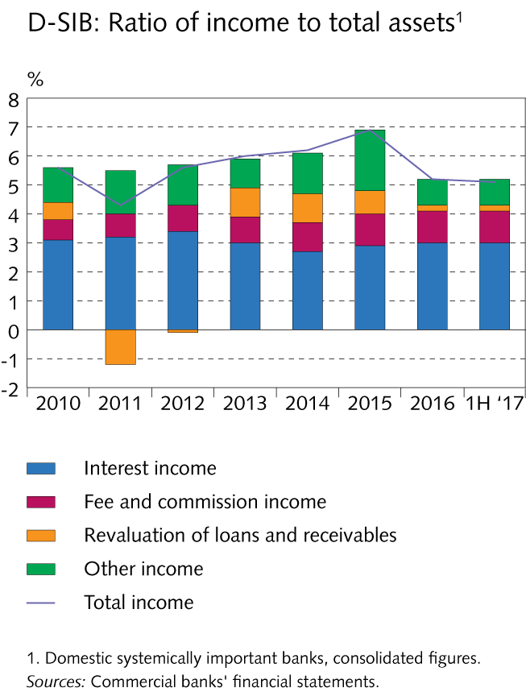
Financial market entities

Slide 31
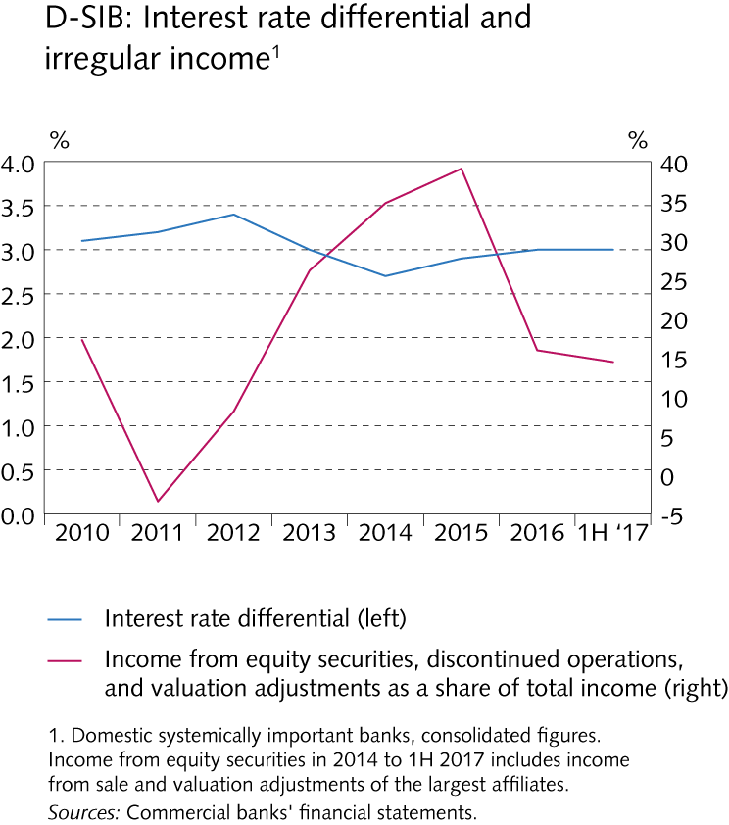
Financial market entities

Slide 32
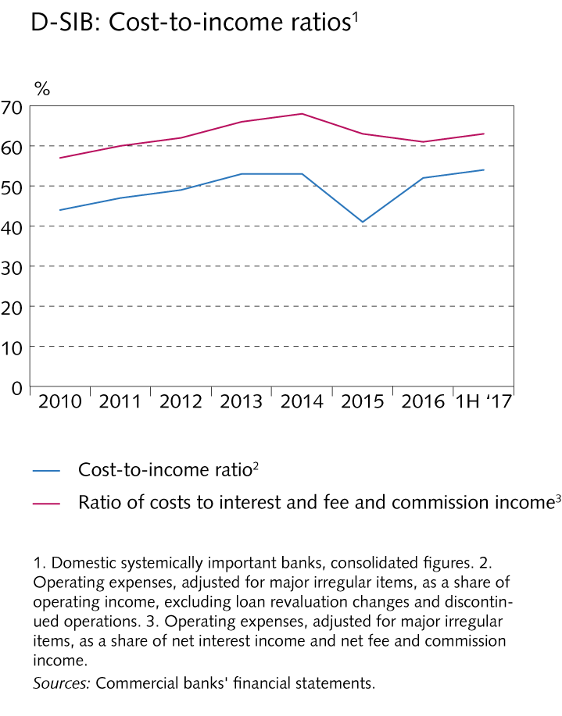
Financial market entities

Slide 33
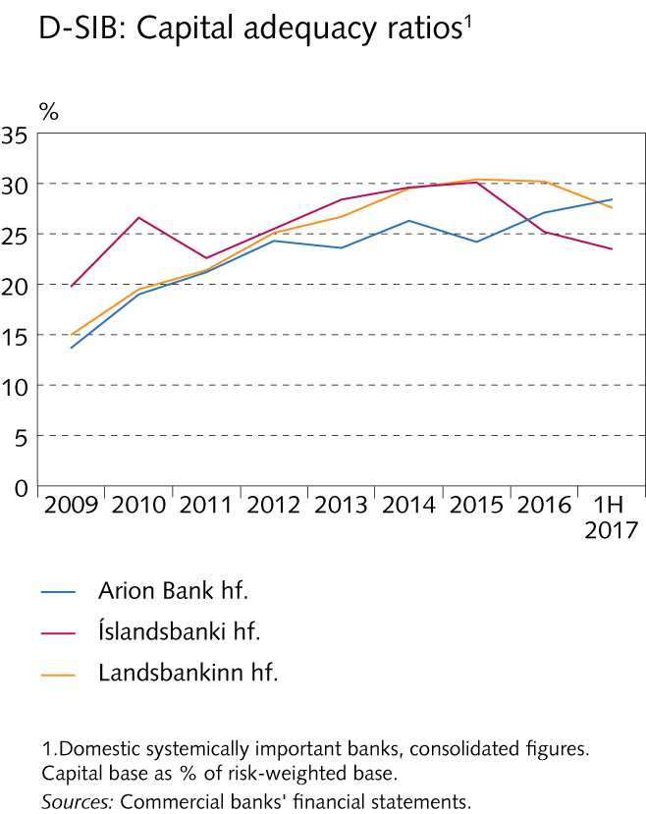
Financial market entities

Slide 34
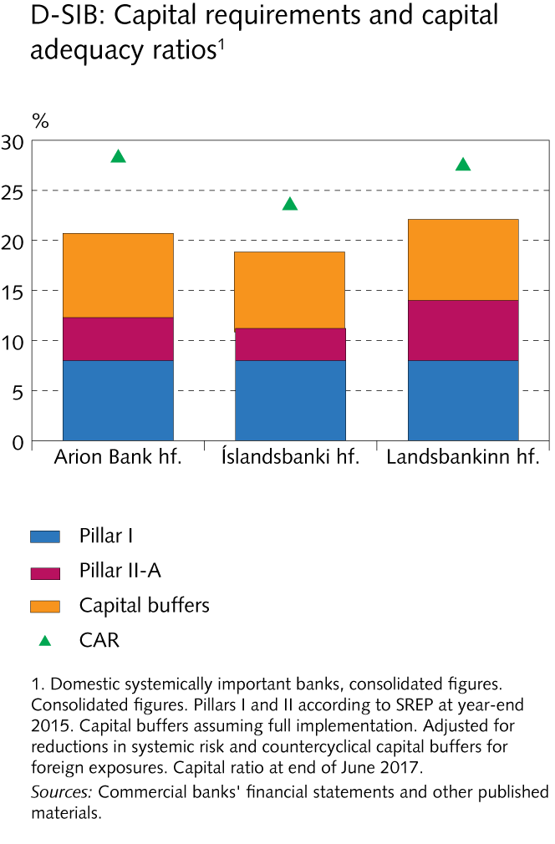
Financial market entities

Slide 35
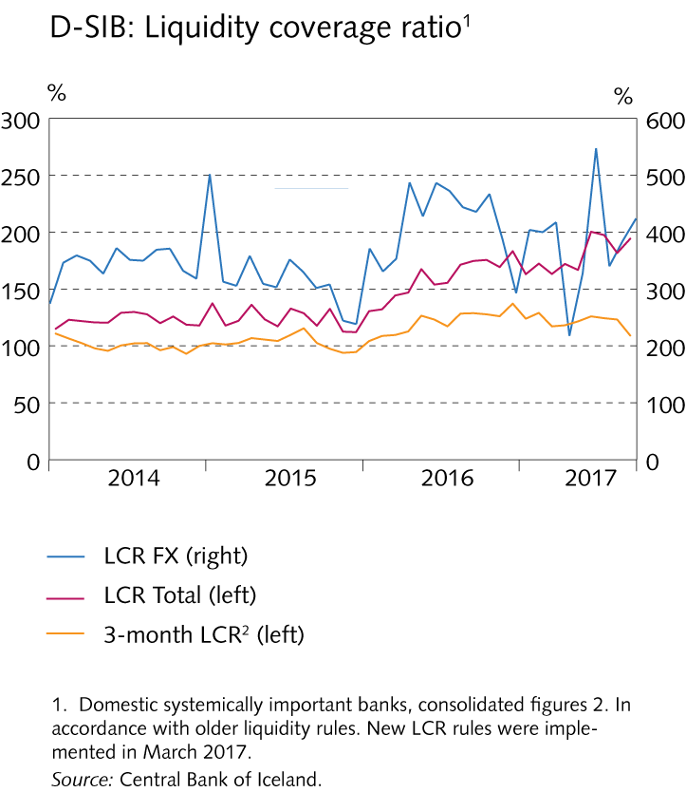
Financial market entities

Slide 36
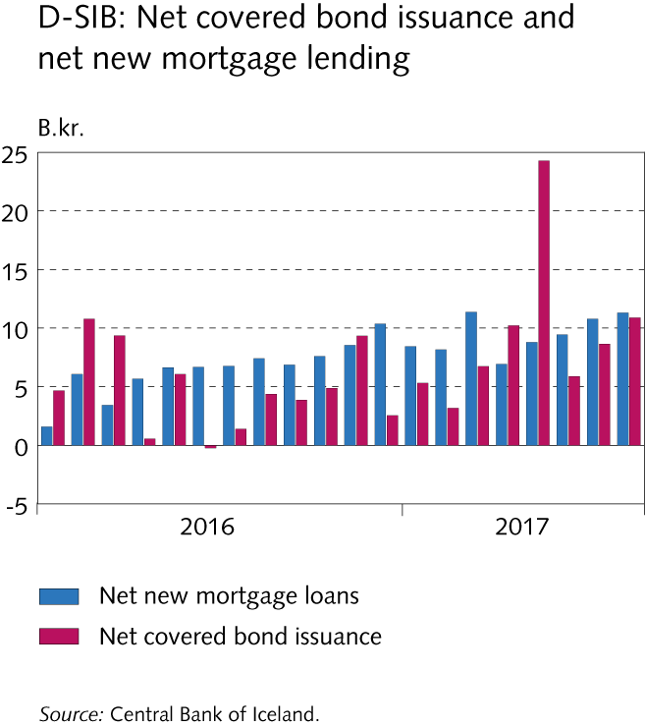
Financial market entities

Slide 37
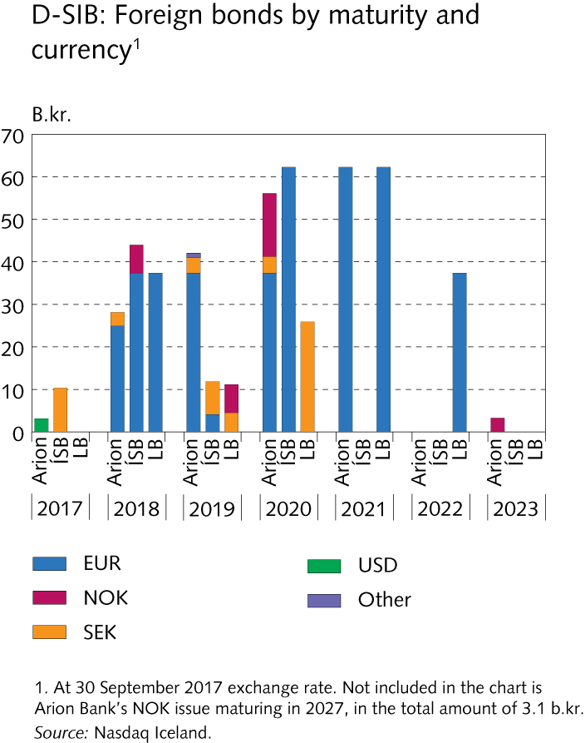
Financial market entities

Slide 38
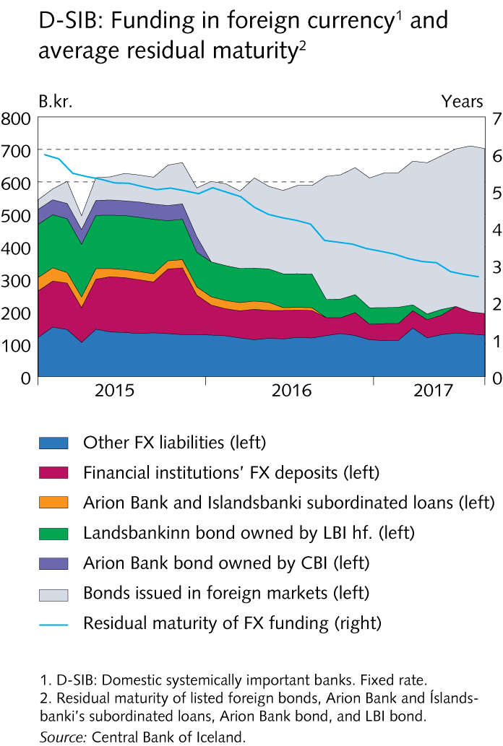
Financial market entities

Slide 39
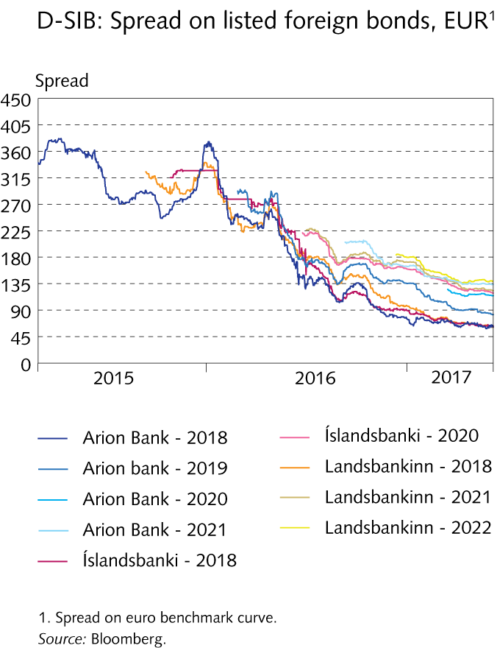
Financial market entities

Slide 40
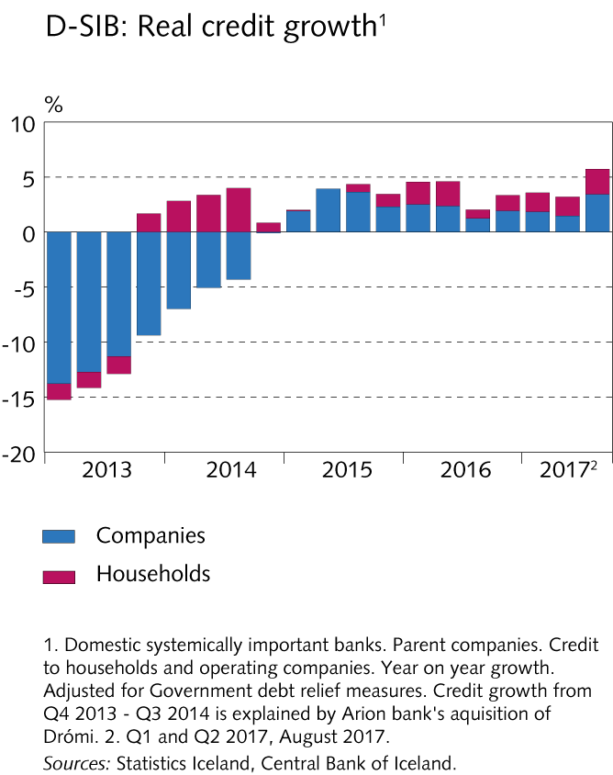
Financial market entities

Slide 41
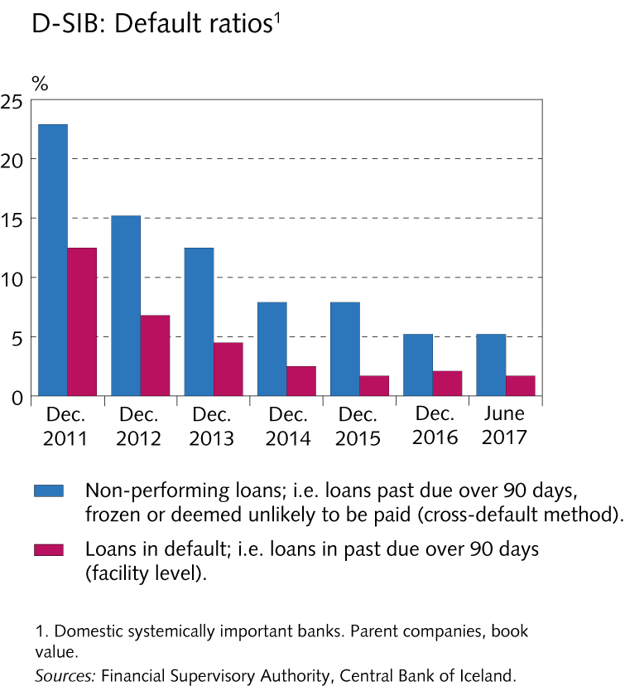
Financial market entities

Slide 42
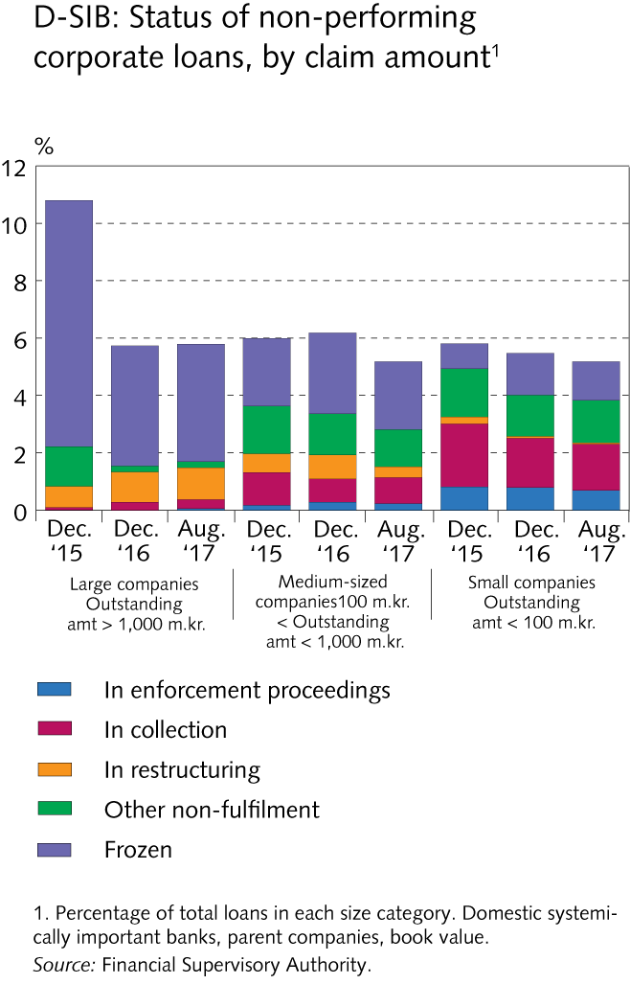
Financial market entities

Slide 43
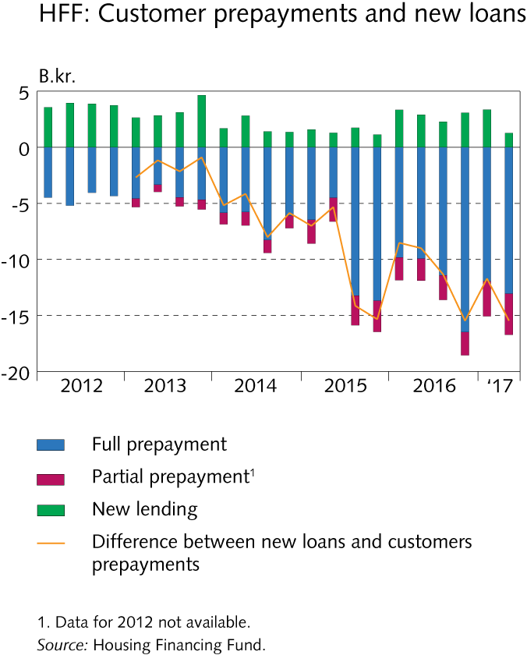
Financial market entities

Slide 44
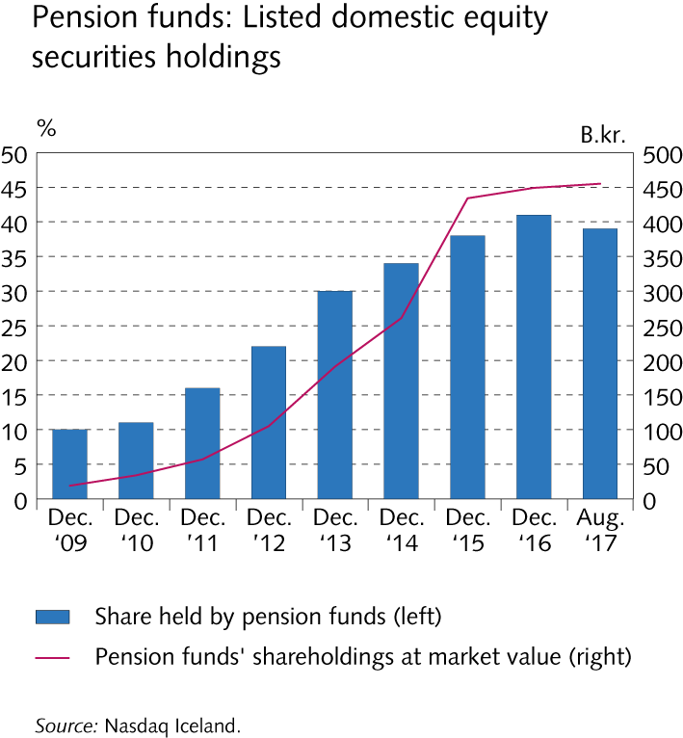
Financial market entities

Slide 45
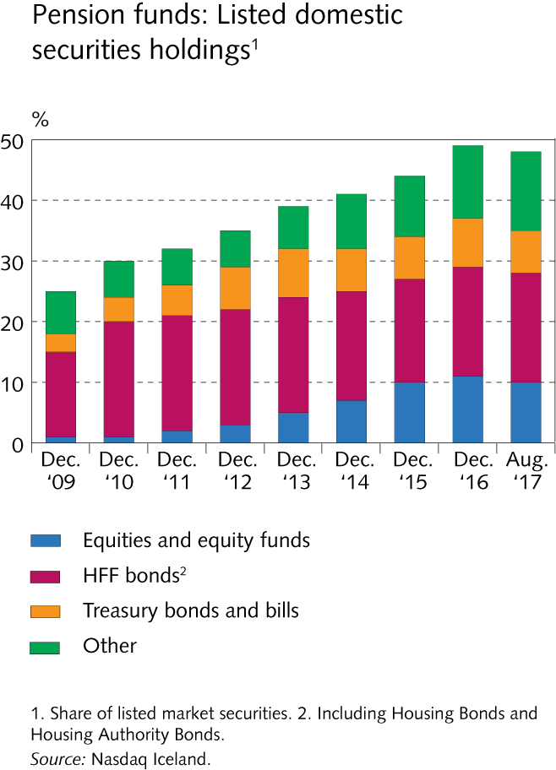
Financial market entities

Slide 46
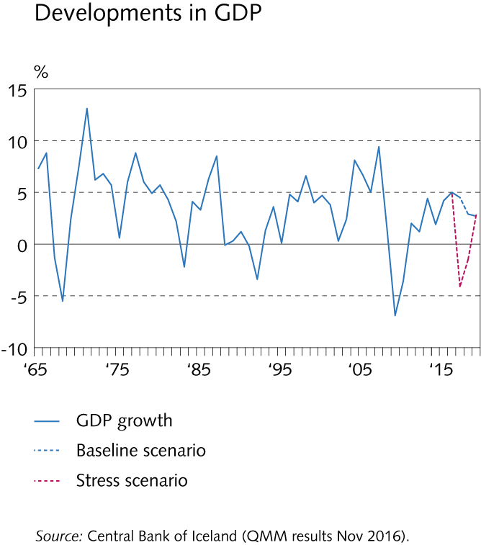
Central Bank stress test 2017

Slide 47
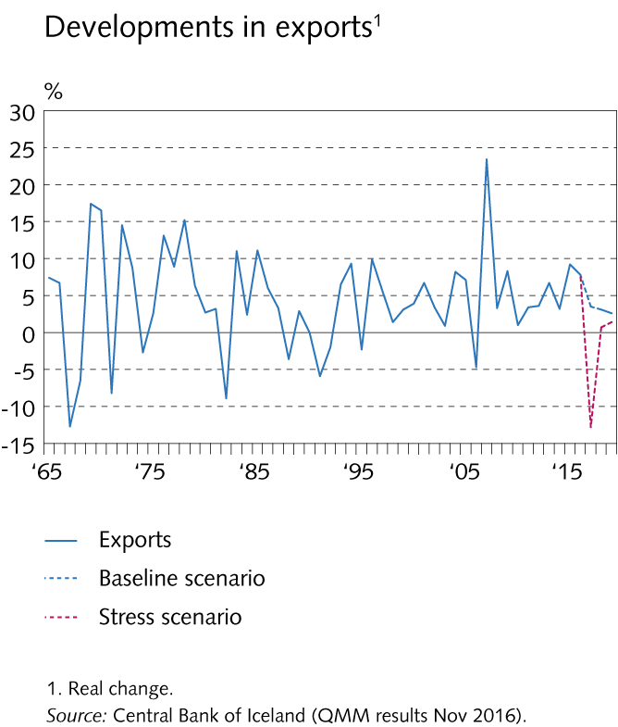
Central Bank stress test 2017

Slide 48
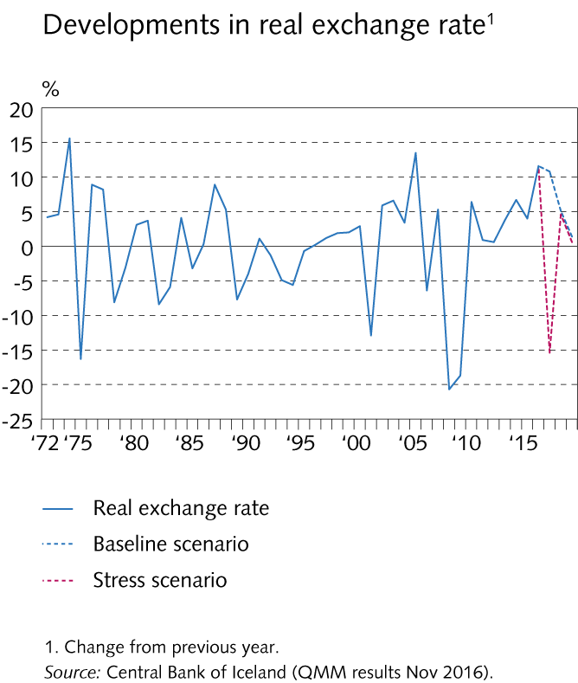
Central Bank stress test 2017

Slide 49
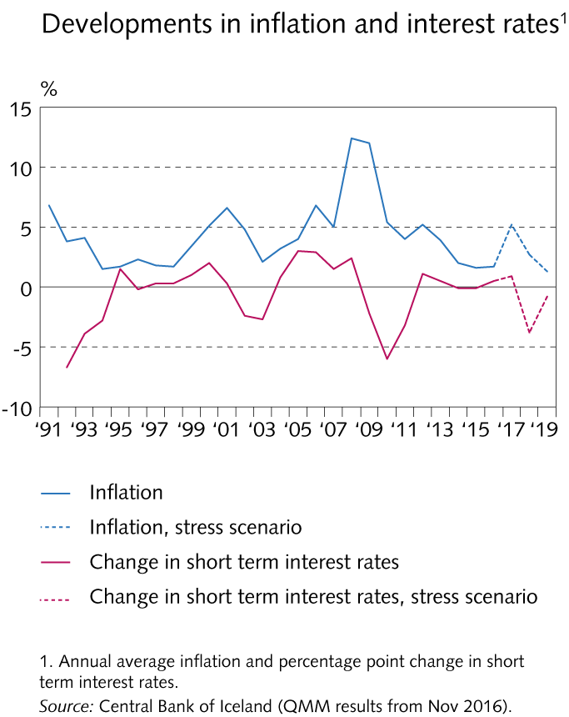
Central Bank stress test 2017

Slide 50
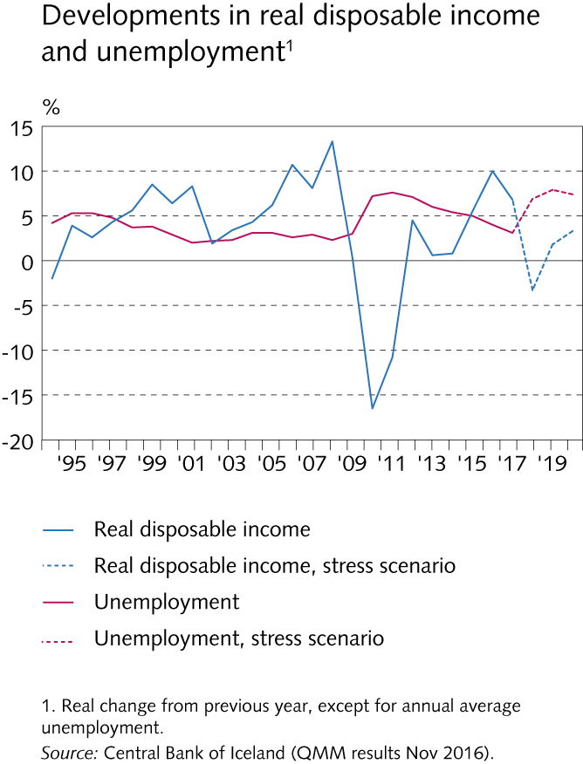
Central Bank stress test 2017

Slide 51
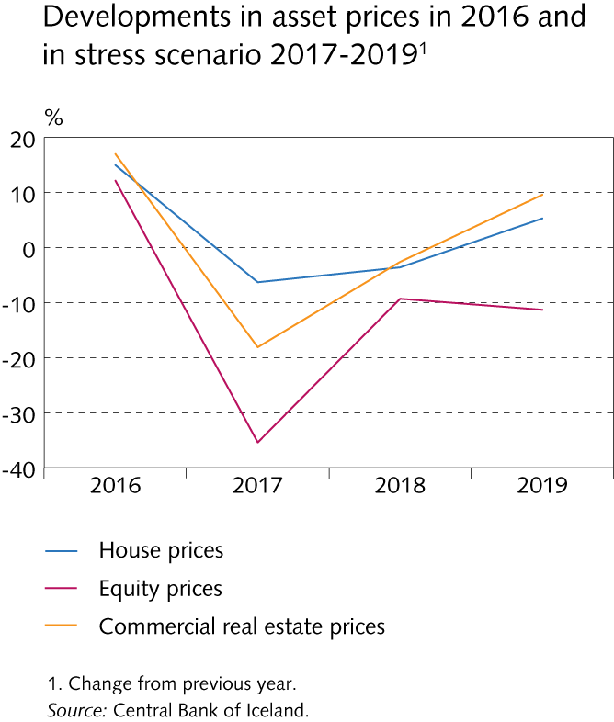
Central Bank stress test 2017

Slide 52

Central Bank stress test 2017

Slide 53

Central Bank stress test 2017

Slide 54

Central Bank stress test 2017

Slide 55

Central Bank stress test 2017

Slide 56

Central Bank stress test 2017

Slide 57

Central Bank stress test 2017

Slide 58

Box IV-1

Slide 59

Appendix I

Slide 60

Appendix I

Slide 61

Appendix I

Slide 62

Appendix I

Slide 63

Appendix I

Slide 64

Appendix I

Slide 65

Appendix I

Slide 66

Appendix I

Slide 67

Appendix I

Slide 68
Appendix I

Slide 69

Appendix I

Slide 70

Appendix I

Slide 71

Appendix I

Slide 72

Appendix I

Slide 73

Appendix I

Slide 74

Appendix I

Slide 75

Appendix I

Slide 76

Appendix I

Slide 77

Appendix I

Slide 78

Appendix I

Slide 79

Appendix I

Slide 80

Appendix I

Slide 81

Appendix I

Slide 82

Appendix I

Slide 83

Appendix I

Slide 84

Appendix I

Slide 85

Appendix I

Slide 86

Appendix I

Slide 87

Appendix I

Slide 88

Appendix I

Slide 89

Appendix I

Slide 90

Appendix I

Slide 91

Appendix I

Slide 92

Appendix I

Slide 93

Appendix I

Slide 94

Appendix I

Slide 95

Appendix I

Slide 96

Appendix I

Slide 97

Appendix I

Slide 98

Appendix I

Slide 99

Appendix I

Slide 100

Appendix I

Slide 101

Appendix I

Slide 102

Appendix I

Slide 103

Appendix I

Slide 104

Appendix I

Slide 105

Appendix I

Slide 106

Appendix I

Slide 107

Appendix I

Slide 108

Appendix I

Slide 109

Appendix I

Slide 110

Appendix I

Slide 111

Appendix I

Slide 112

Appendix I

Slide 113

Appendix I

Slide 114

Appendix I

Slide 115

Appendix I

Slide 116

Appendix I

Slide 117

Appendix I

Slide 118

Appendix I

Slide 119

Appendix I

Slide 120

Appendix I

Slide 121

Appendix I

Slide 122

Appendix I

Slide 123

Appendix I

Slide 124

Appendix I

Slide 125

Appendix I

Slide 126

Appendix I

Slide 127

Appendix I

Slide 128

Appendix I

Slide 129

Appendix I

Slide 130

Appendix I

Slide 131

Appendix I

Slide 132

Appendix I

Slide 133

Appendix I

Slide 134

Appendix I

Slide 135

Appendix I

Slide 136

Appendix I

Slide 137

Appendix I

Slide 138

Appendix I

Slide 139

Appendix I

Slide 140

Appendix I

Slide 141

Appendix I

Slide 142

Appendix I

Slide 143

Appendix I

Slide 144

Appendix I

Slide 145

Appendix I

Slide 146

Appendix I

Slide 147

Appendix I

Slide 148

Appendix I

