Slide 1
Financial Stability 2020/1
Charts
July 2020

Slide 2
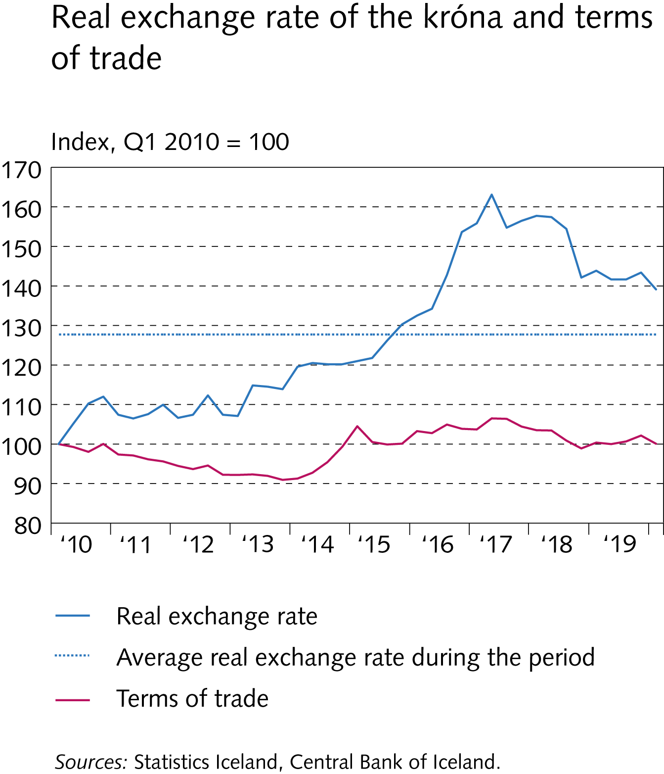
I Financial Stability: Developments and prospects

Slide 3
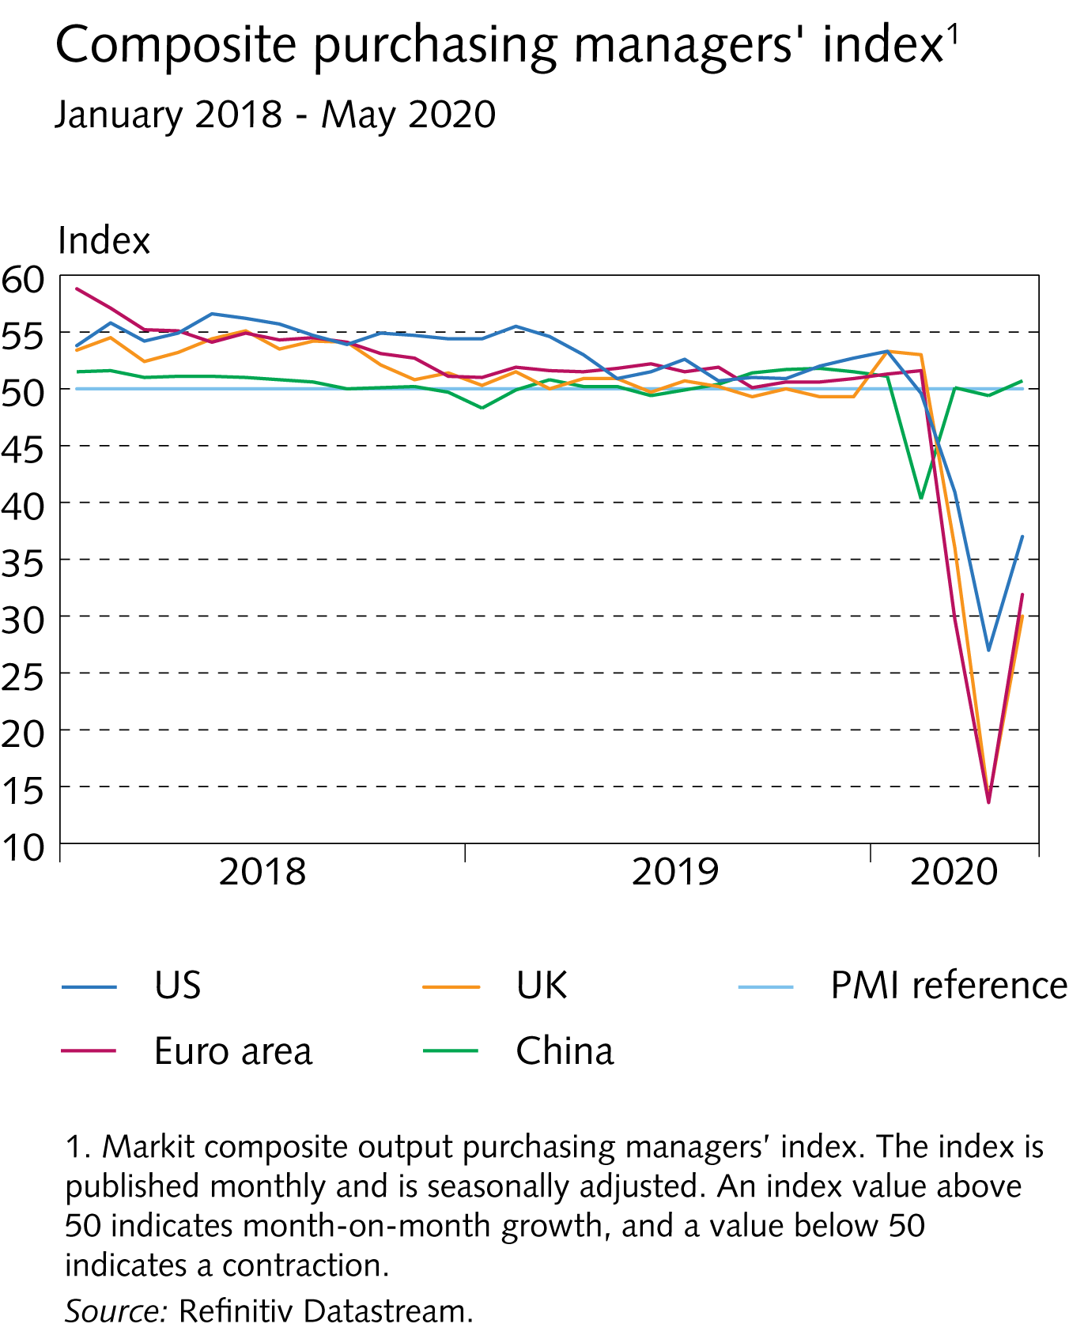
I Financial Stability: Developments and prospects

Slide 4
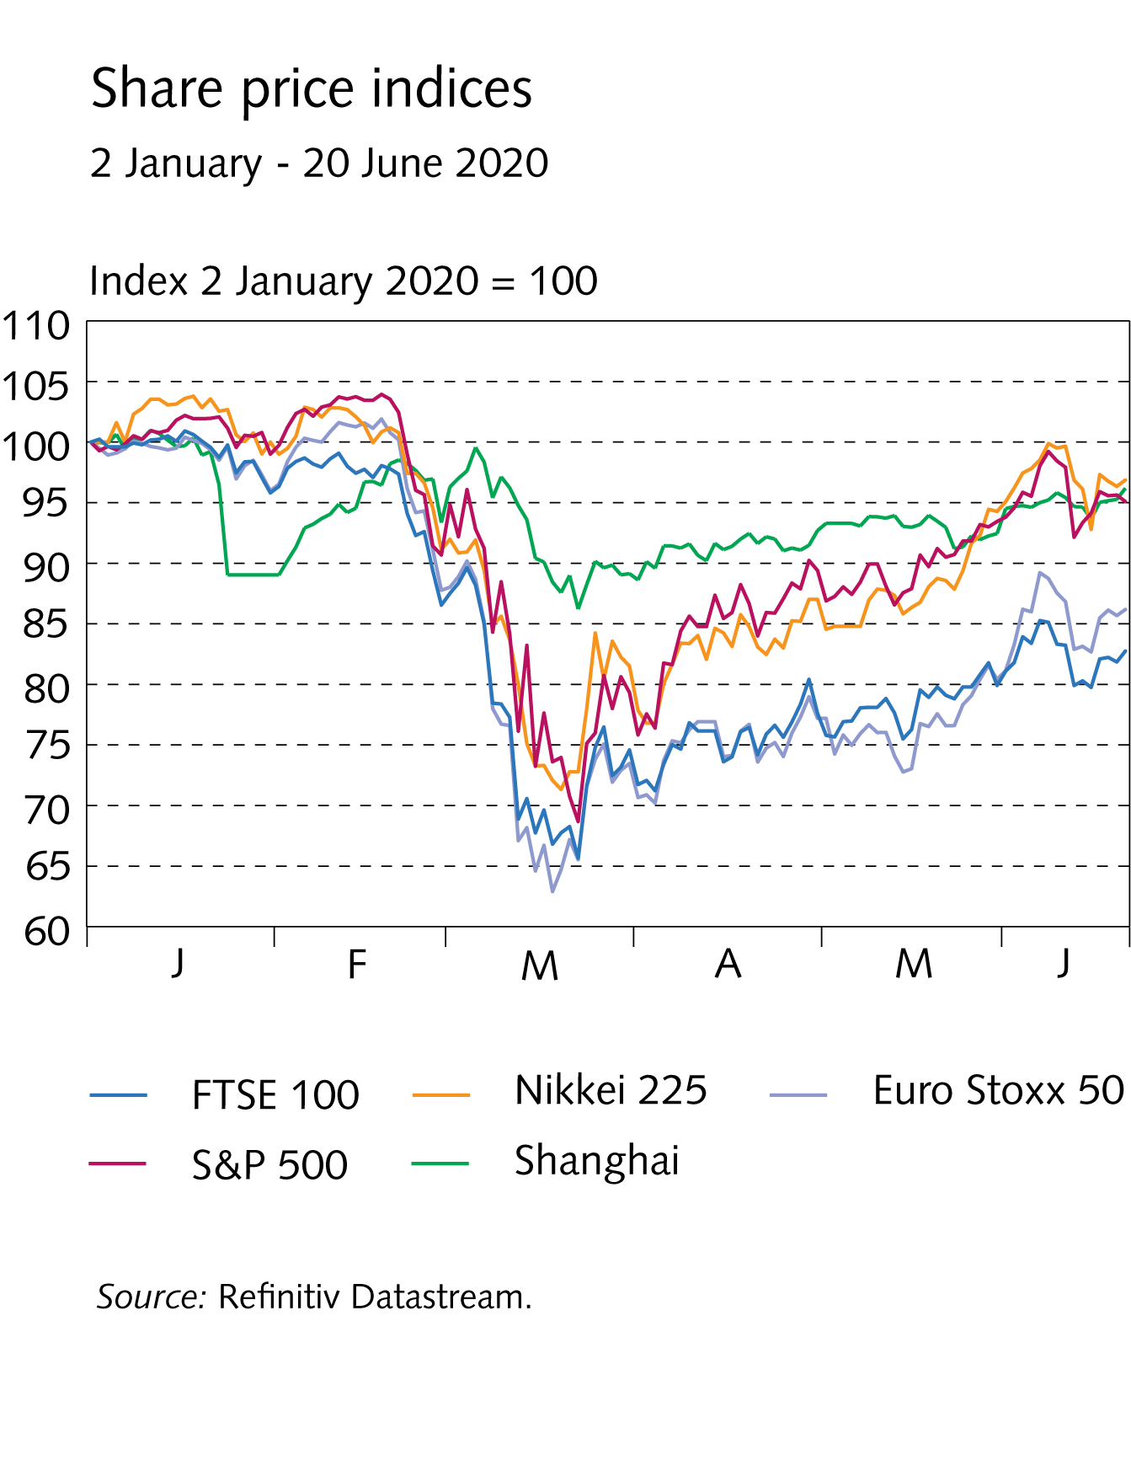
I Financial Stability: Developments and prospects

Slide 5
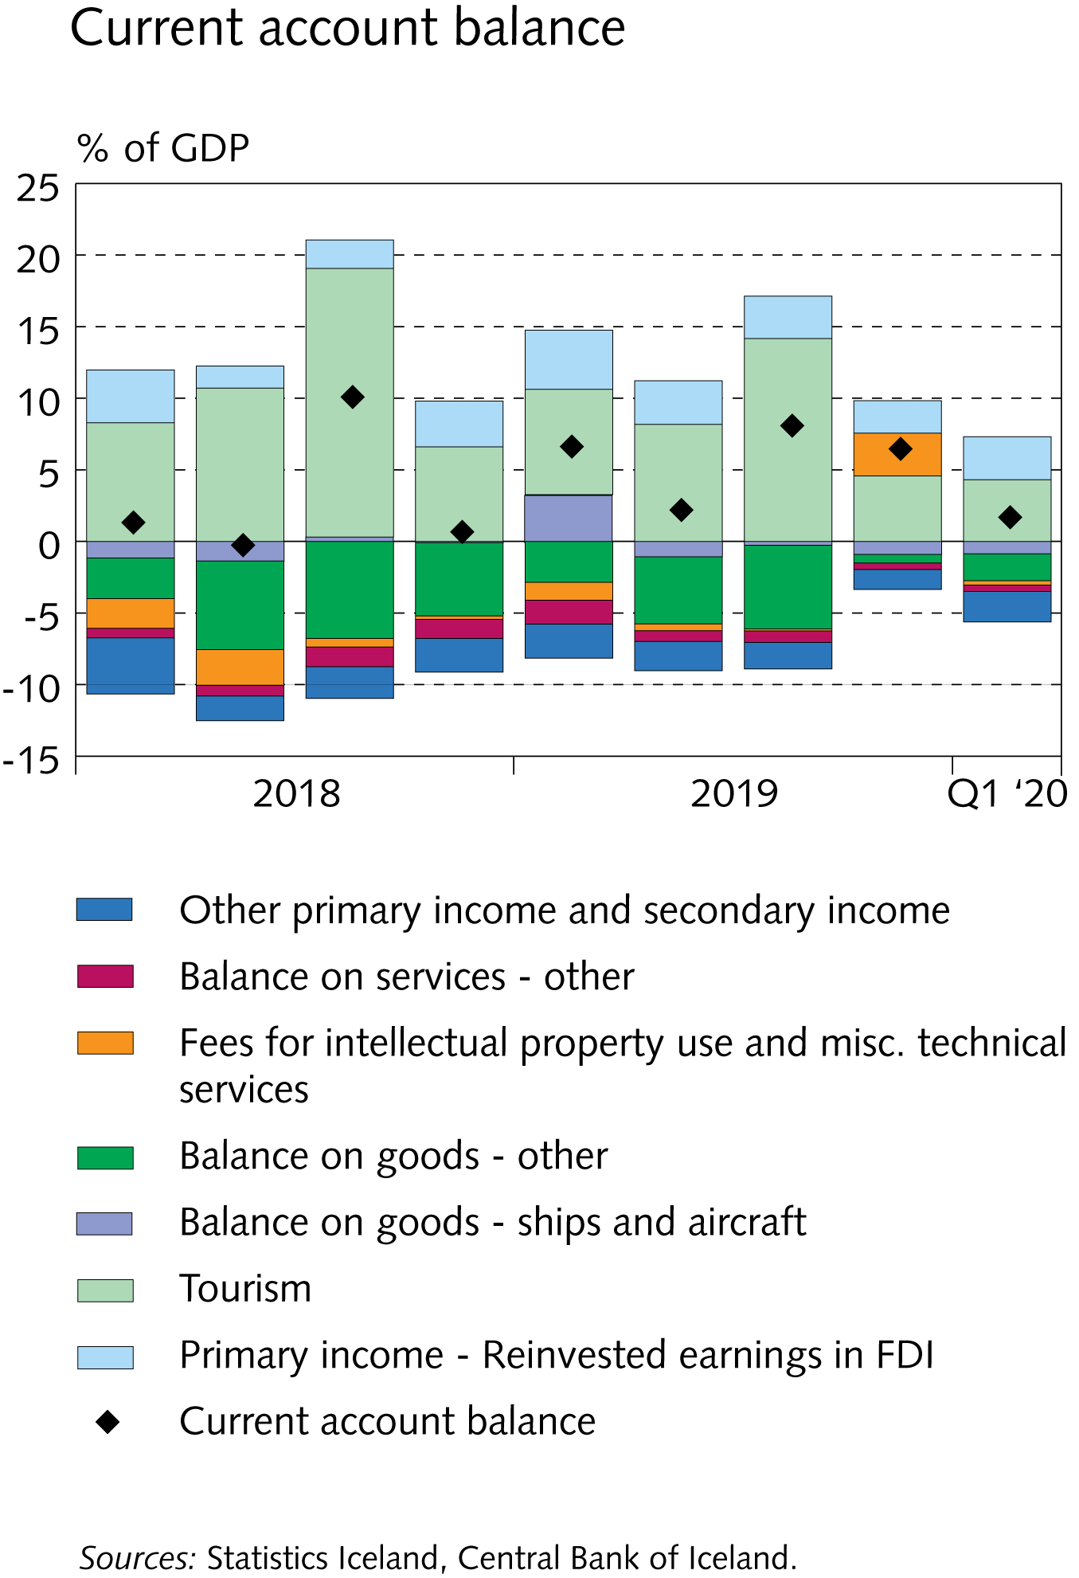
I Financial Stability: Developments and prospects

Slide 6
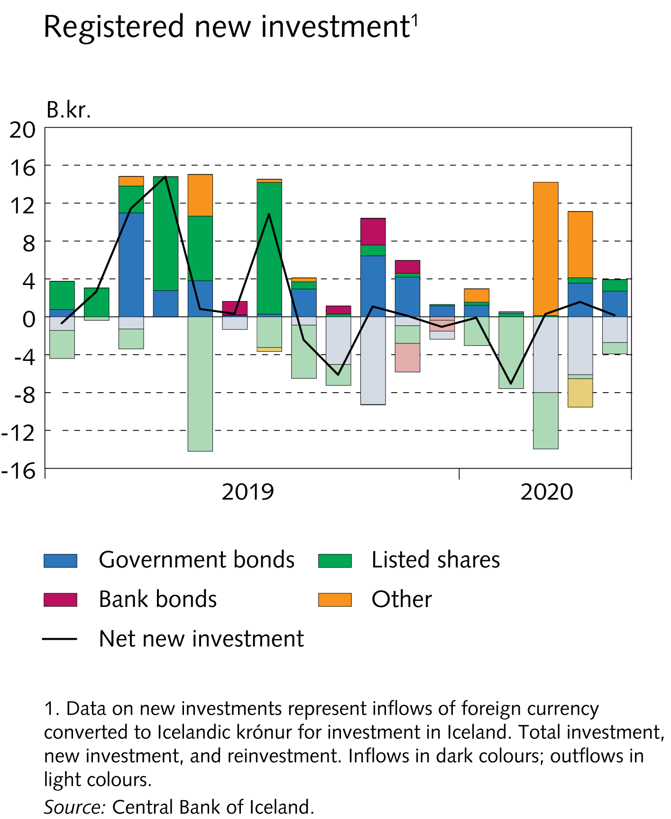
I Financial Stability: Developments and prospects

Slide 7
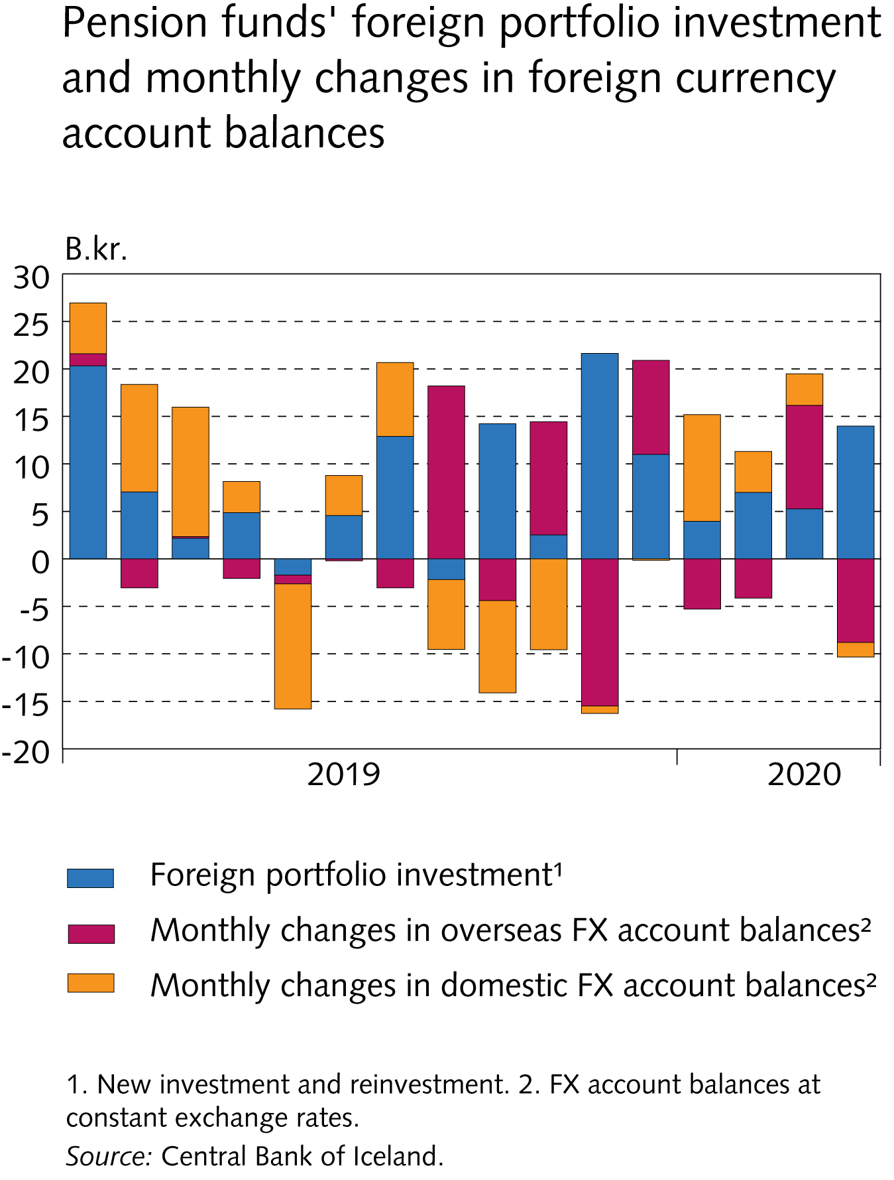
I Financial Stability: Developments and prospects

Slide 8
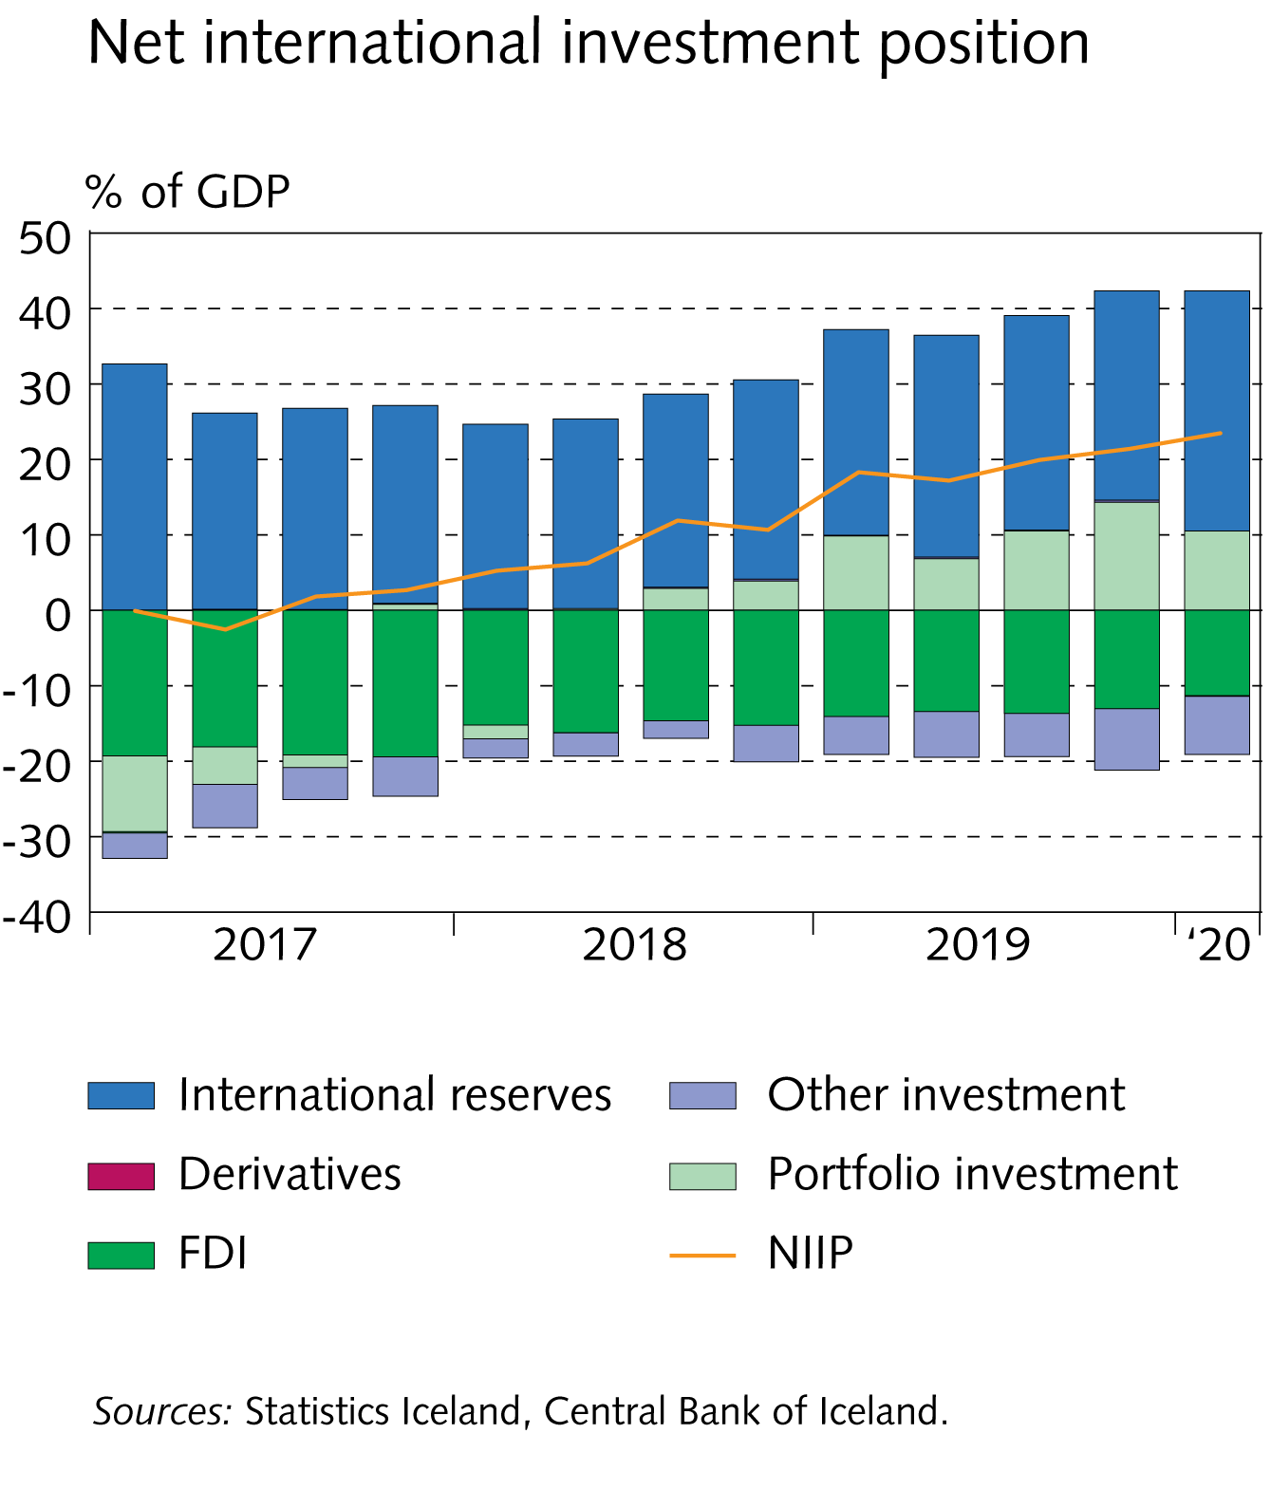
I Financial Stability: Developments and prospects

Slide 9
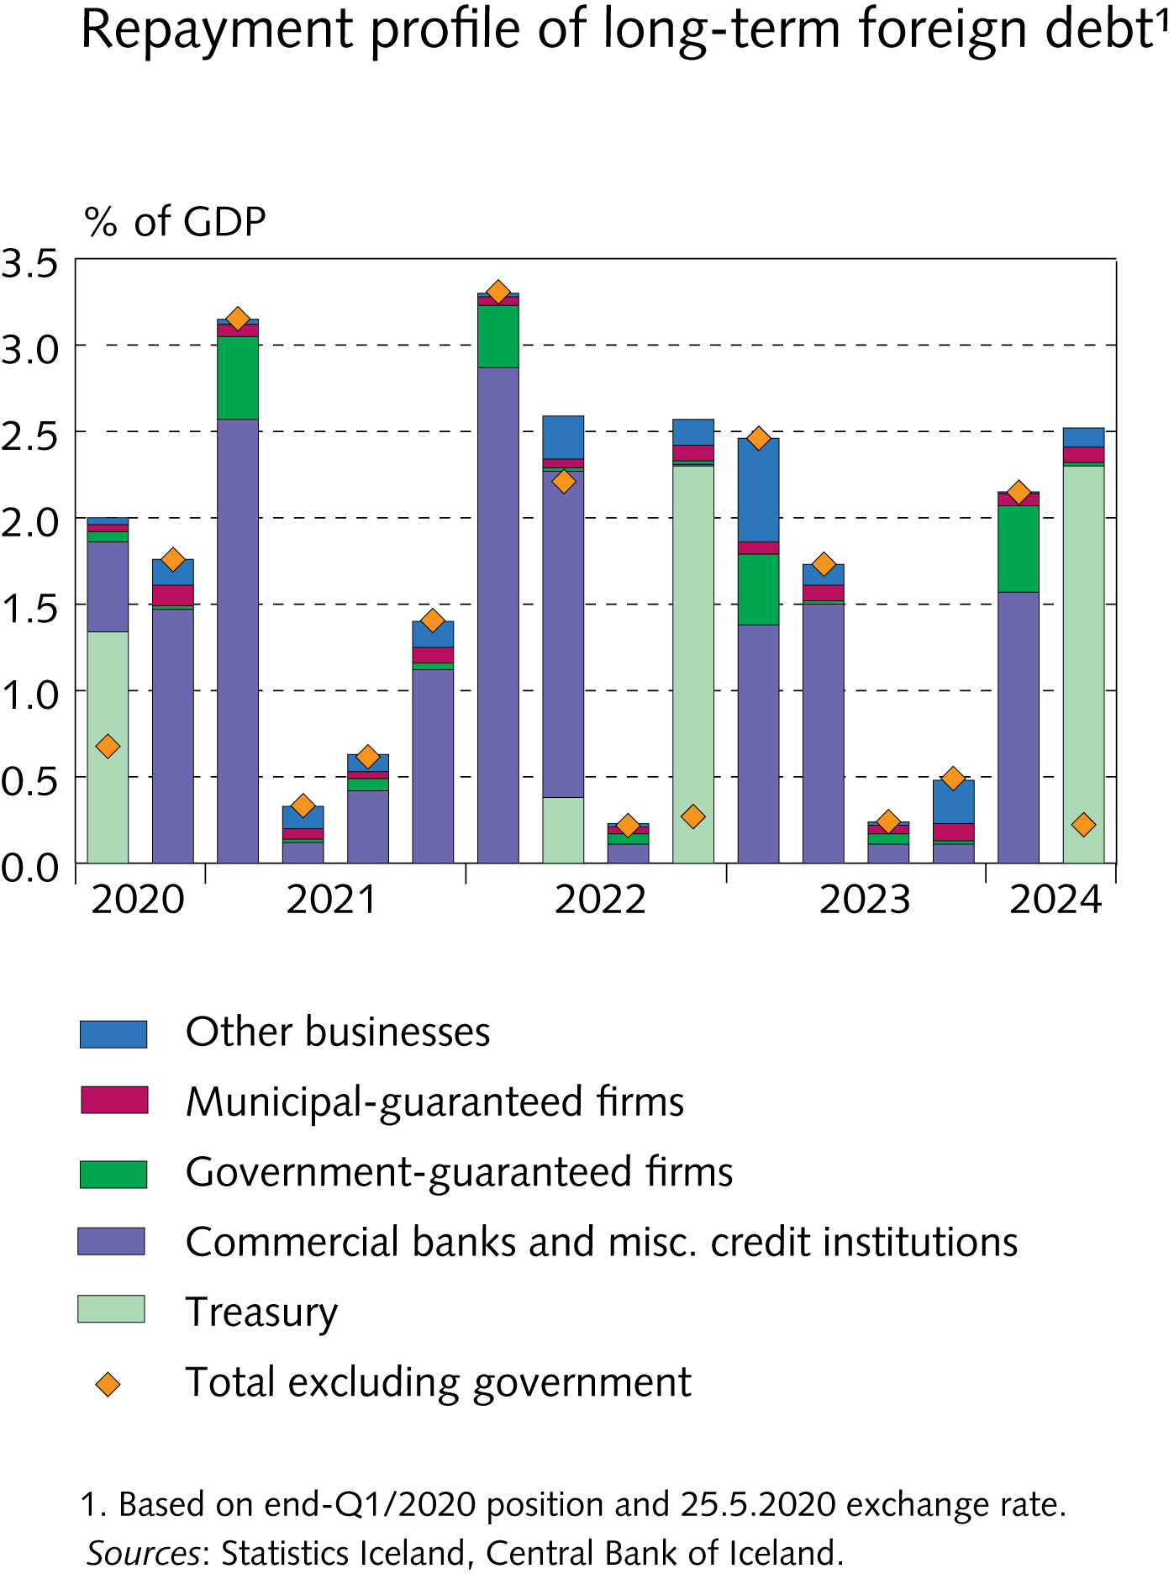
I Financial Stability: Developments and prospects

Slide 10
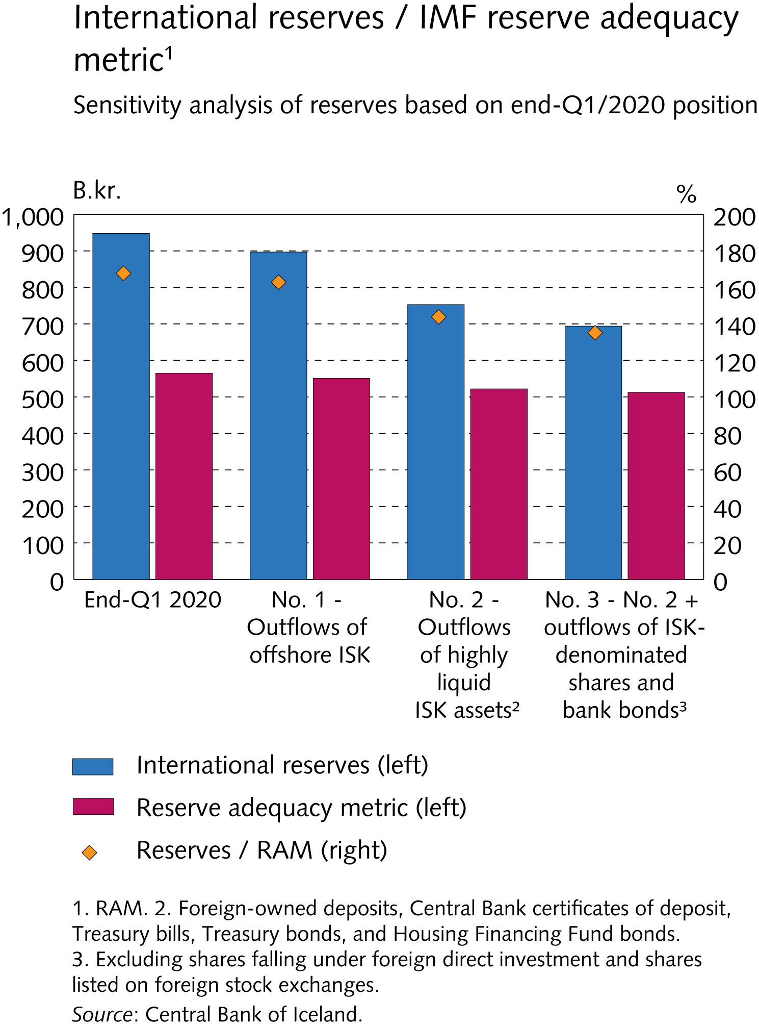
I Financial Stability: Developments and prospects

Slide 11
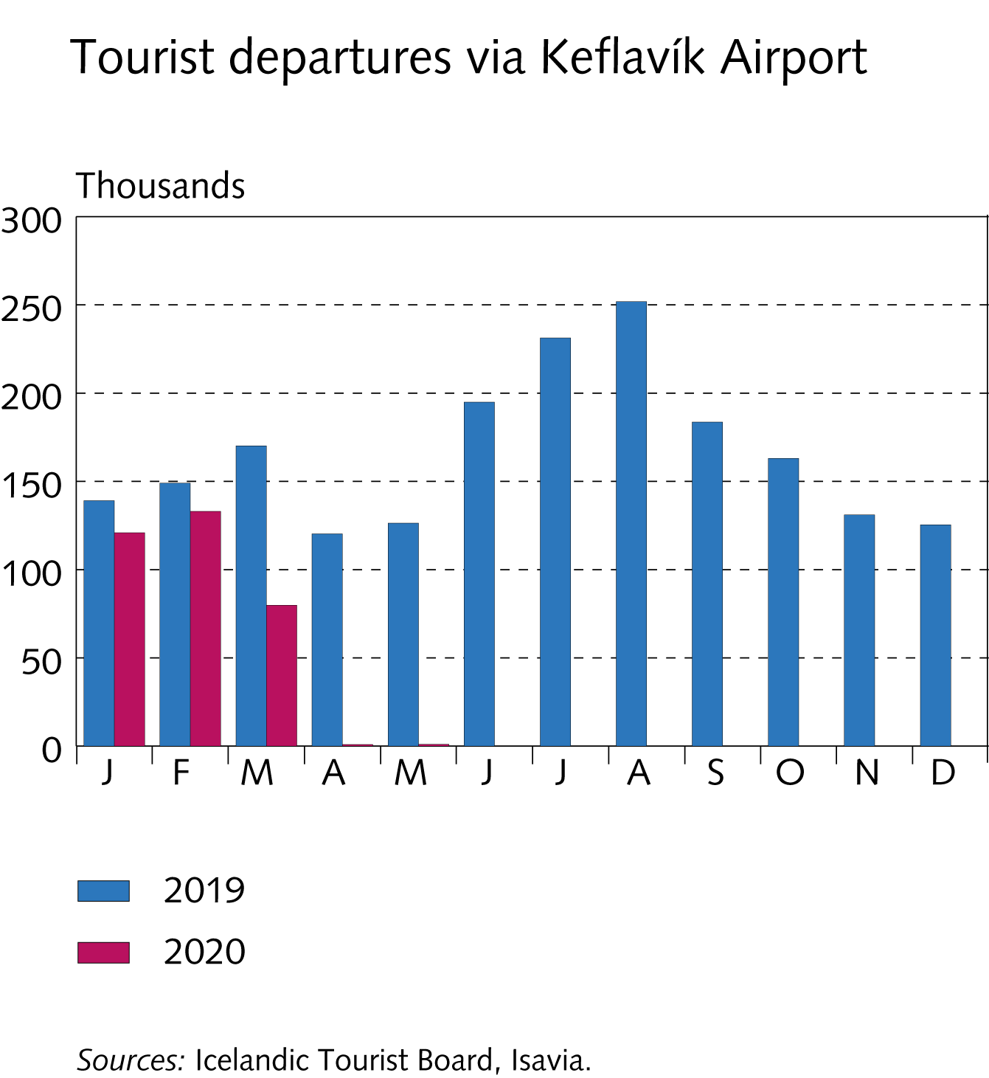
I Financial Stability: Developments and prospects

Slide 12
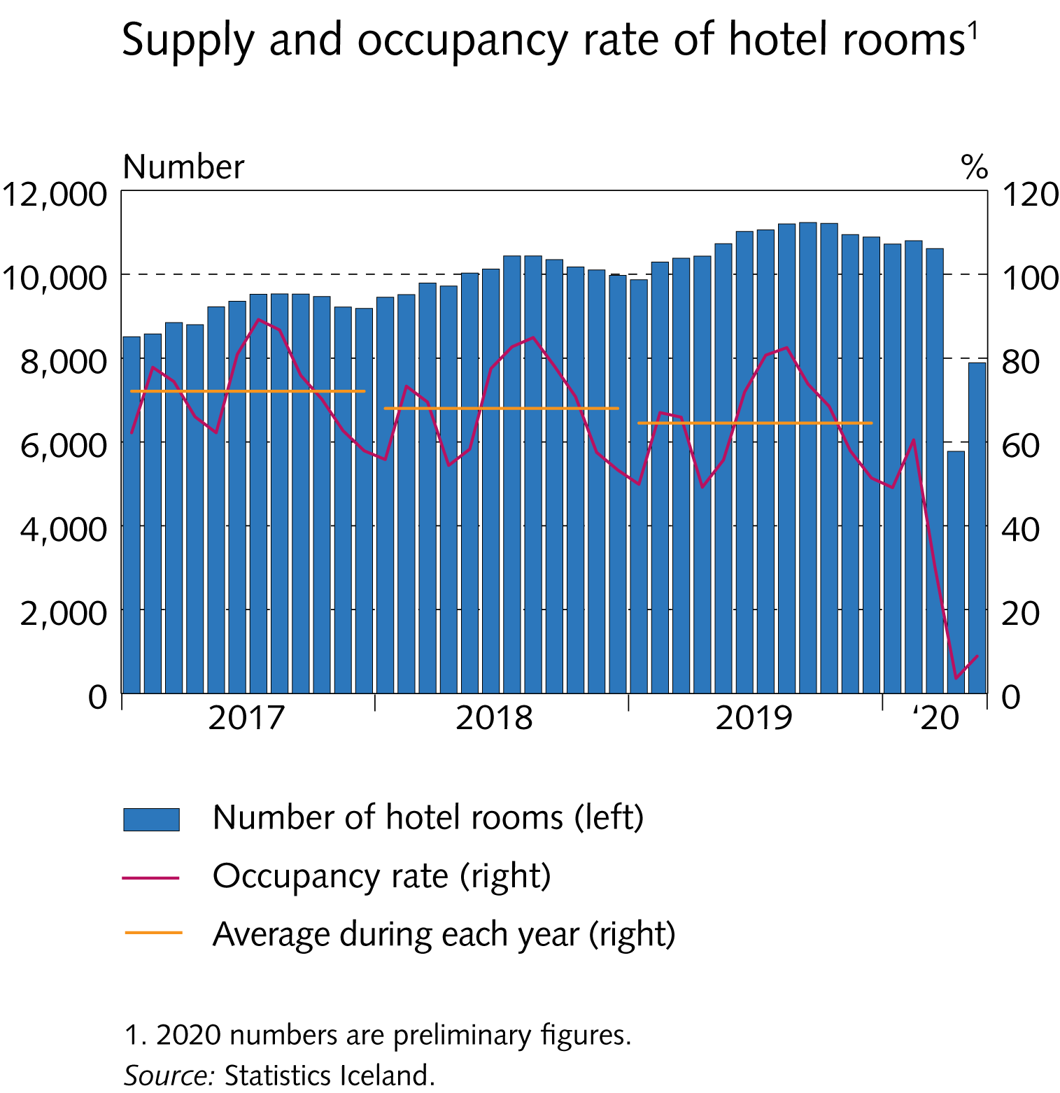
I Financial Stability: Developments and prospects

Slide 13
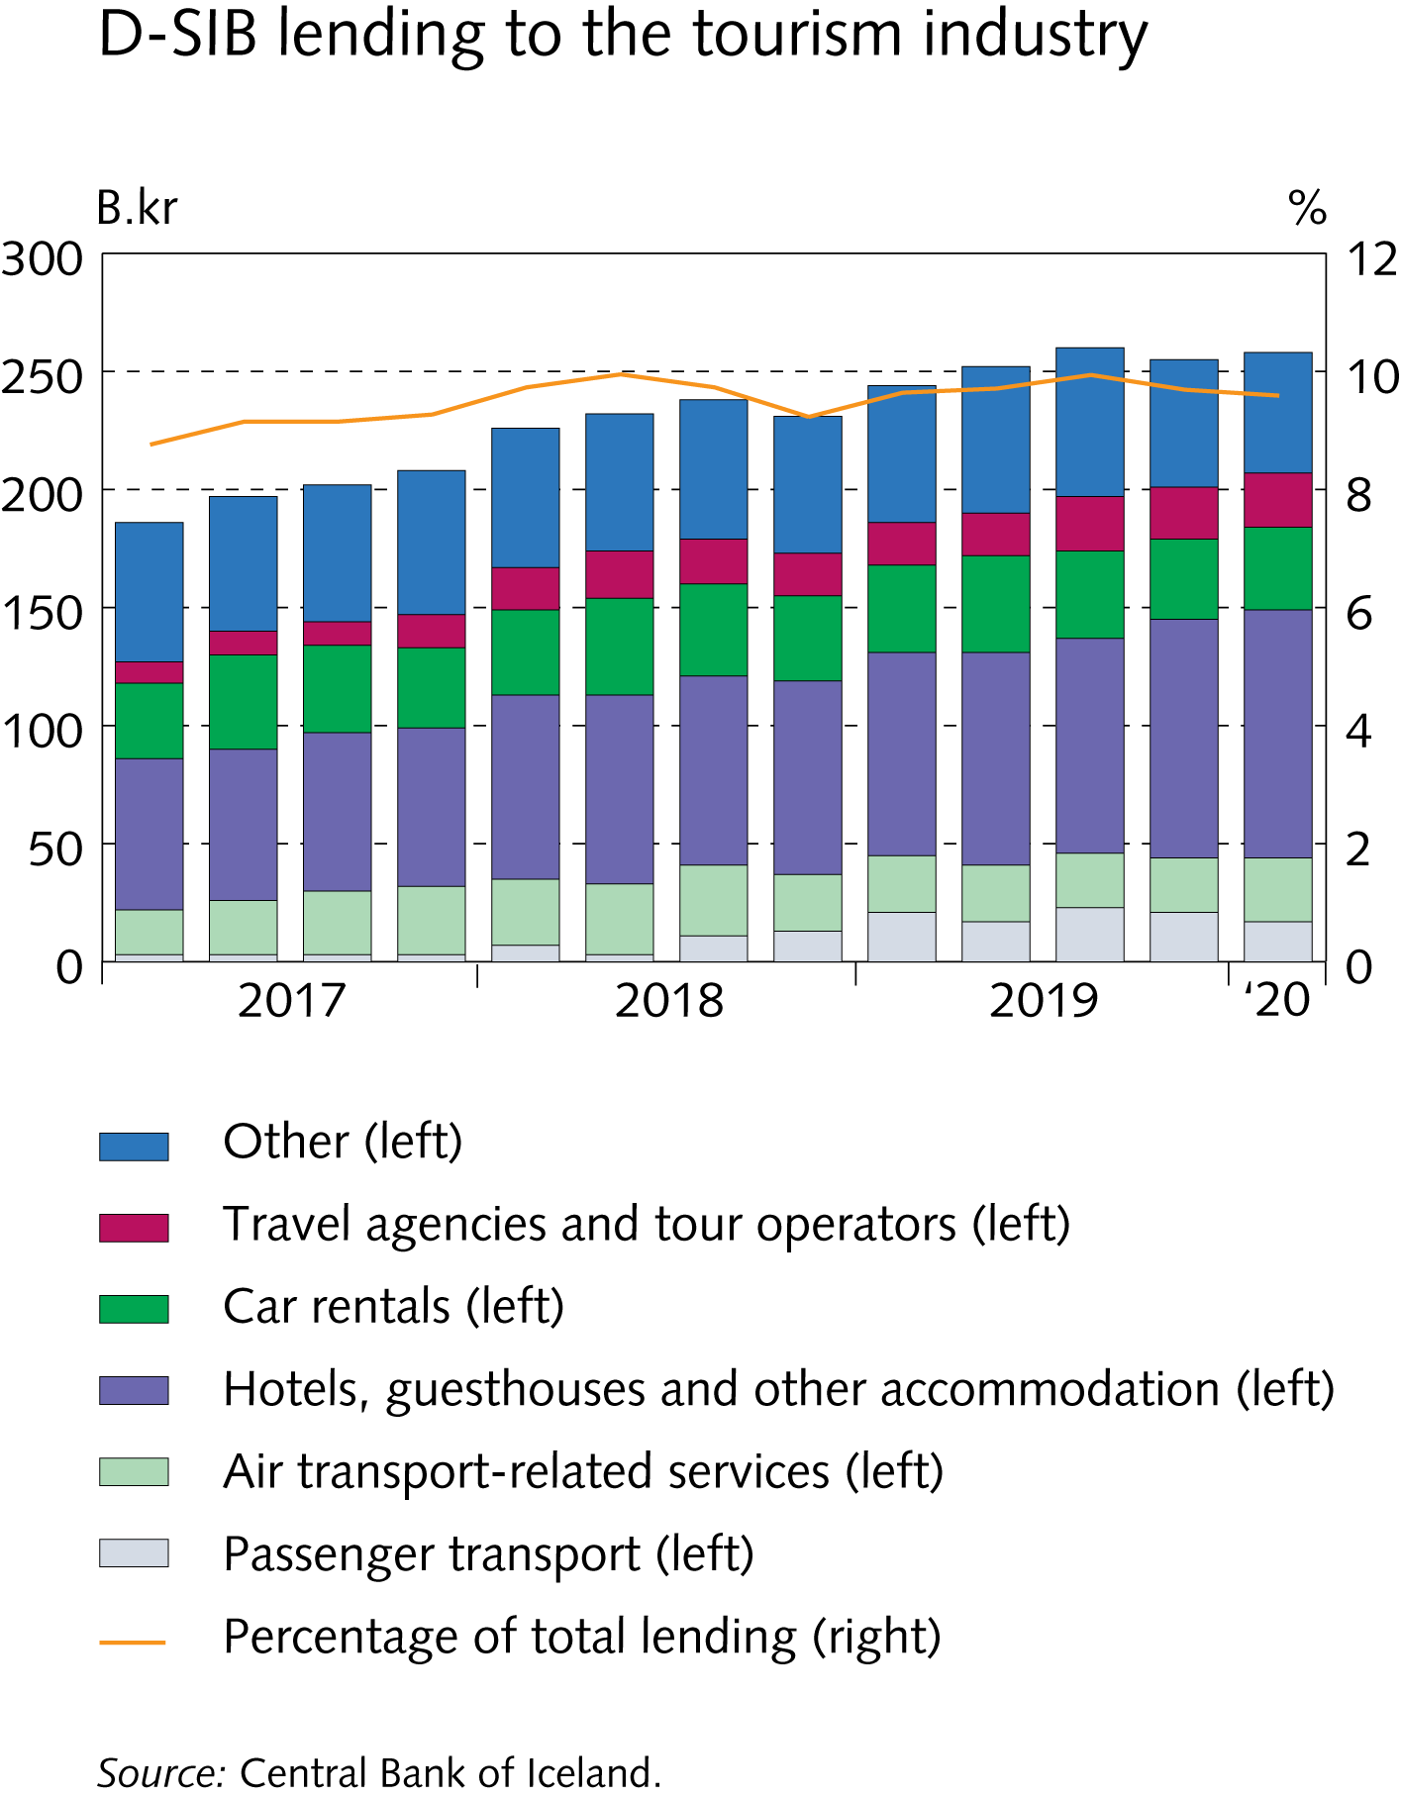
I Financial Stability: Developments and prospects

Slide 14
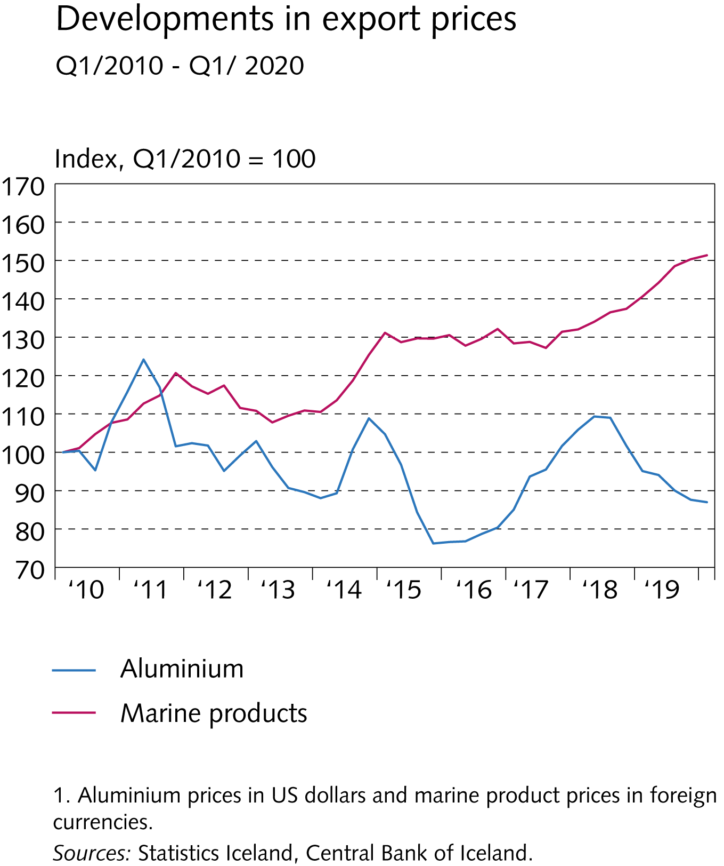
I Financial Stability: Developments and prospects

Slide 15
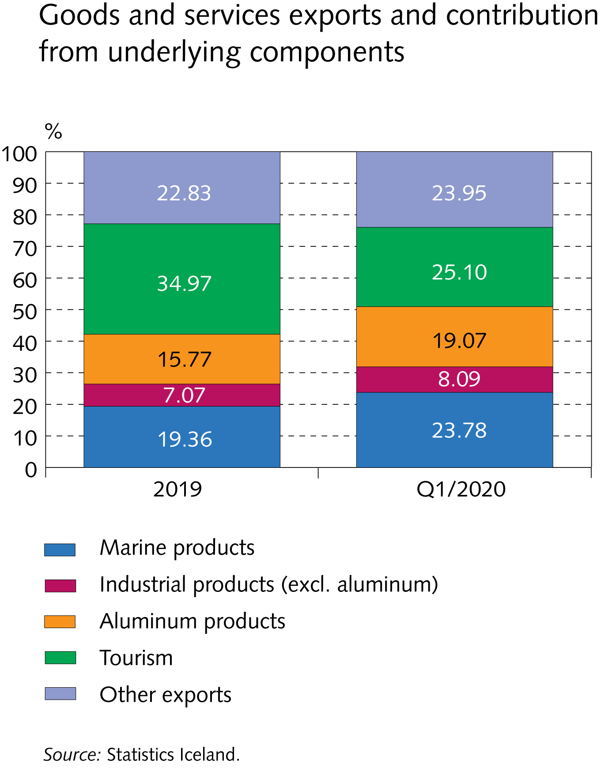
I Financial Stability: Developments and prospects

Slide 16
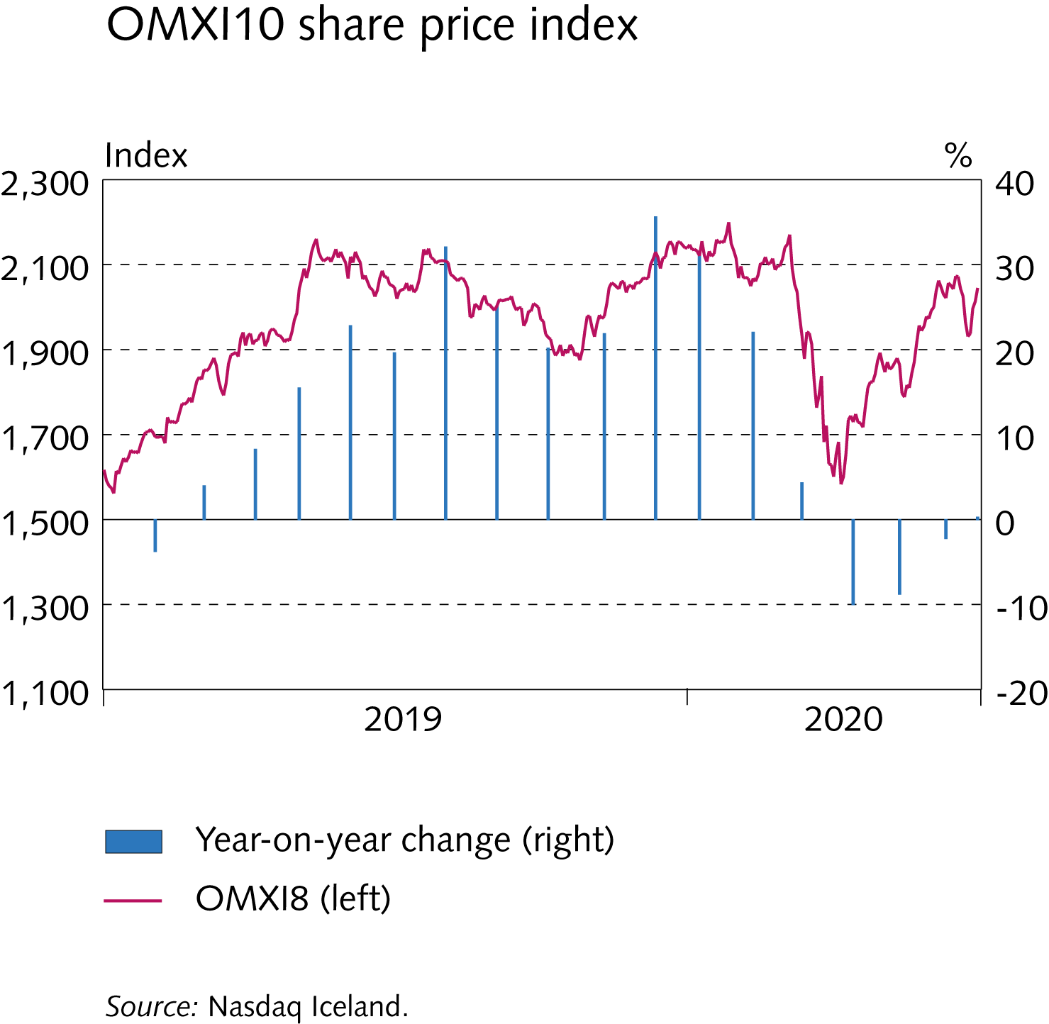
I Financial Stability: Developments and prospects

Slide 17
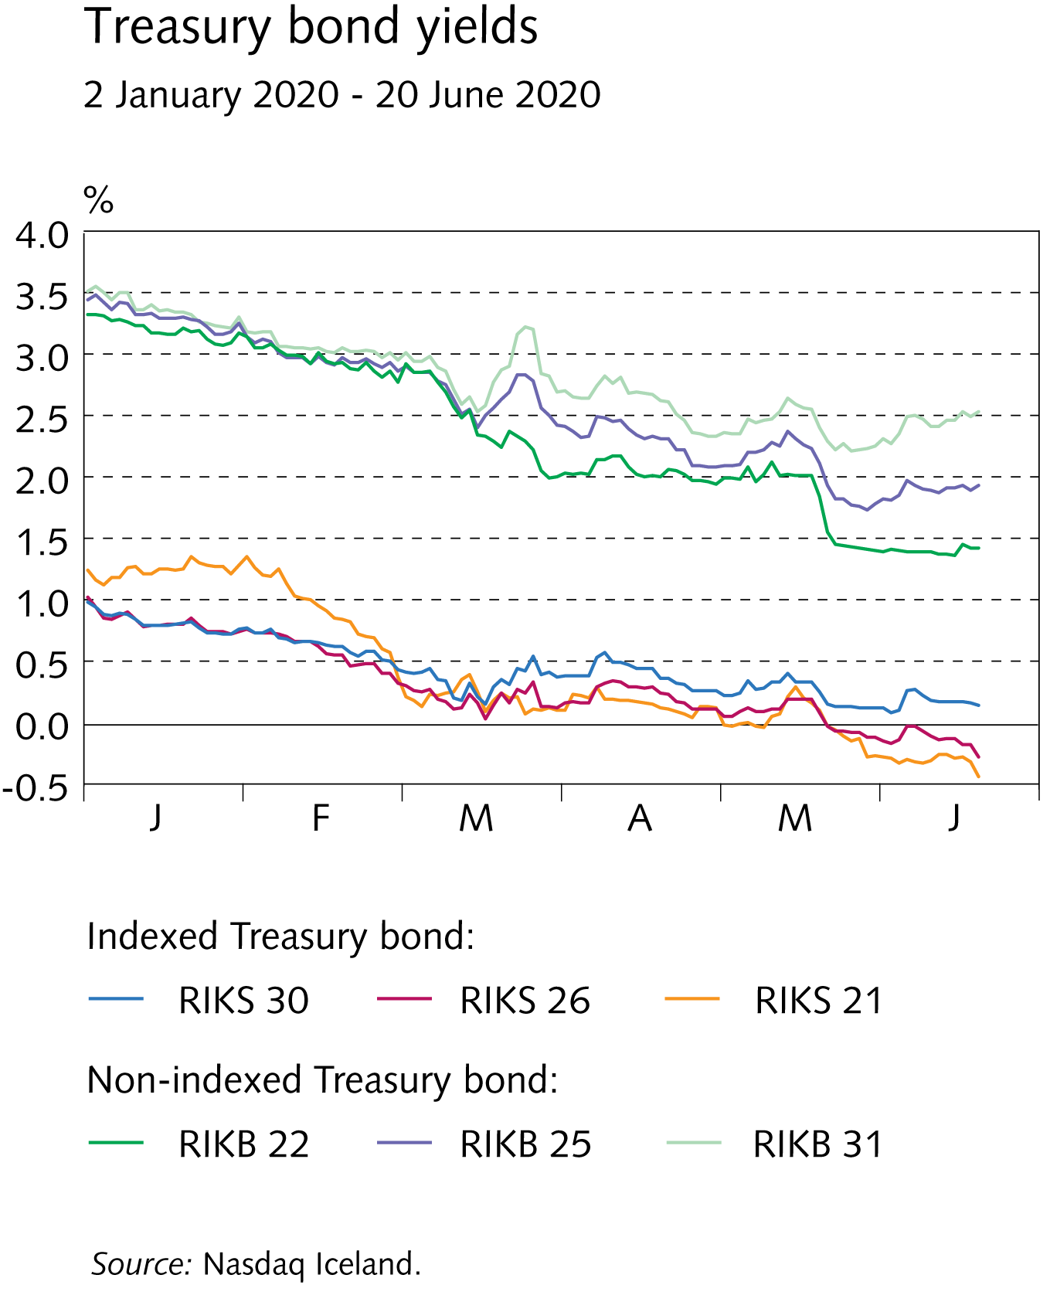
I Financial Stability: Developments and prospects

Slide 18
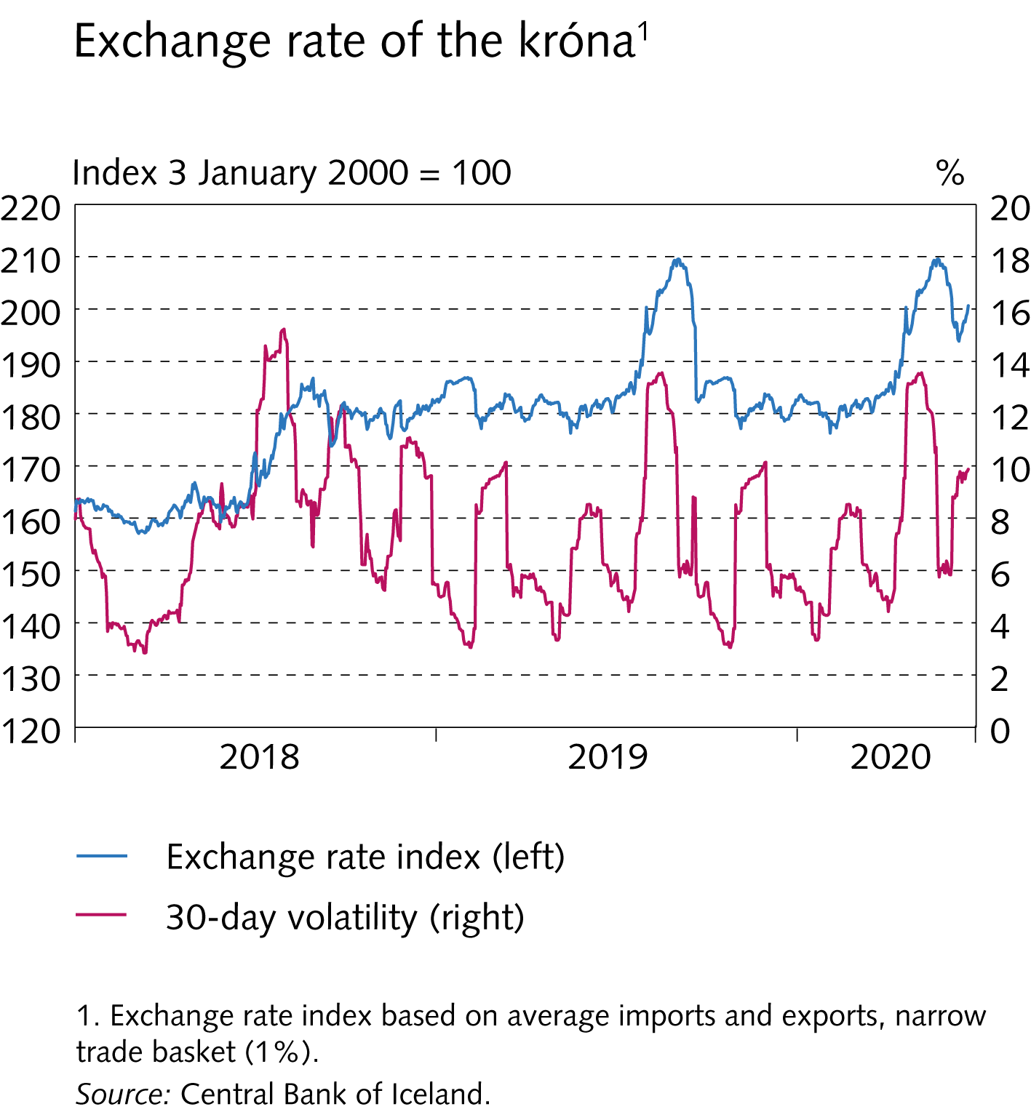
I Financial Stability: Developments and prospects

Slide 19
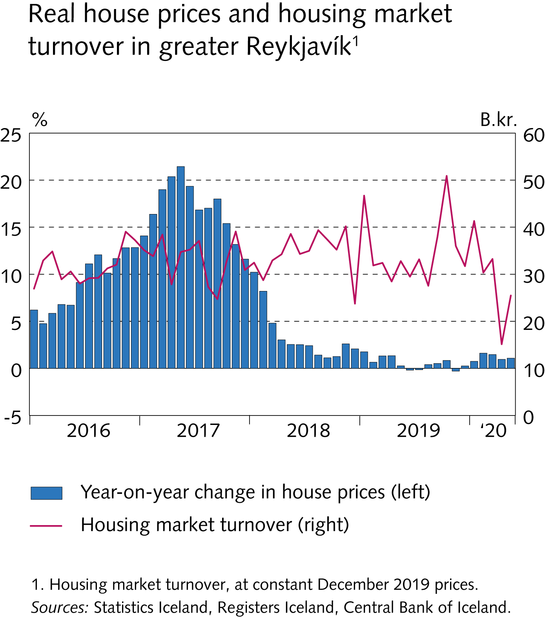
I Financial Stability: Developments and prospects

Slide 20
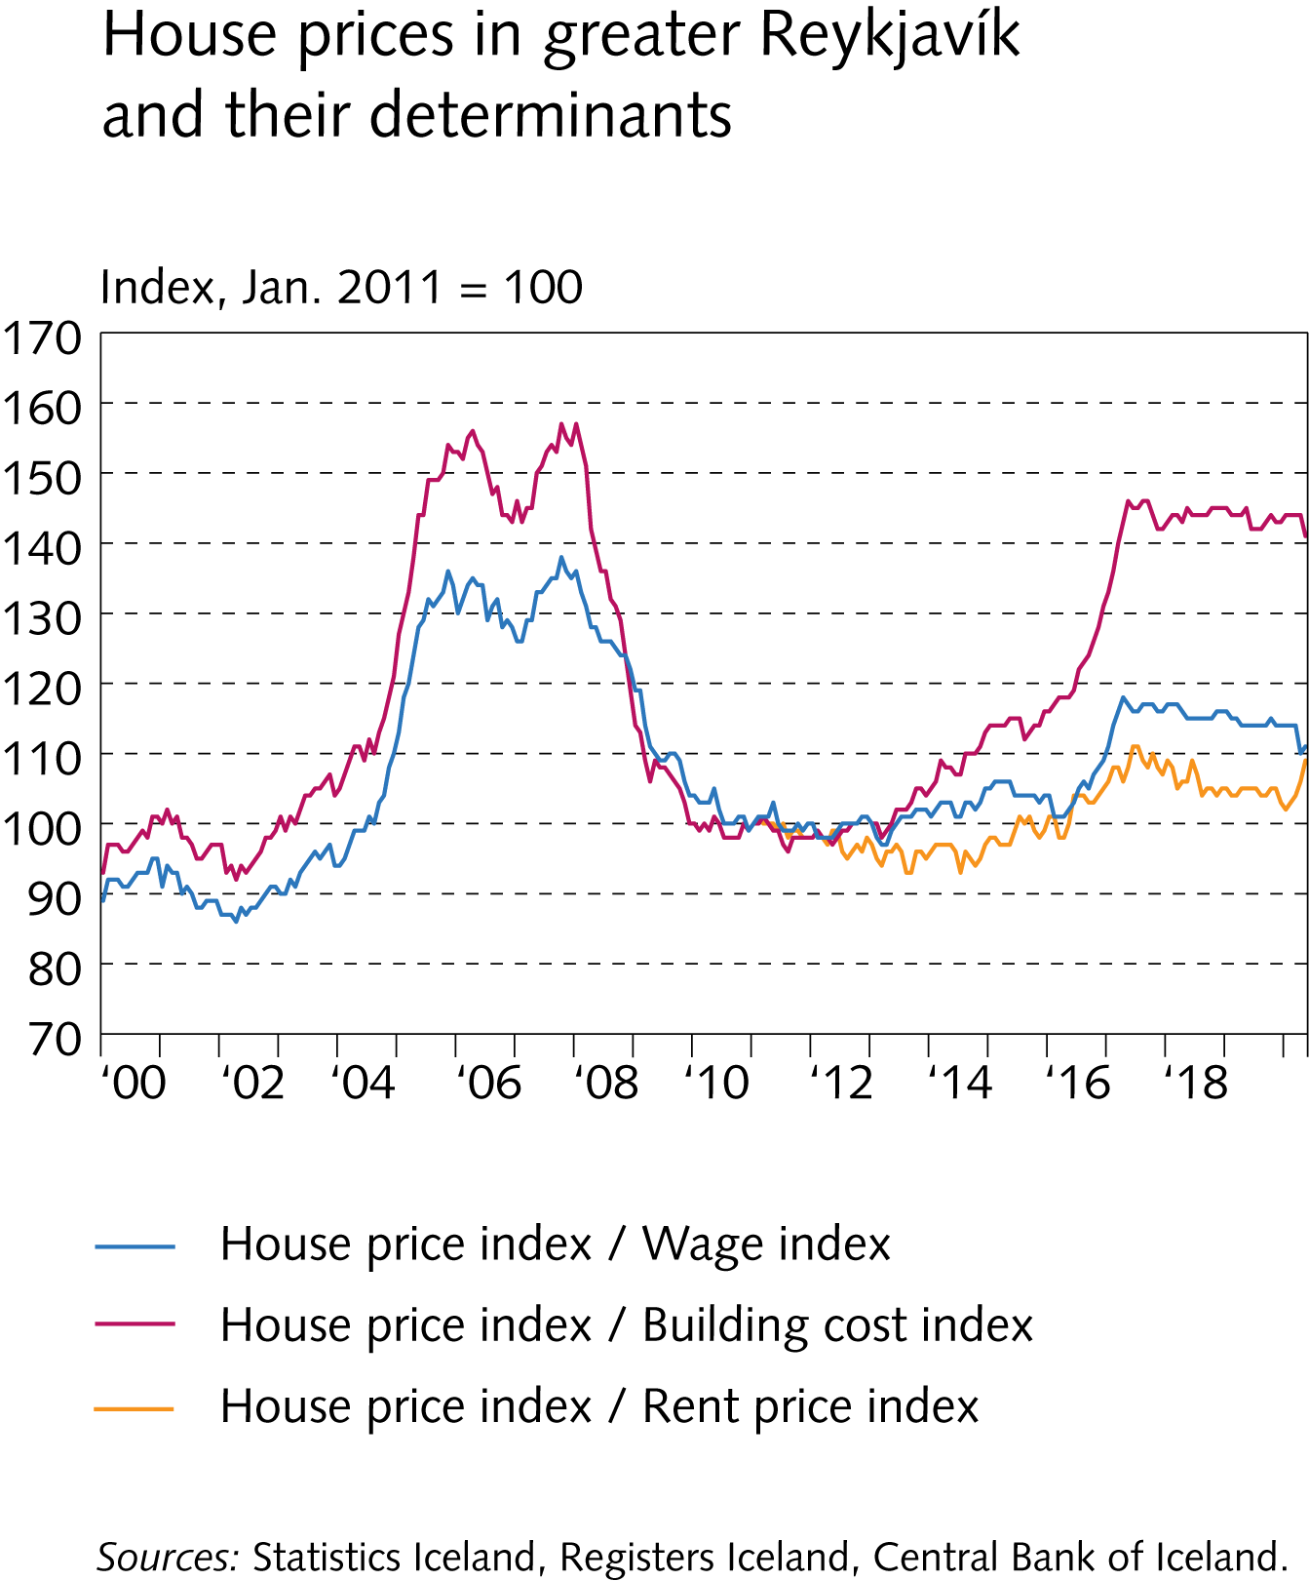
I Financial Stability: Developments and prospects

Slide 21
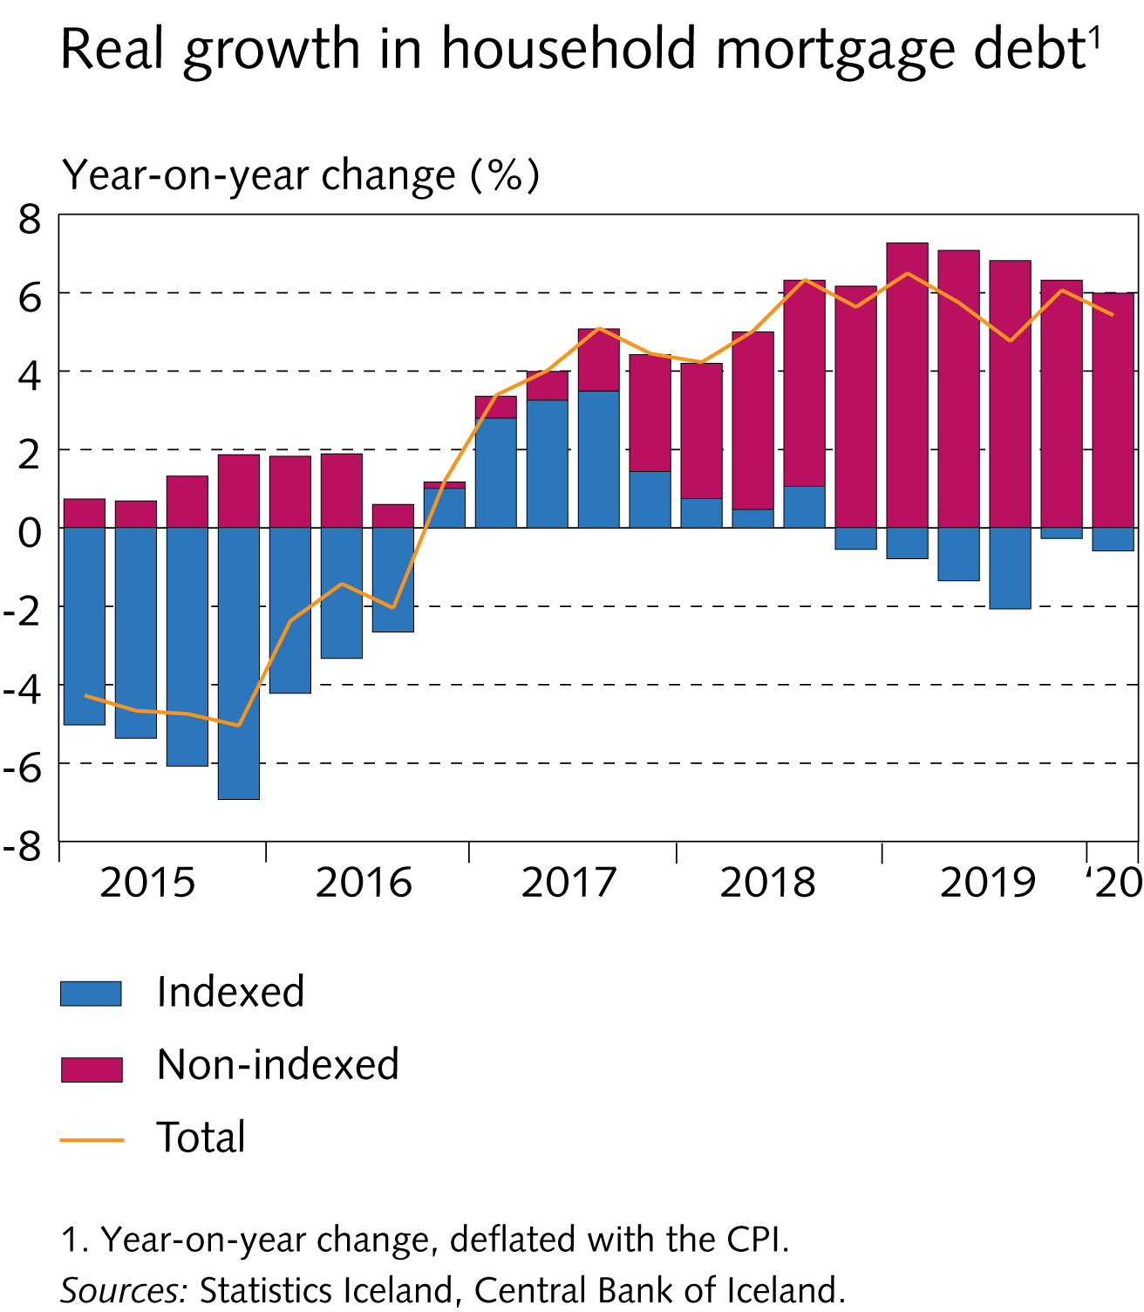
I Financial Stability: Developments and prospects

Slide 22
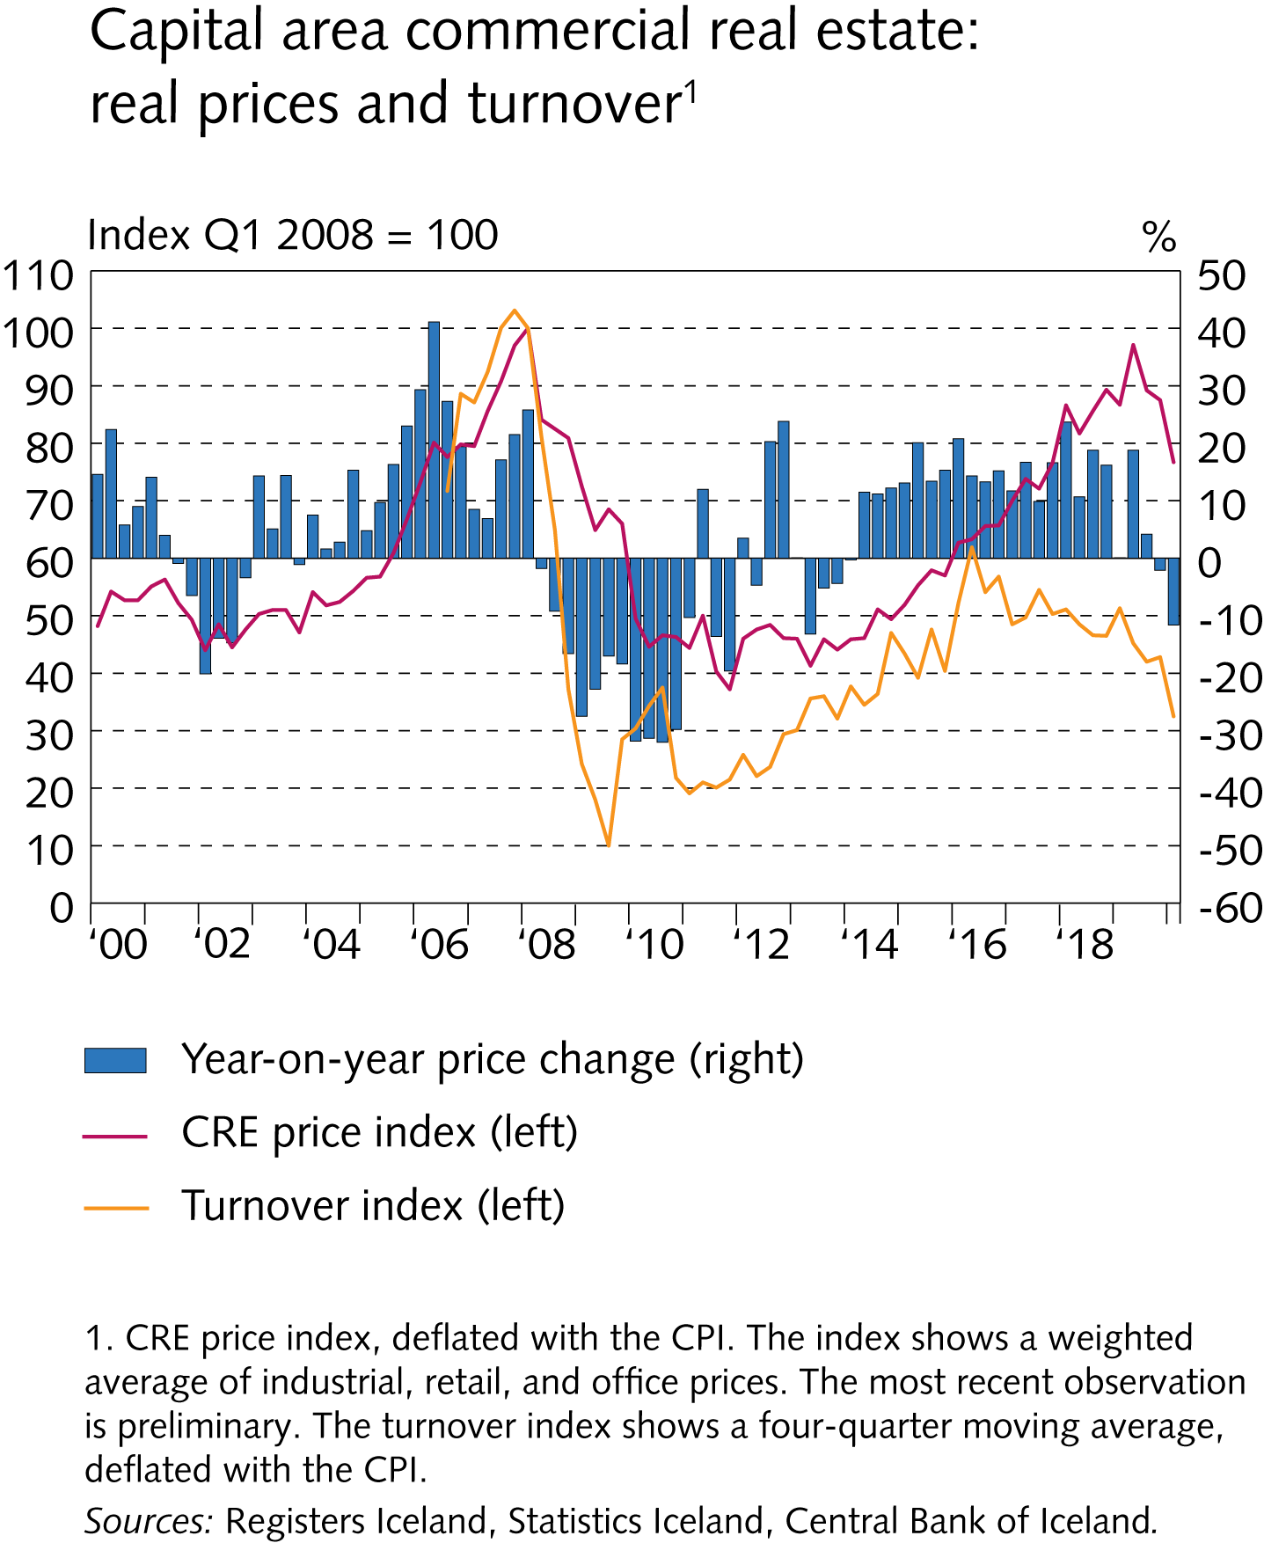
I Financial Stability: Developments and prospects

Slide 23
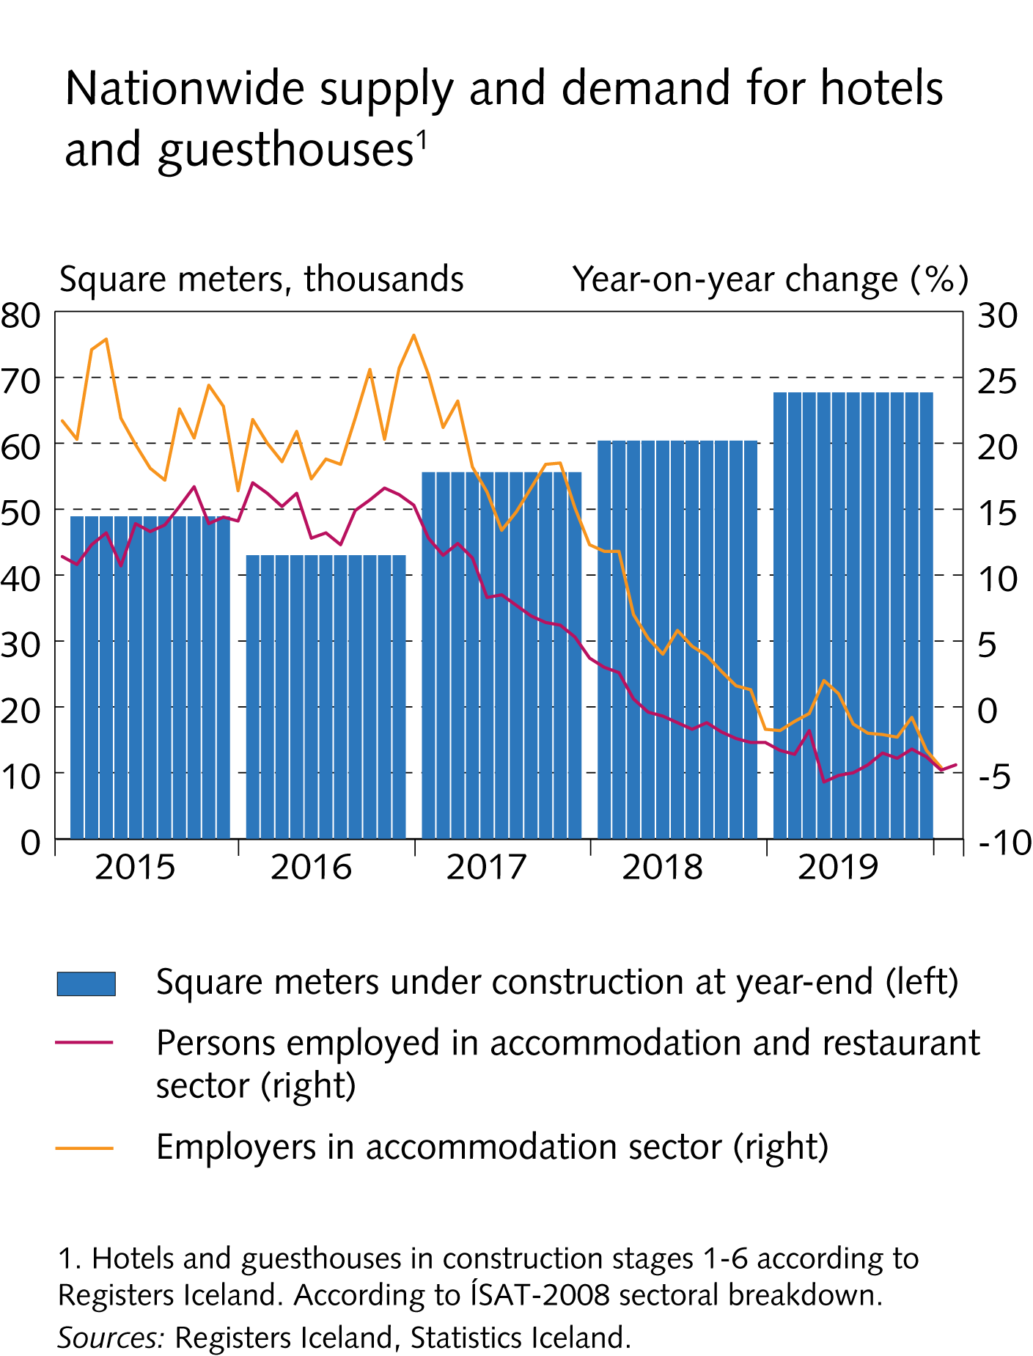
I Financial Stability: Developments and prospects

Slide 24
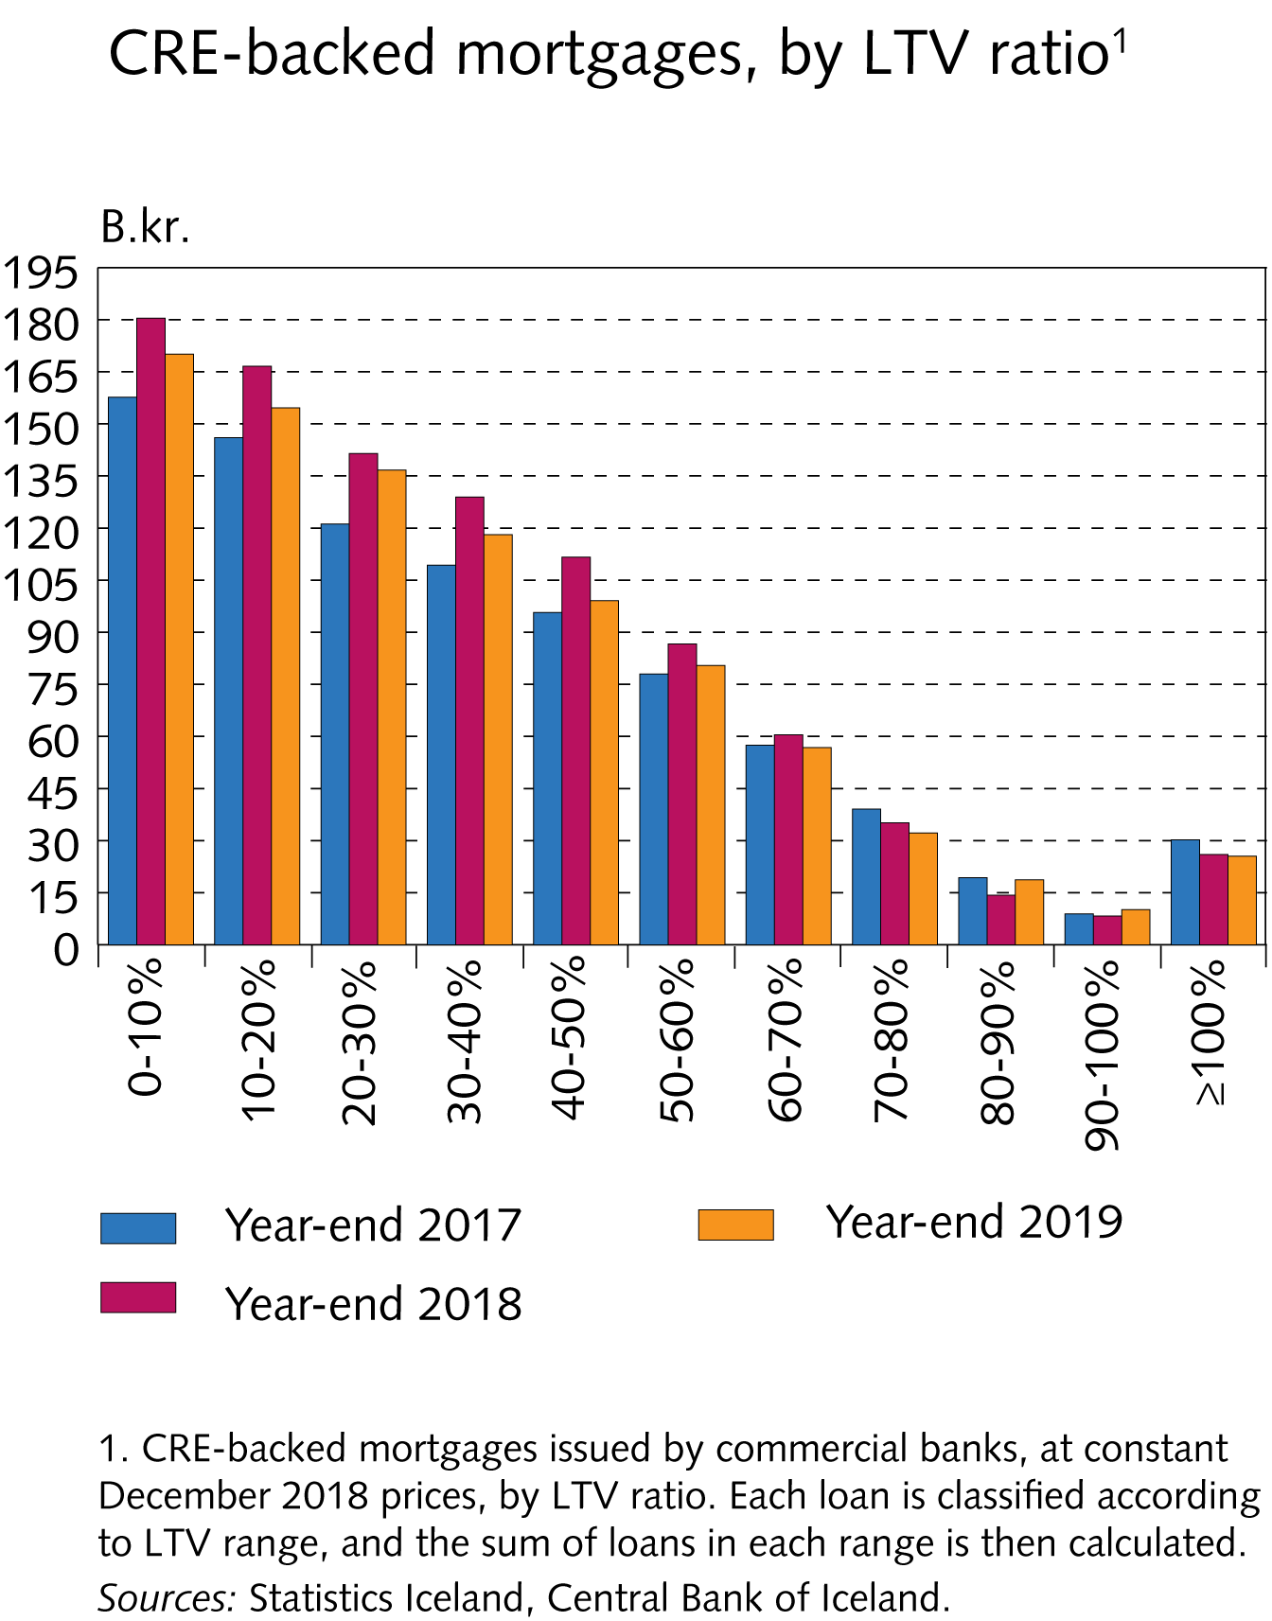
I Financial Stability: Developments and prospects

Slide 25
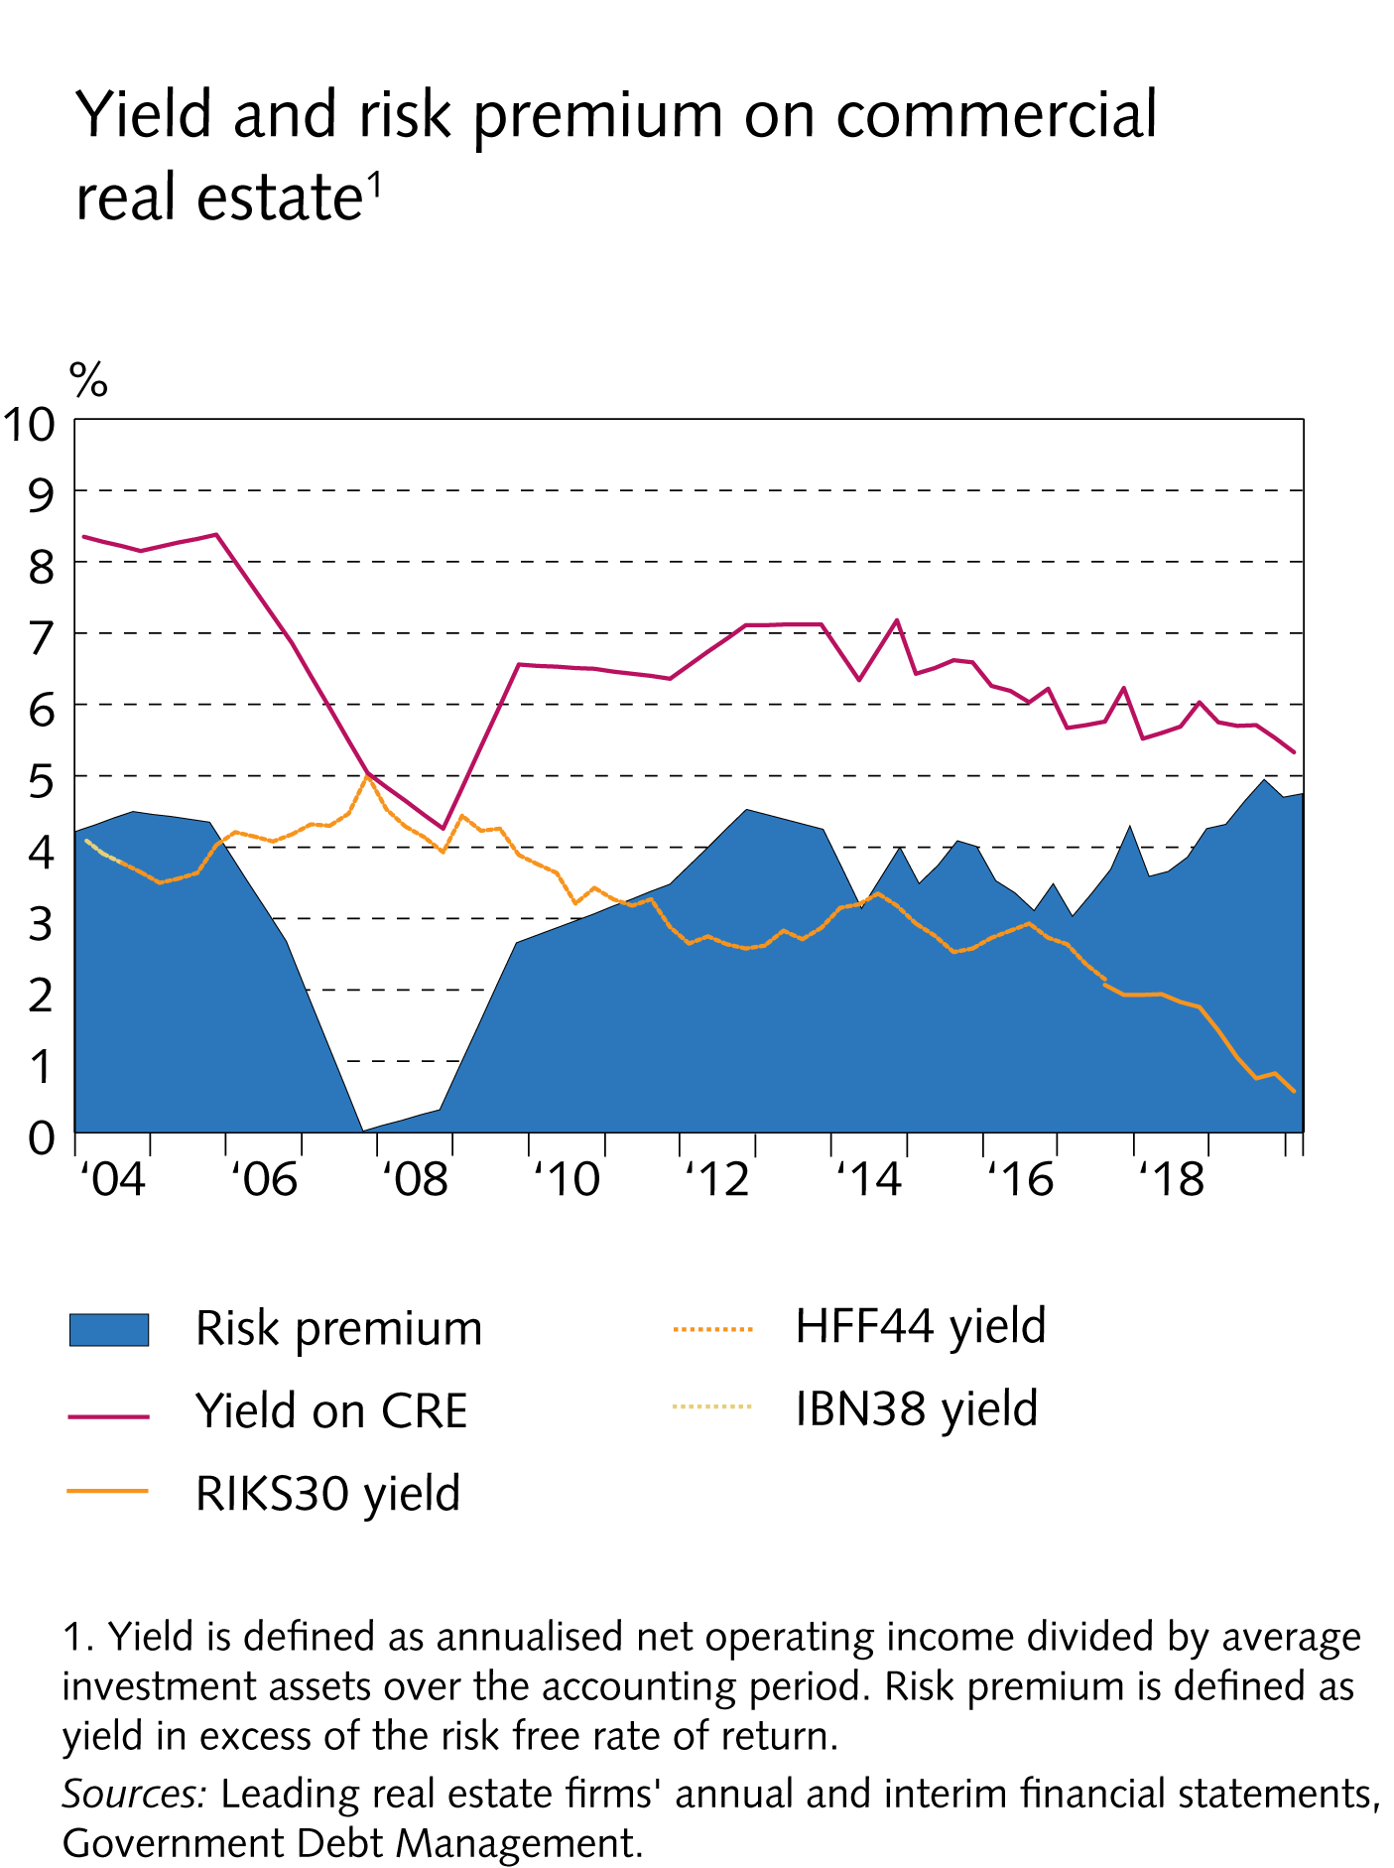
I Financial Stability: Developments and prospects

Slide 26
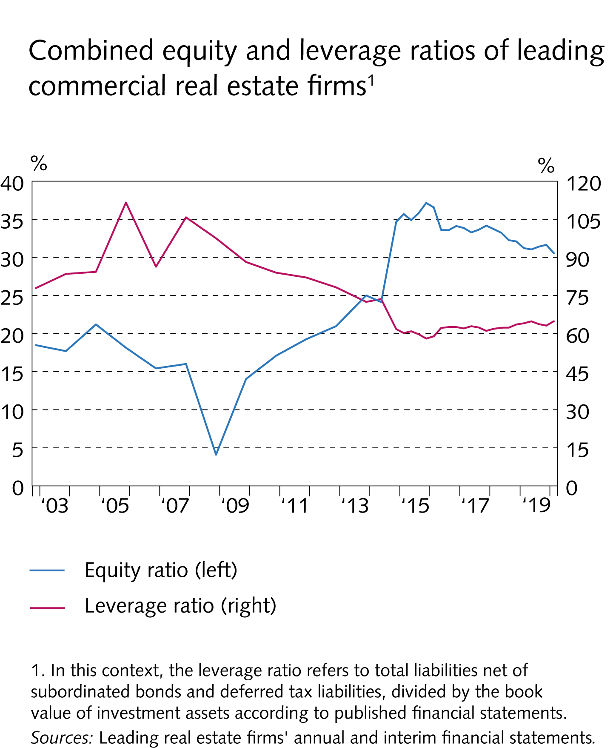
I Financial Stability: Developments and prospects

Slide 27
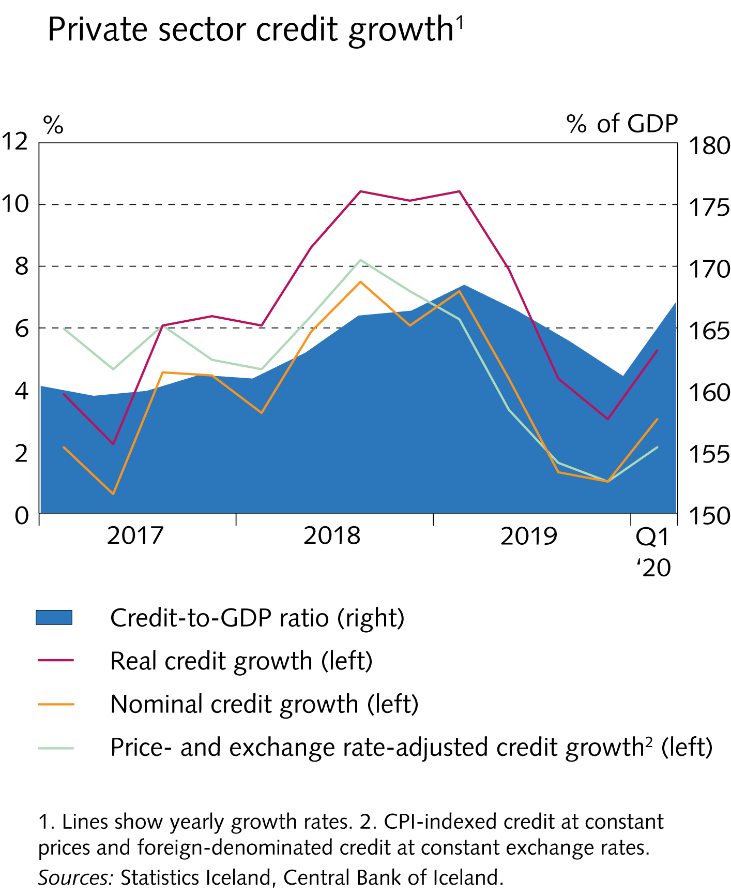
I Financial Stability: Developments and prospects

Slide 28
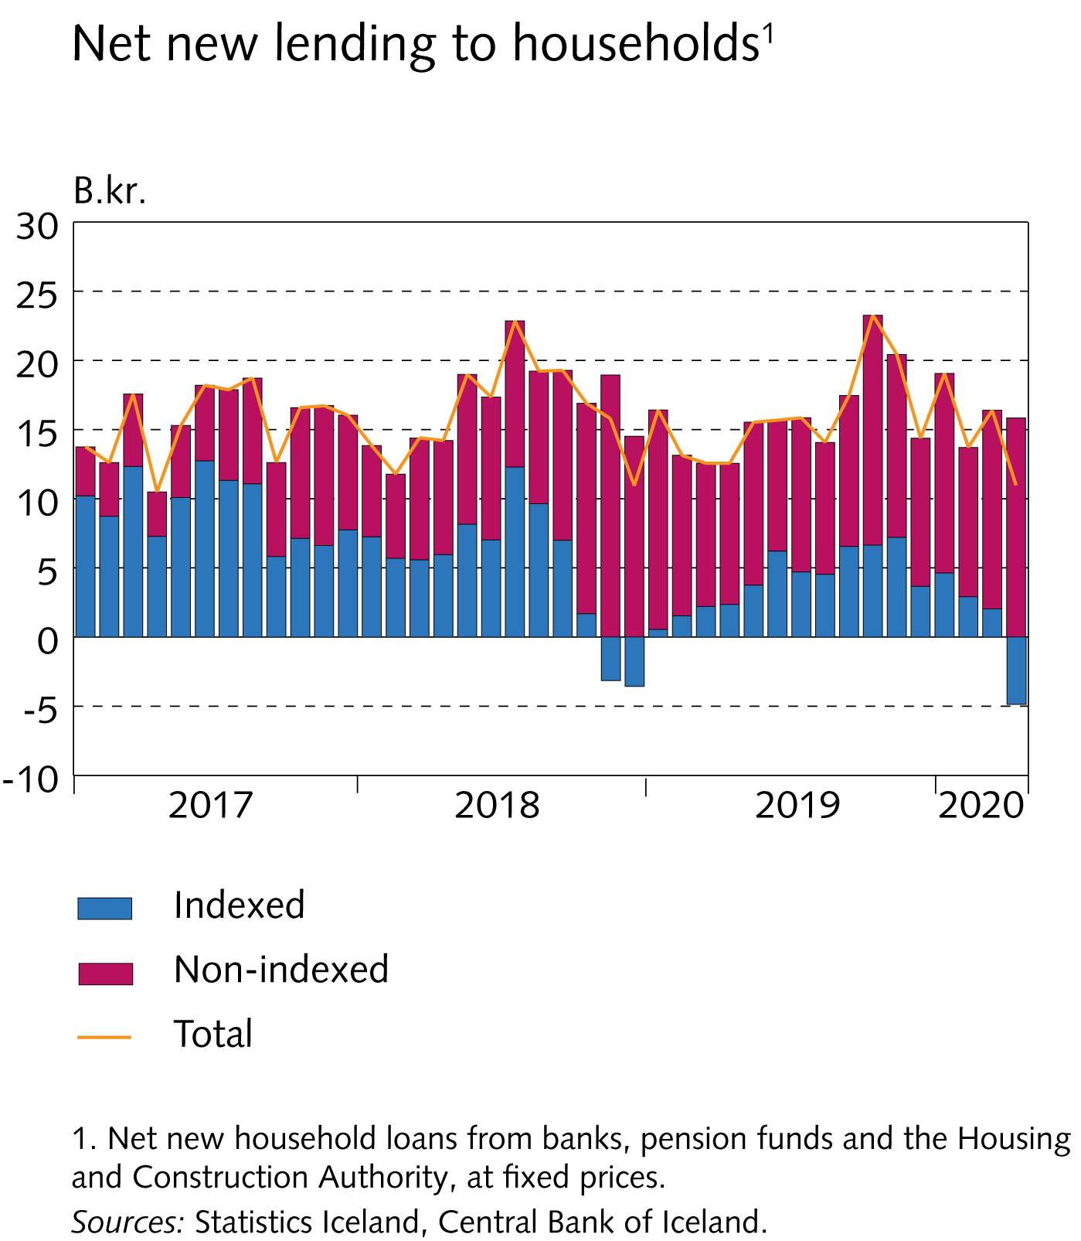
I Financial Stability: Developments and prospects

Slide 29
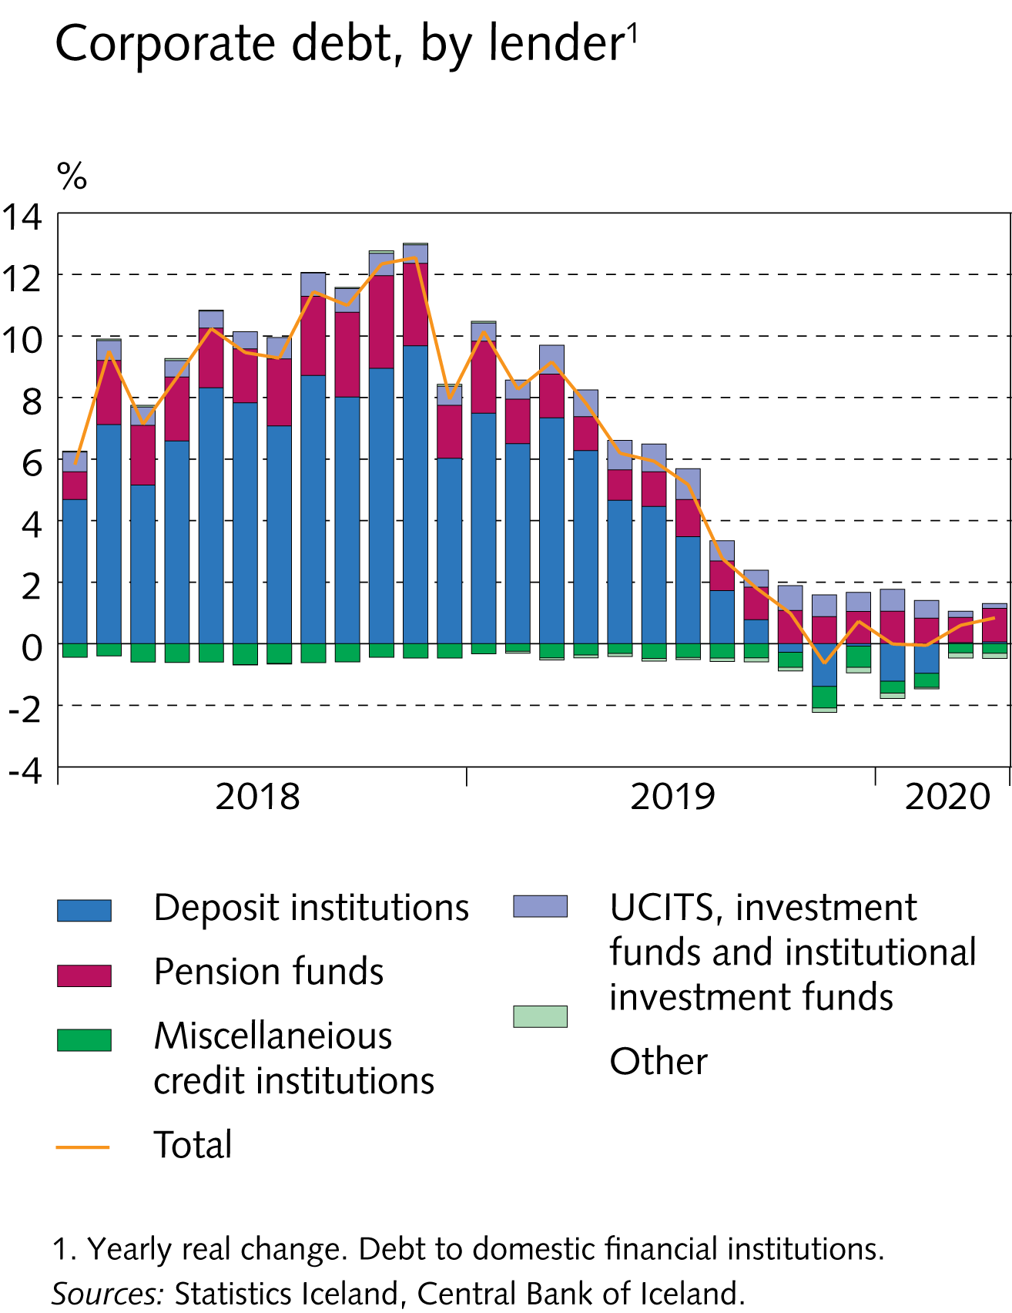
I Financial Stability: Developments and prospects

Slide 30
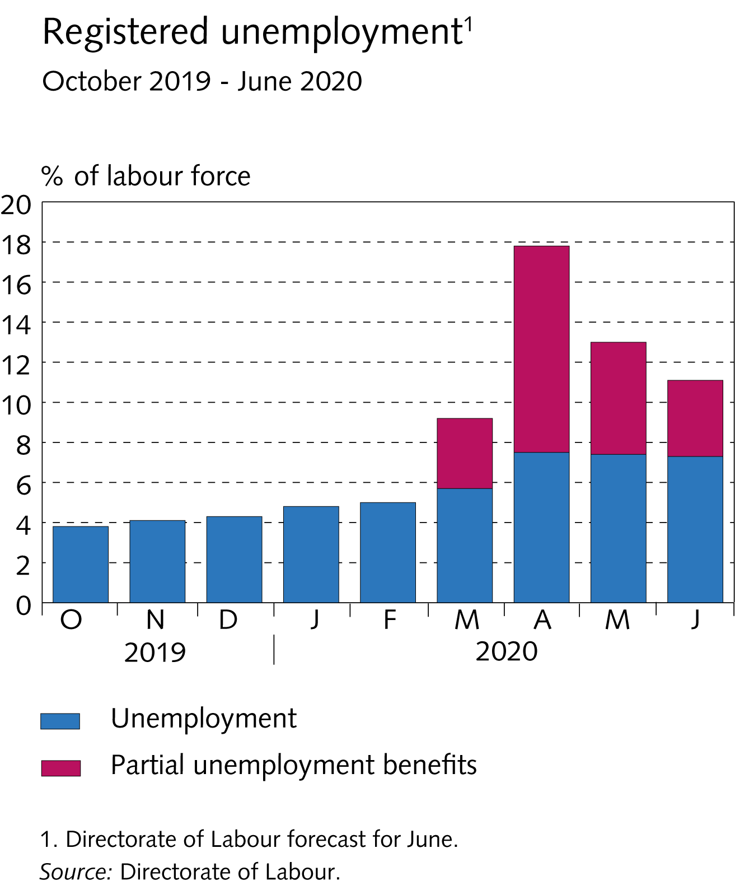
I Financial Stability: Developments and prospects

Slide 31
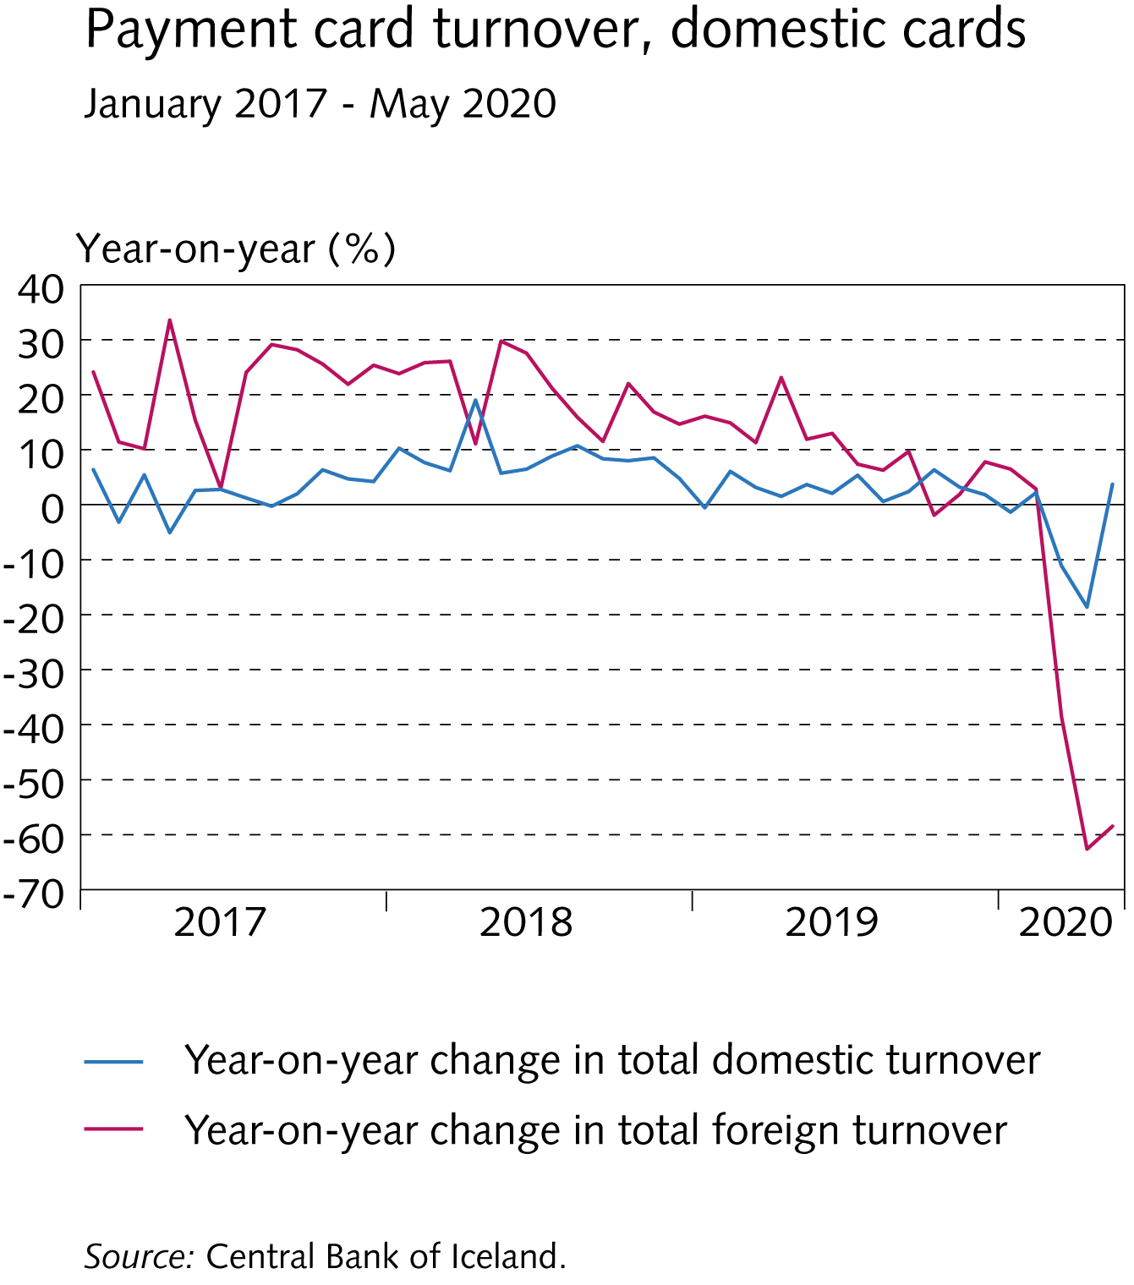
I Financial Stability: Developments and prospects

Slide 32
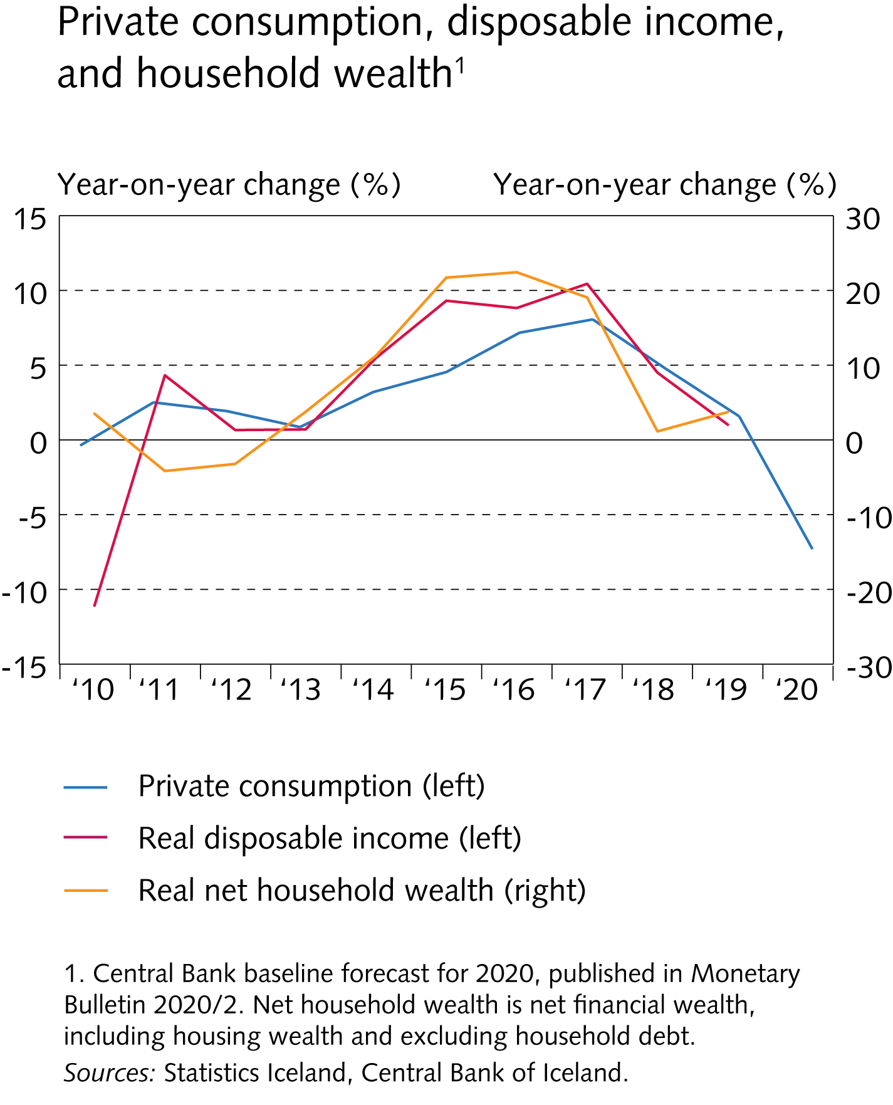
I Financial Stability: Developments and prospects

Slide 33
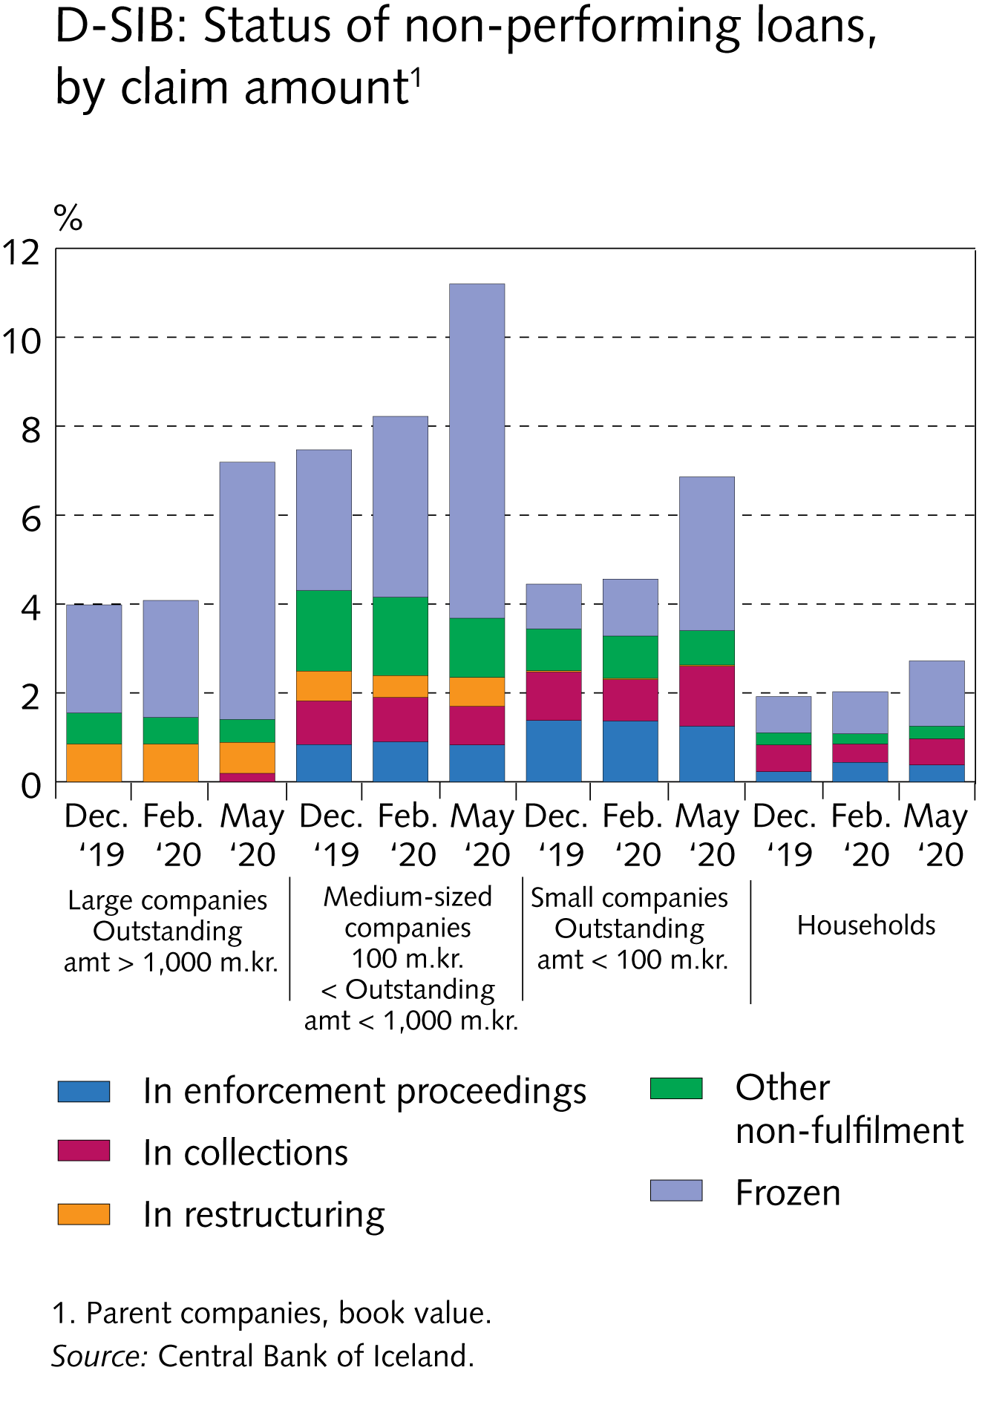
I Financial Stability: Developments and prospects

Slide 34
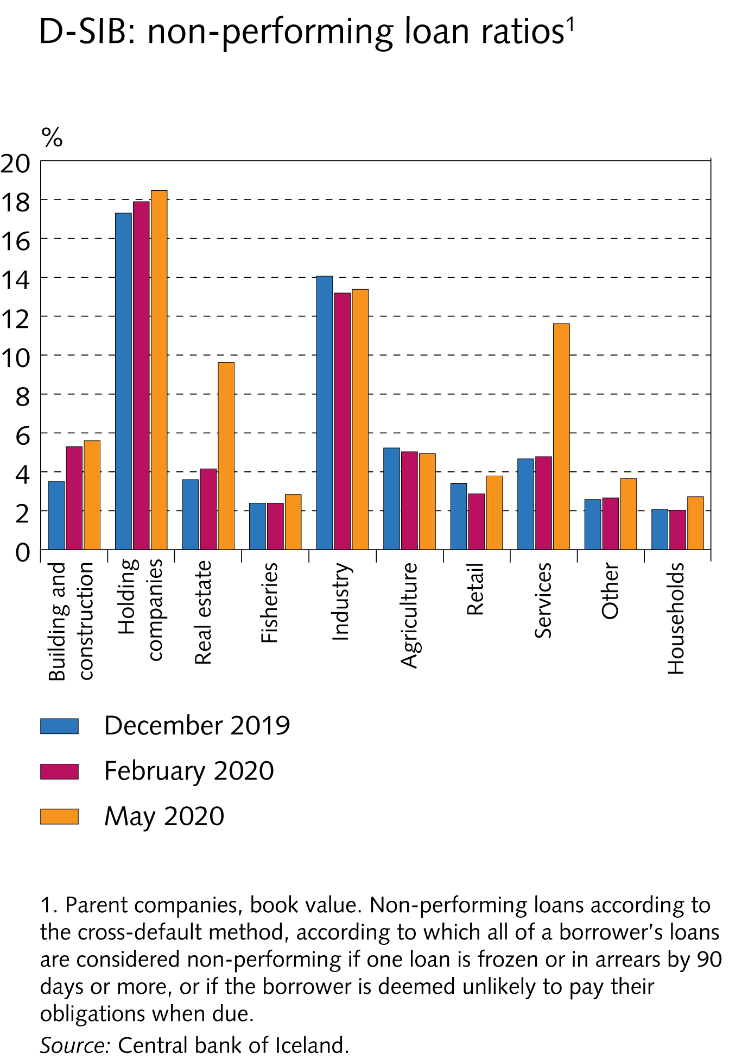
I Financial Stability: Developments and prospects

Slide 35
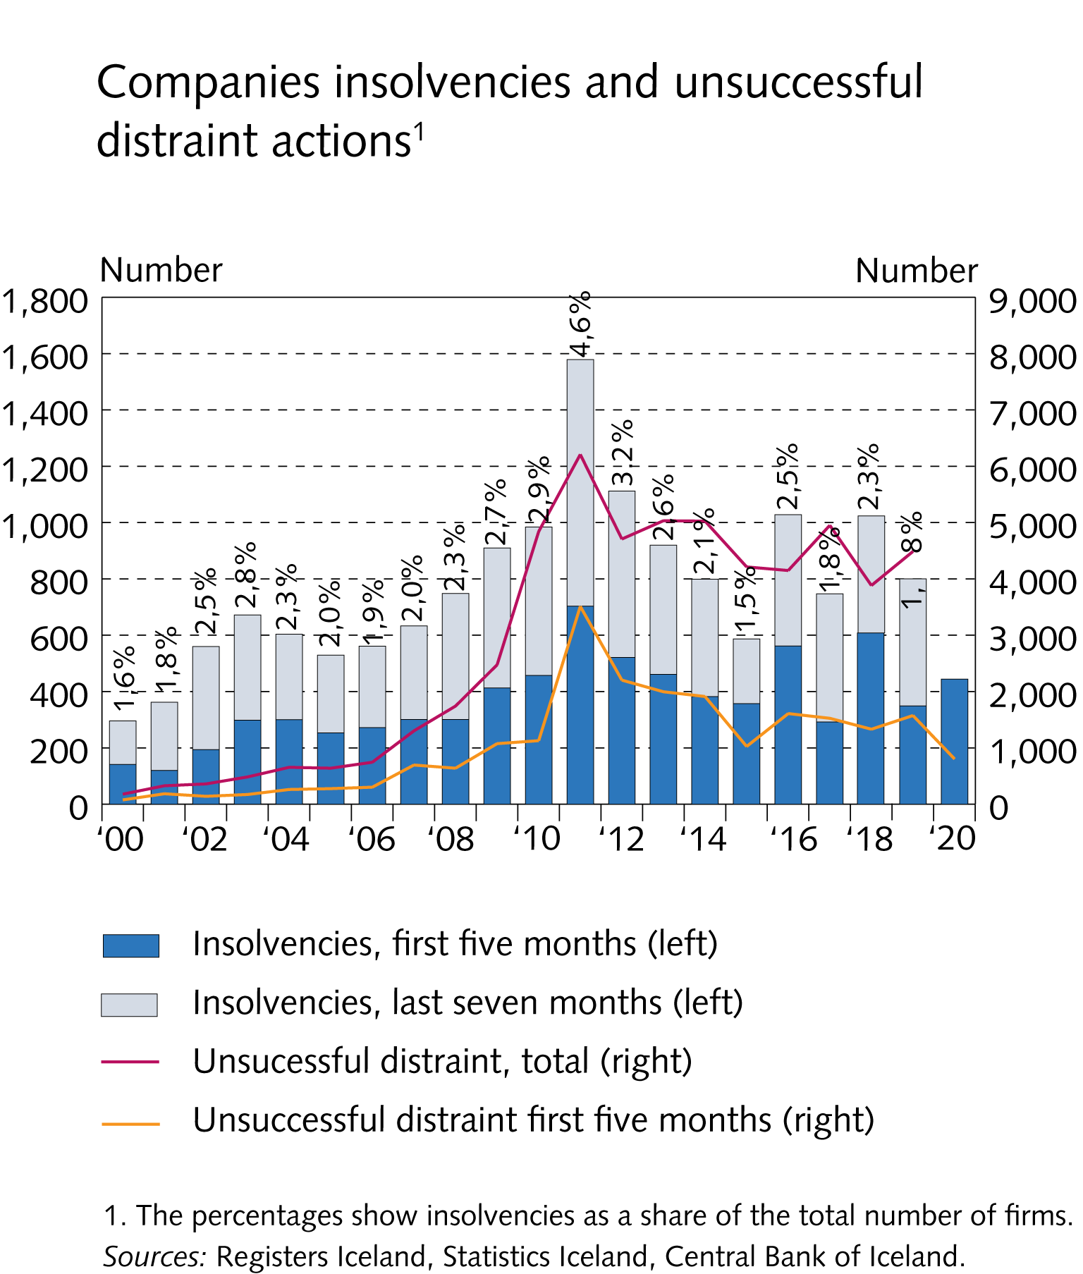
I Financial Stability: Developments and prospects

Slide 36
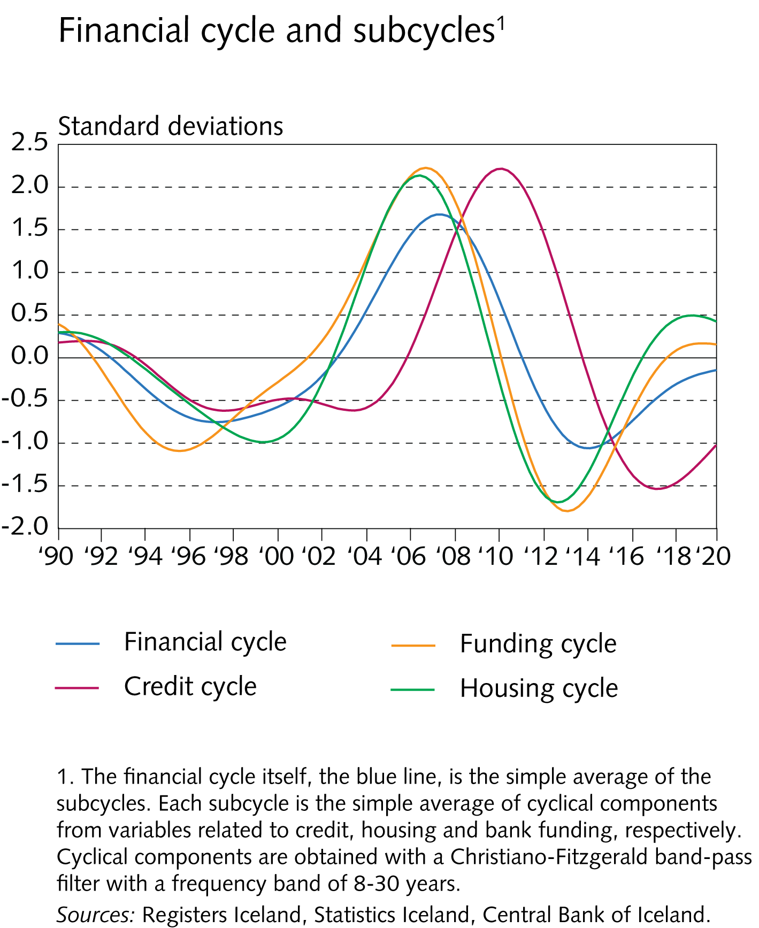
I Financial Stability: Developments and prospects

Slide 37
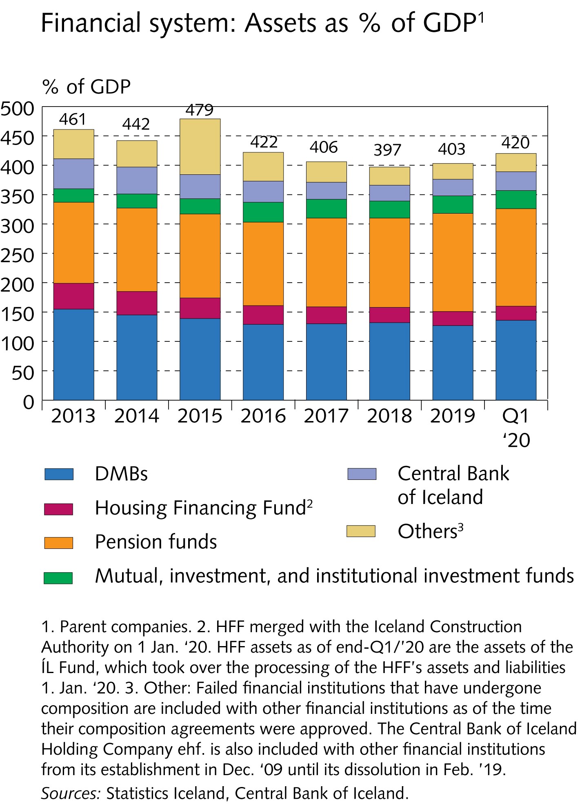
II The financial system

Slide 38
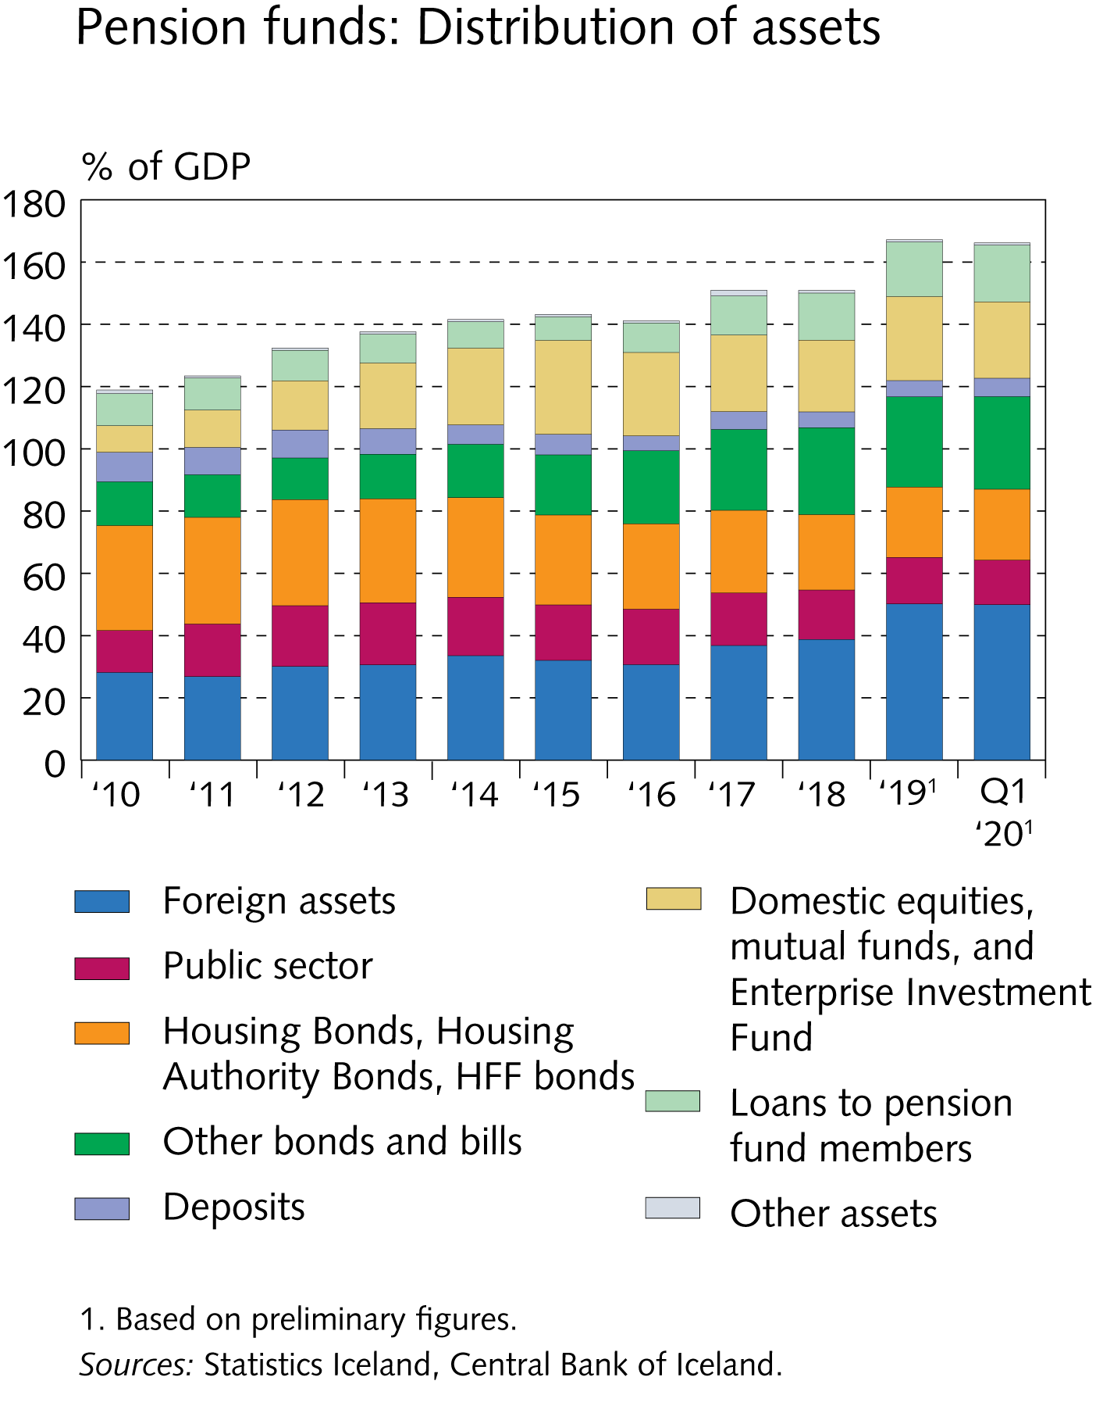
II The financial system

Slide 39
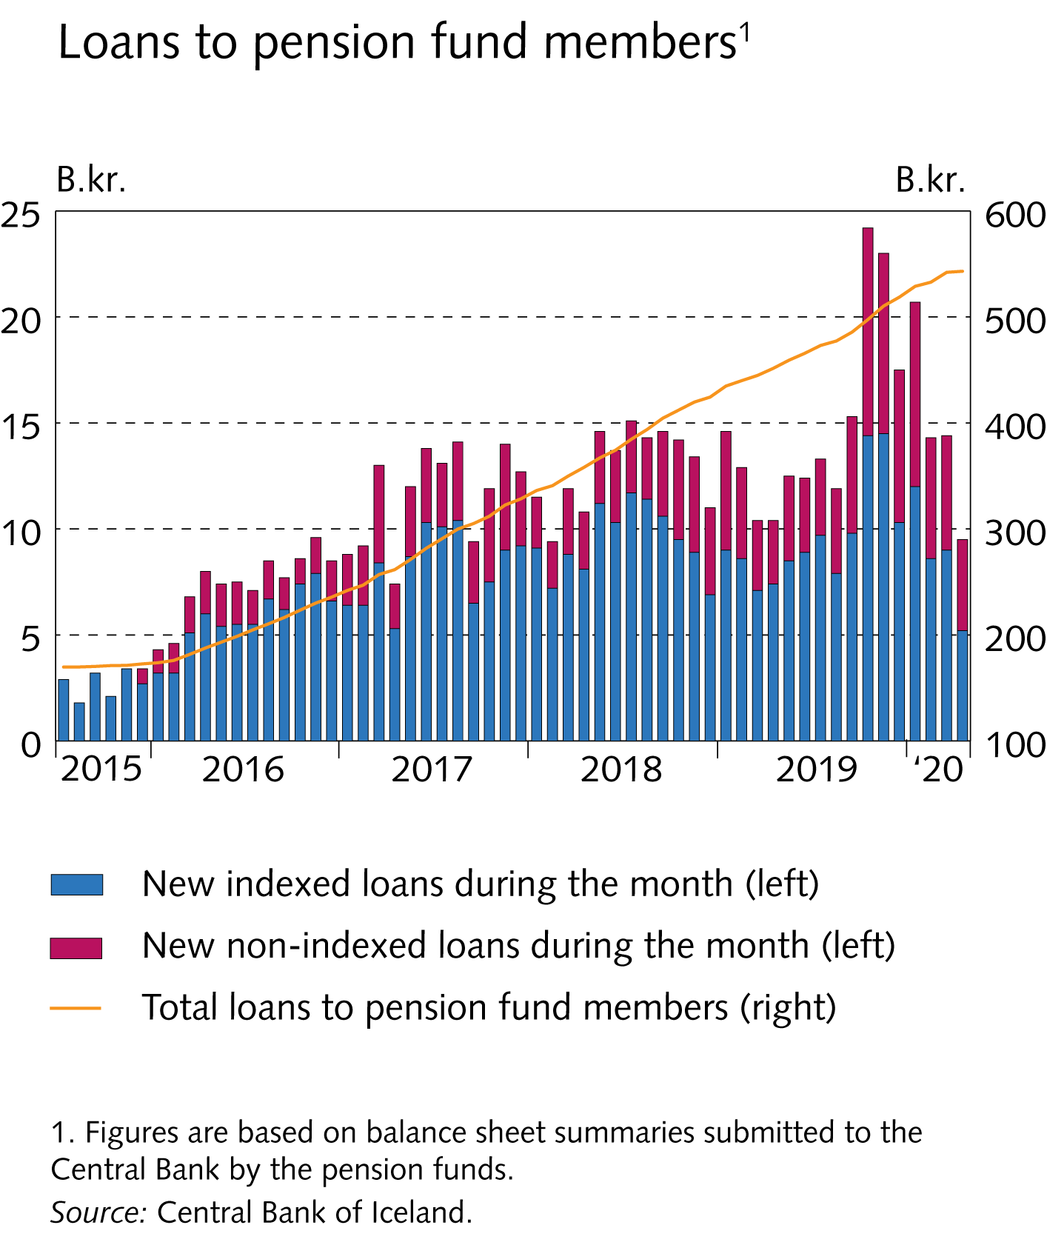
II The financial system

Slide 40
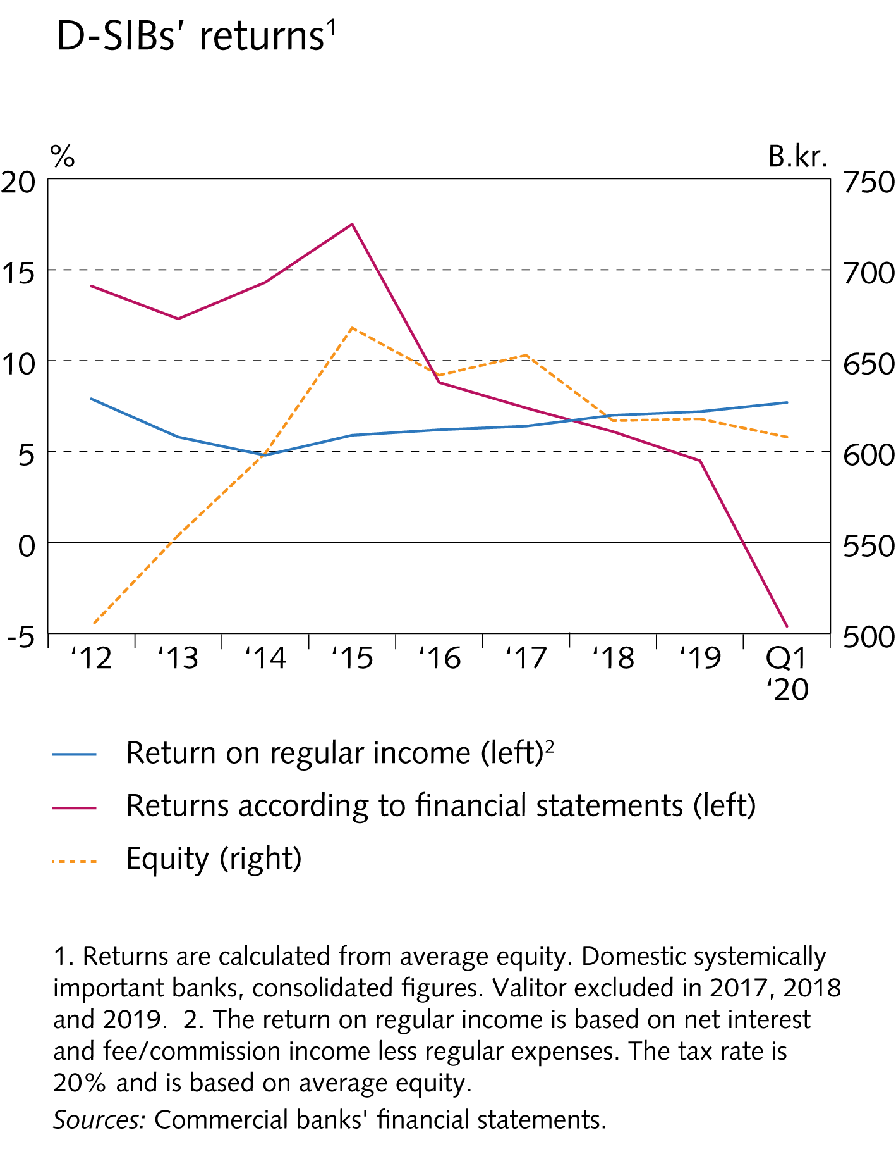
II The financial system

Slide 41
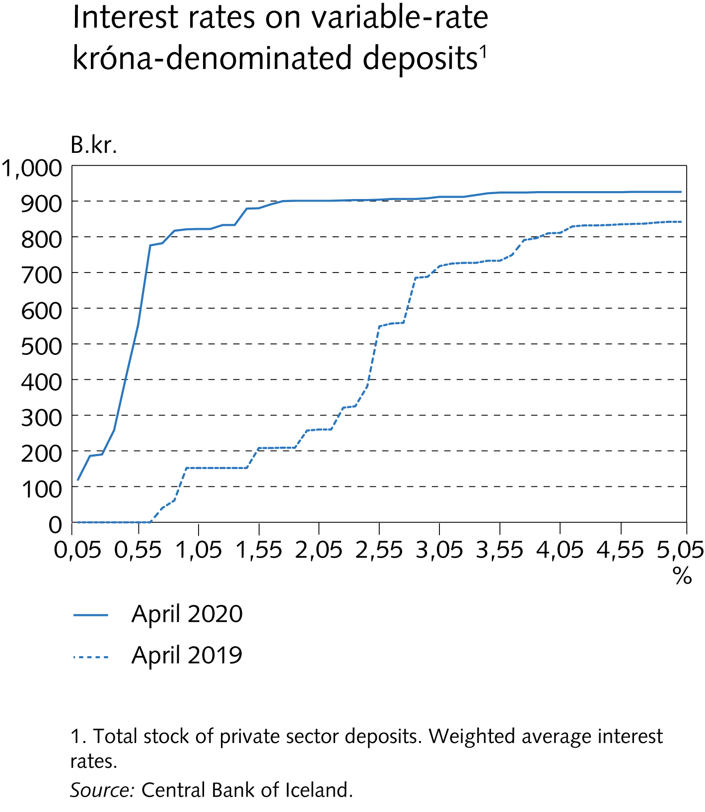
II The financial system

Slide 42
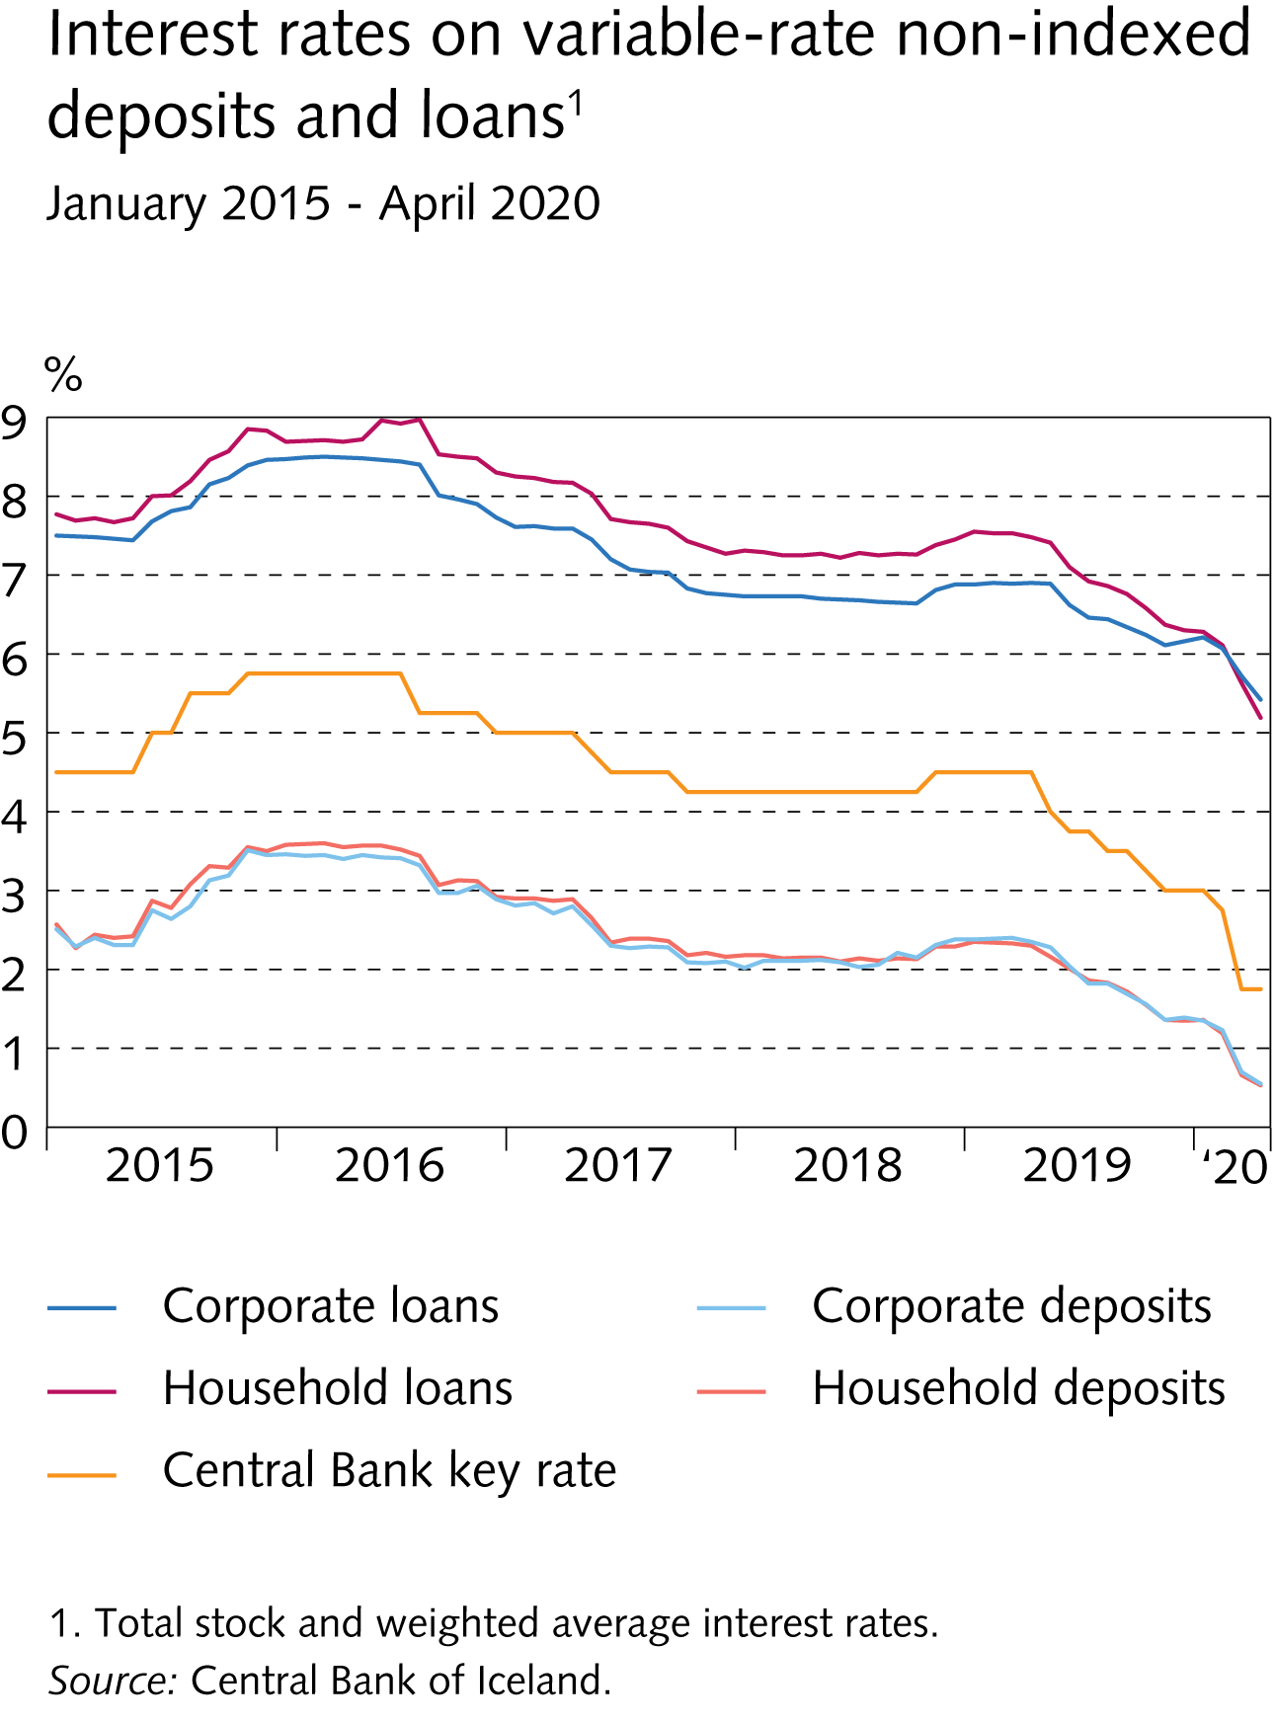
II The financial system

Slide 43
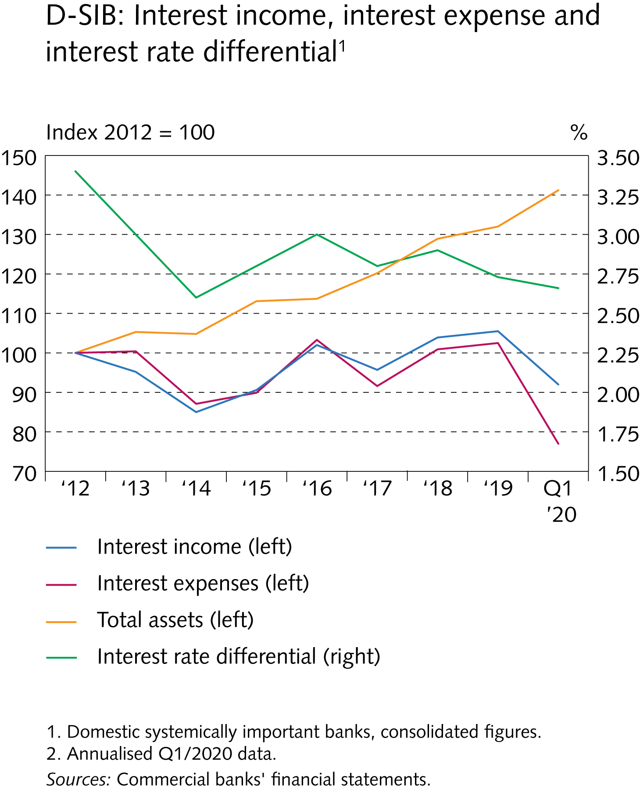
II The financial system

Slide 44
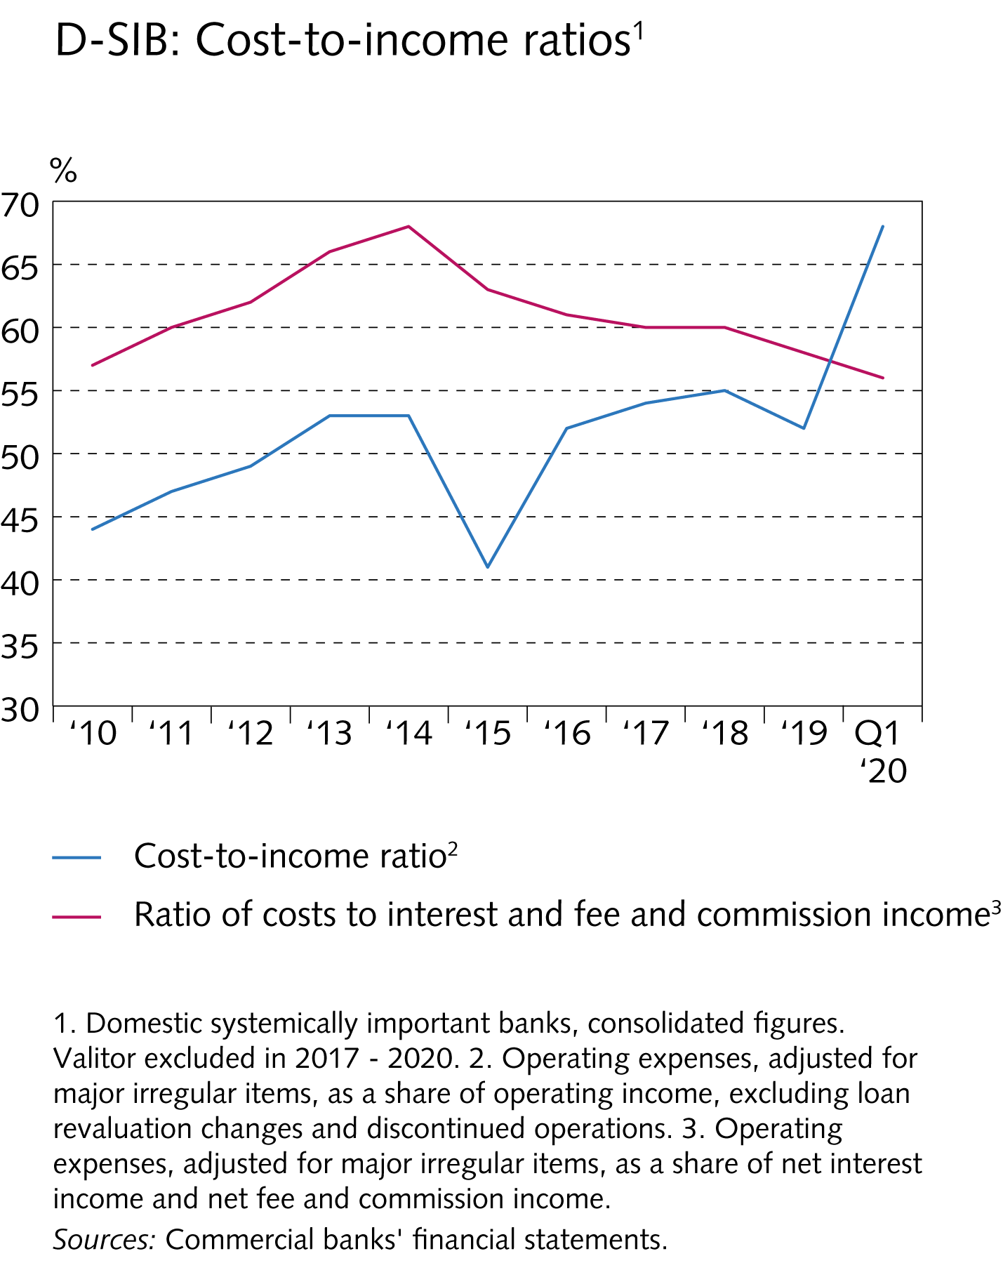
II The financial system

Slide 45
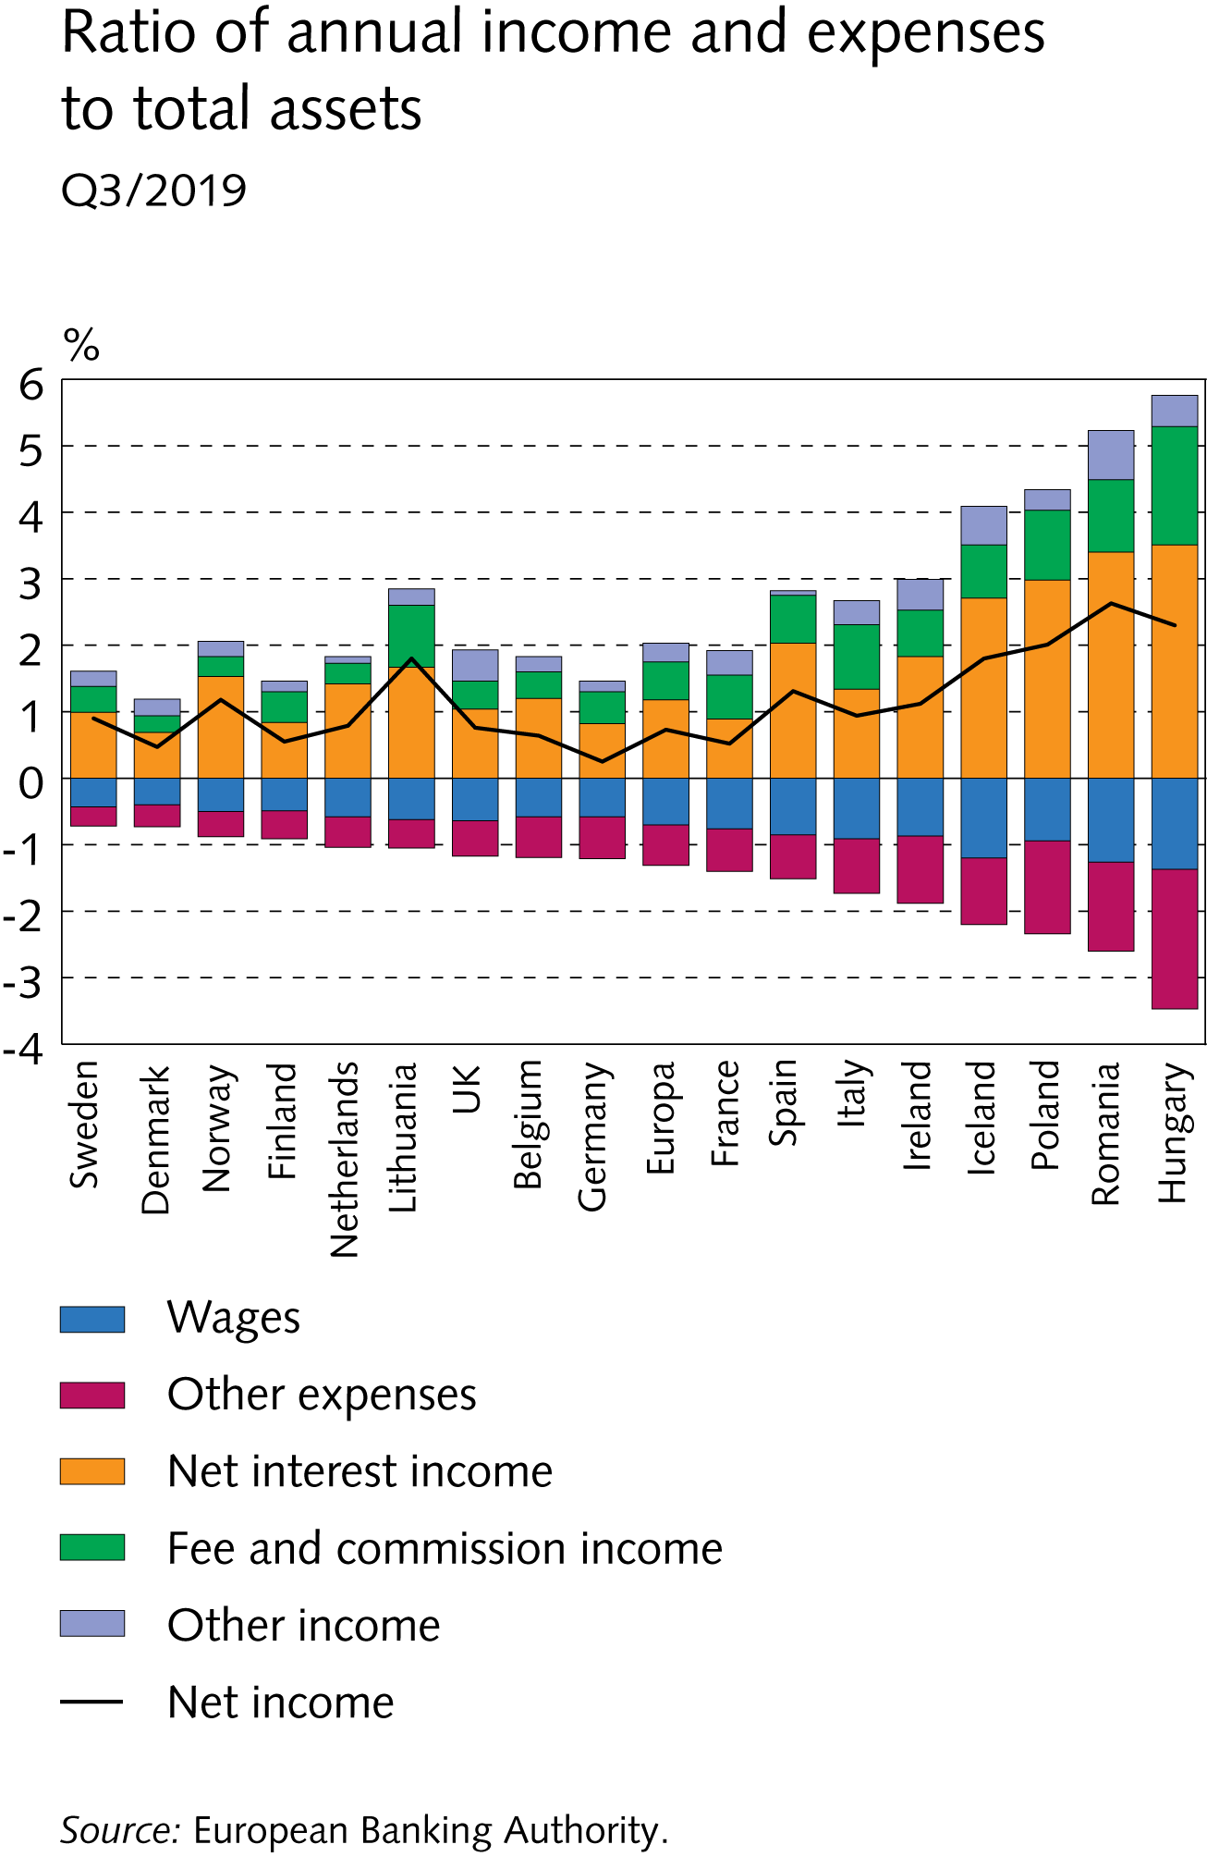
II The financial system

Slide 46
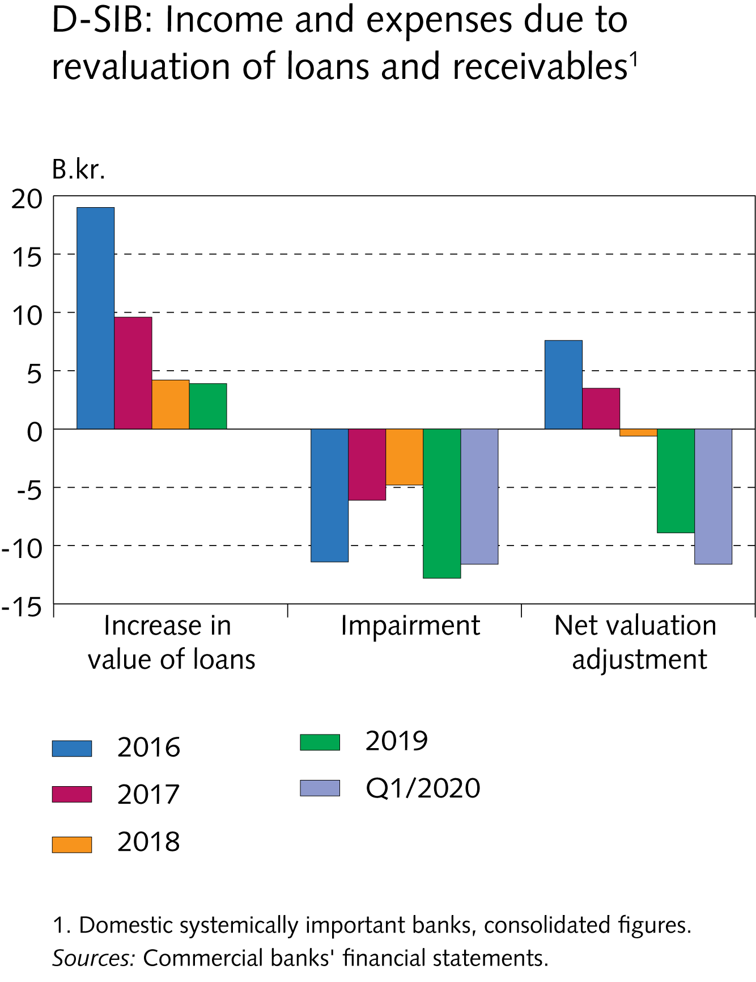
II The financial system

Slide 47
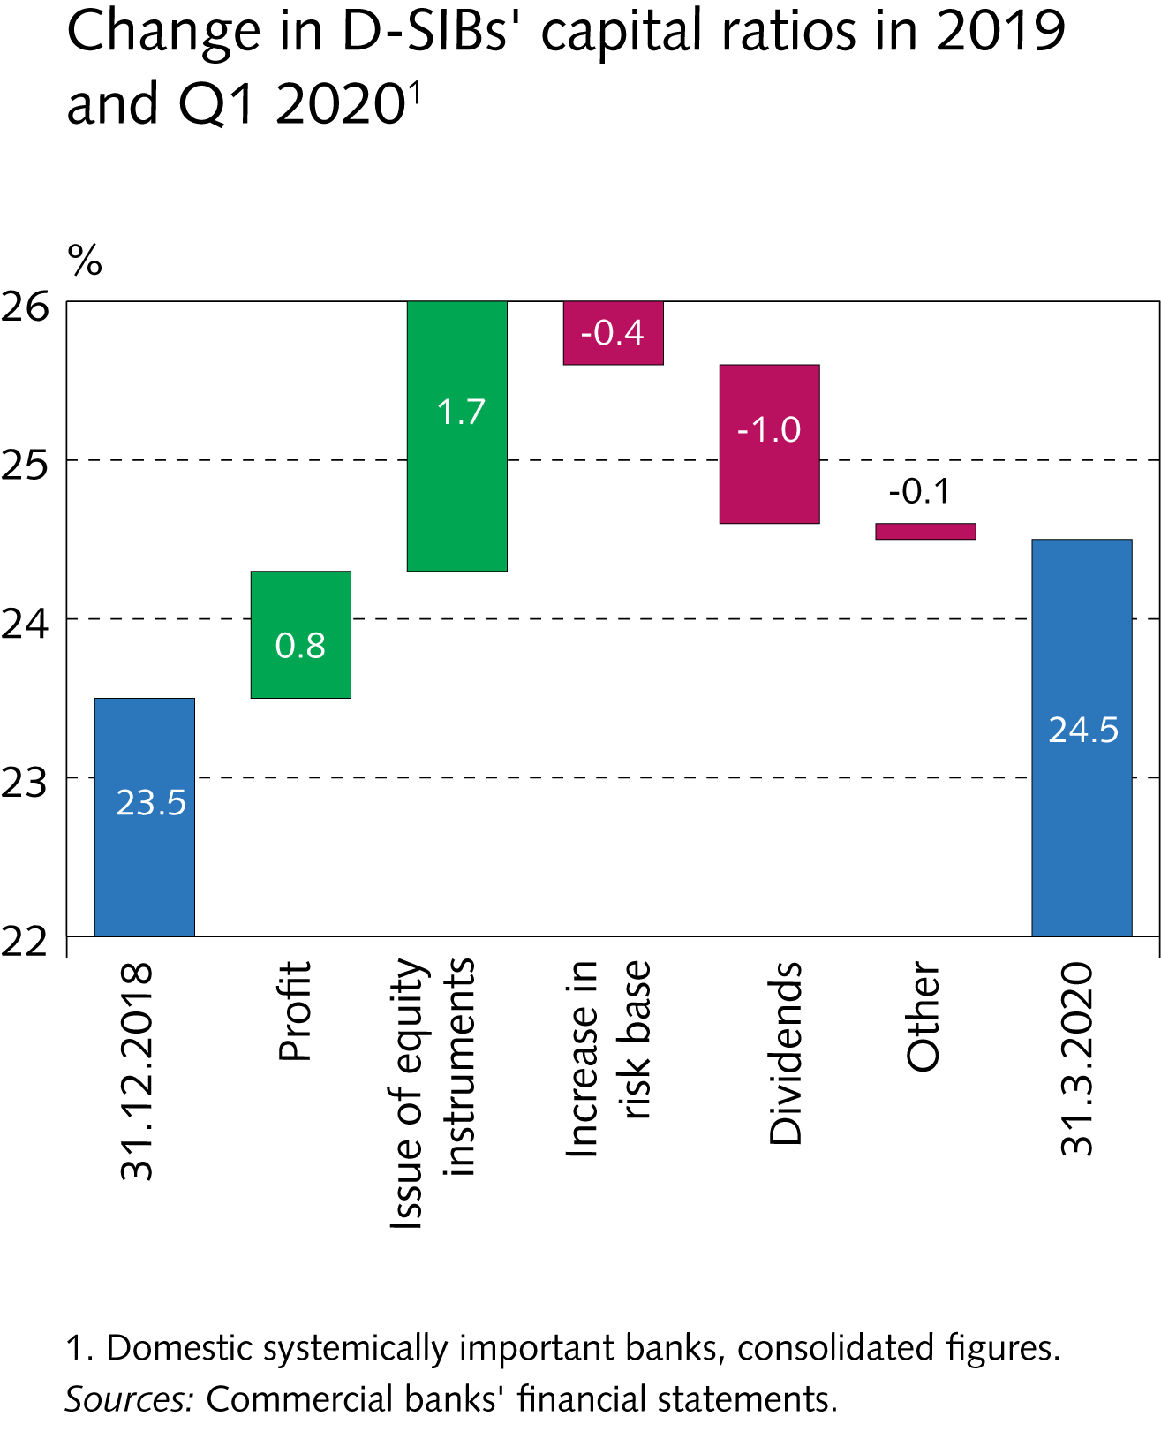
II The financial system

Slide 48
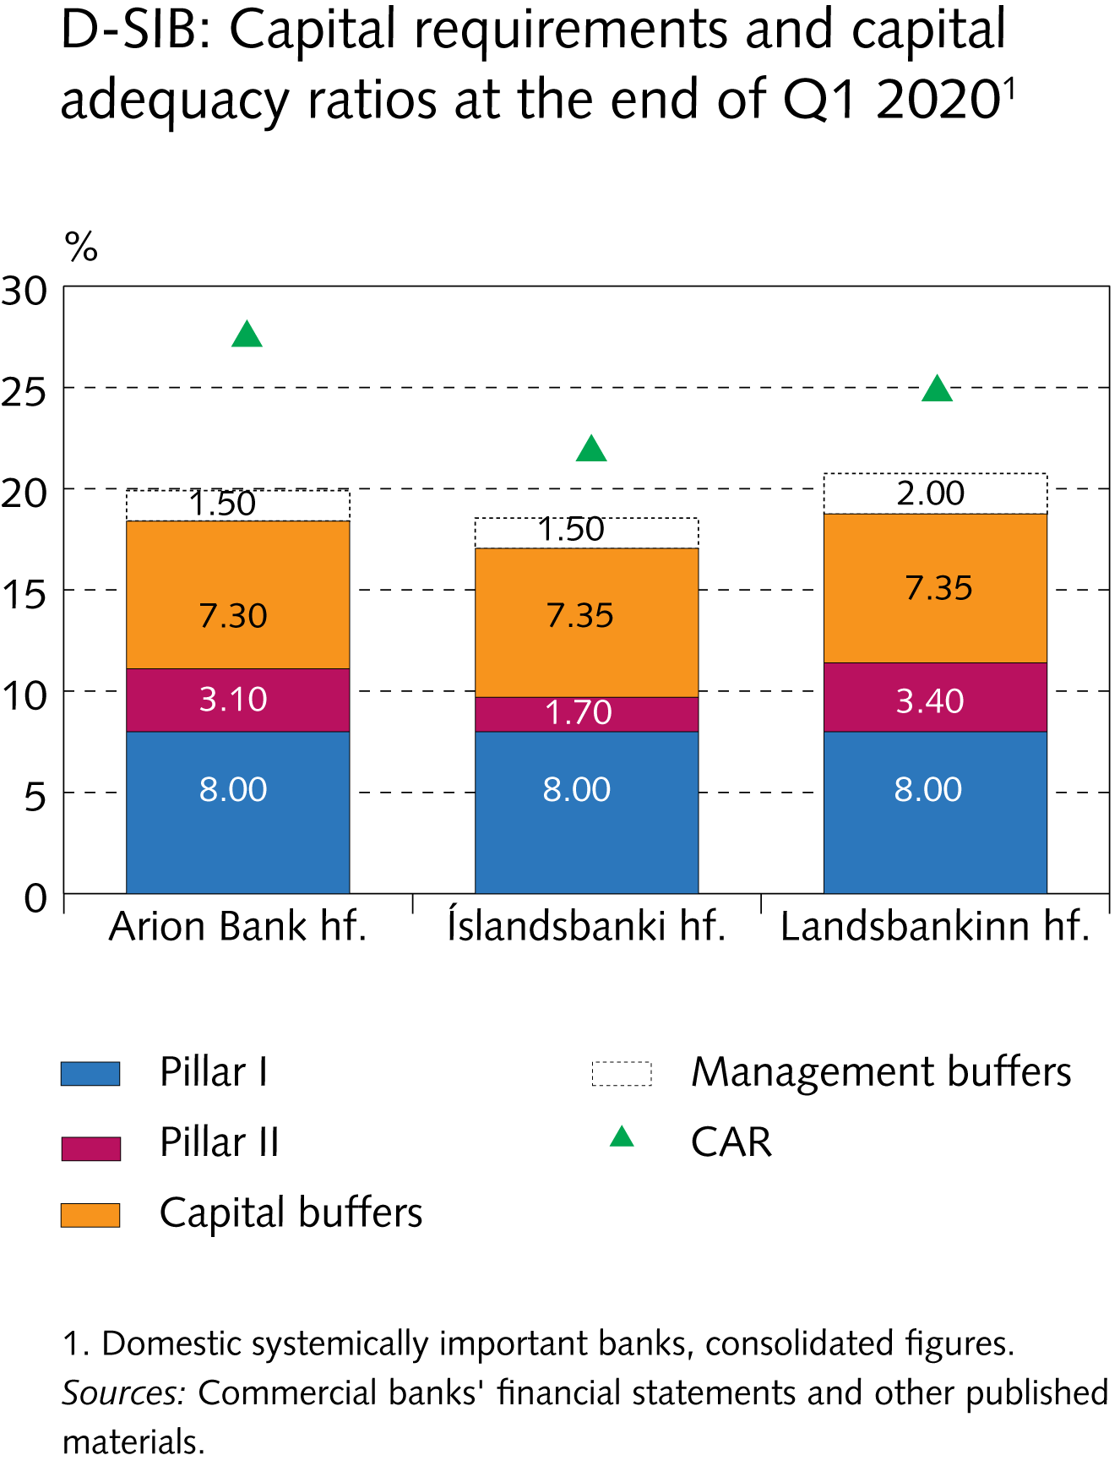
II The financial system

Slide 49
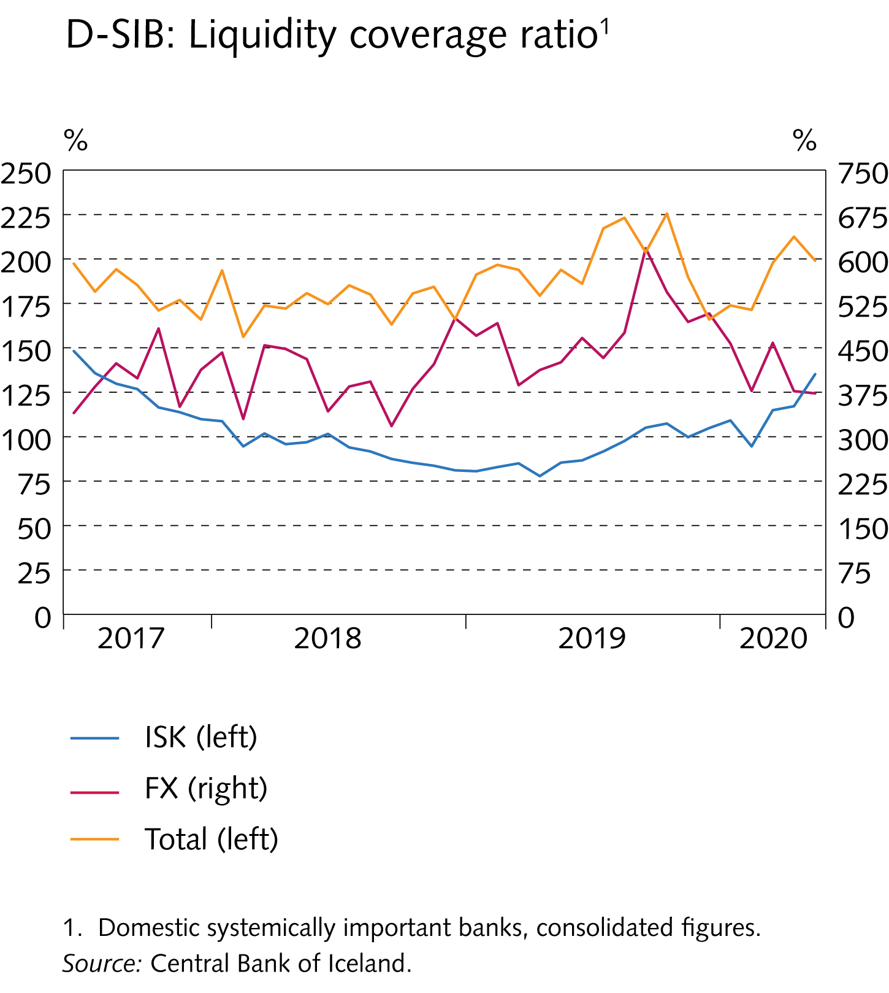
II The financial system

Slide 50
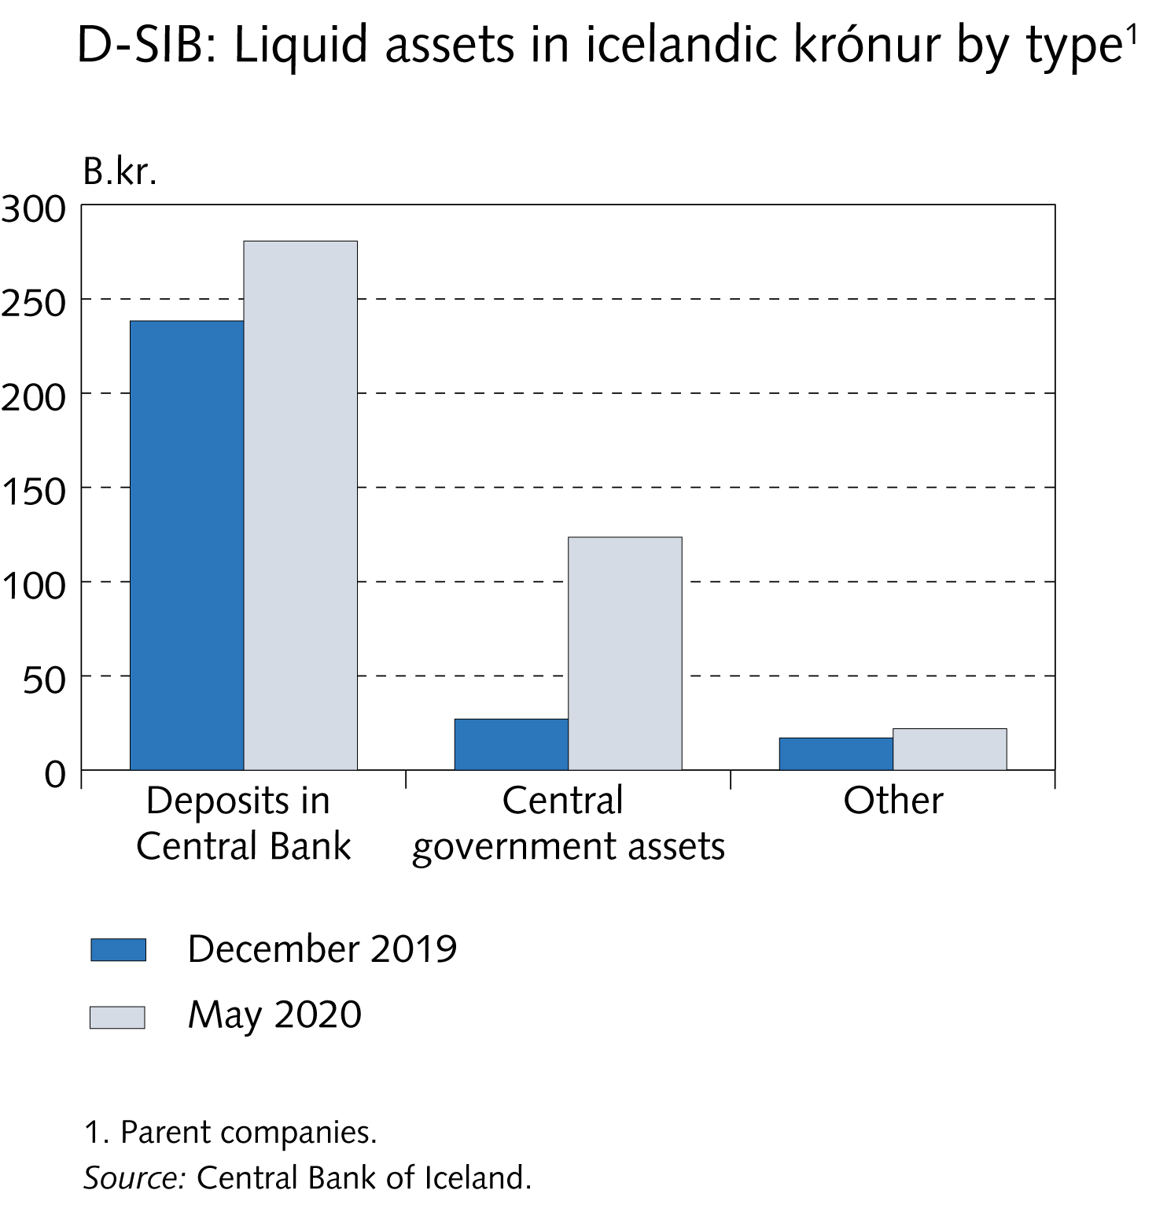
II The financial system

Slide 51
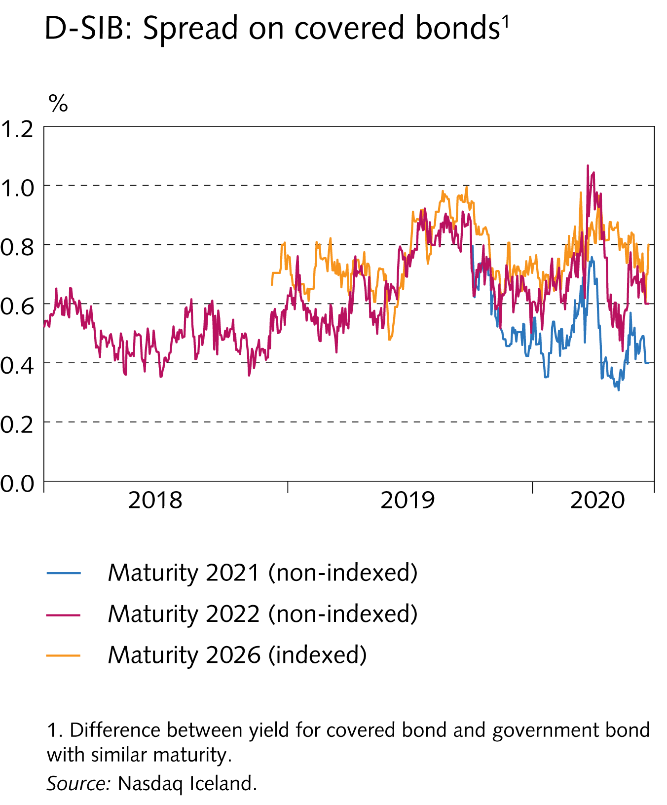
II The financial system

Slide 52

II The financial system

Slide 53

II The financial system

Slide 54

II The financial system

Slide 55

Central Bank scenario analysis

Slide 56

Central Bank scenario analysis

Slide 57

Central Bank scenario analysis

Slide 58

Central Bank scenario analysis

Slide 59

Central Bank scenario analysis

Slide 60

Central Bank scenario analysis

Slide 61

Central Bank scenario analysis

Slide 62

Central Bank scenario analysis

Slide 63

Central Bank scenario analysis

Slide 64

Central Bank scenario analysis

Slide 65

Box

Slide 66

Box

Slide 67

Box

Slide 68

Box

Slide 69

Box

Slide 70

Box

Slide 71

Box

Slide 72

Box

Slide 73

Box

Slide 74

Box

Slide 75

Box

Slide 76

Box

Slide 77

Box

Slide 78

Box

Slide 79

Box

Slide 80

Box

Slide 81

Box

